Slide 1
Financial Literacy for Families
Train the Trainers Module 1
Introducing the Money Matters Financial Literacy Train the Trainer Programme and the concepts of Family Learning

Slide 2
Module Aim is to introduce the Money Matters Financial Literacy Train the Trainer Programme and the concepts of Family Learning
Learning Outcomes
Participants will be able to:
Give an overview of the Money matters programme
Explain the importance of using a Family Learning approach
Consider the knowledge and skills related to financial literacy

Slide 3
Module 1 Visual plan for the session

Slide 4
Activity M1.1 Warmer Find Someone Who…
Go around the room speaking to people and ask them if the statements on the sheet are true for them.
If that person says “yes”, write their name in the square then move on until you have at least one name in every square.

Slide 5
Activity M1.2 Introductions and expectations
Introduce yourself and say one of the statements that is true for you.
Name one thing you would like to get from the training today.
Nominate the next person to speak by introducing them using what you know from the last activity.

Slide 6
Activity M1.3 Group agreement
Let’s agree how we can best work together to meet the aims of the training.

Slide 7
Money Matters Programme Overview

Slide 8
The programme introduction
Existing situation
Families now face significant financial insecurity due to:
10 years of debt legacy
Covid-19 pandemic
lack of good financial literacy practices
Scope of the programme
to empower families with money skills and knowledge
to develop new teaching practices
to give family learning support through digital and other learning tools
Keys to success
focus on a family learning approach
the creation of educational material for all the family to share
introduction of new practices and digital learning tools

Slide 9
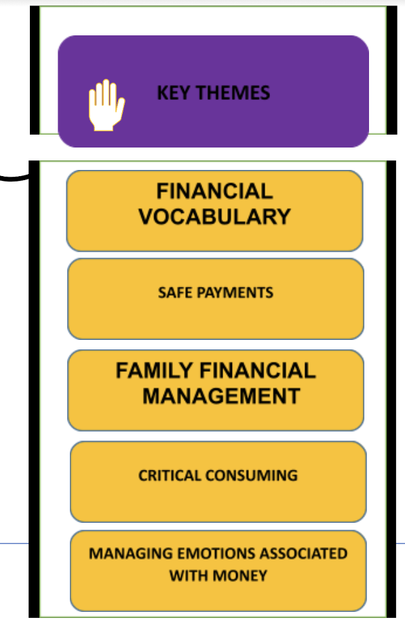
What will it look like?
For Parents
and guardians
A training programme aiming to tackle financial literacy using a workshop-based approach
Support for parents and guardians to use the family learning model
For Youth
19 to 25 years old
A mobile App encouraging learners to develop financial plans to respond to financial situations
A personal or family budget planner
Links to local support agencies
For Teenagers
13 to 18 years old
Six Online Educational Escape Room challenge -based learning resources
Their scenarios will be related to effective financial management
For Children
6 to 12 years old
12 monthly editions of themed comics
Covering some basic good financial principles

Slide 10
Programme content Day One
Module 1
Introduces the Money Matters Train the Trainer Programme and gives an overview of the concepts of Family Learning, challenge-based learning and financial literacy pedagogy.
Module 2
Covers key financial language and vocabulary and the basics of money management.

Slide 11
Programme content Day Two
Module 3
Looks at financial online resources and tools and the emotions associated with money.
Module 4
Considers how to manage money during critical life periods, understanding the role of money in our lives and how to become a critical consumer.

Slide 12
Programme content Day Three
Module 5
Looks further at the role of money, numeracy and its relevance in financial literacy.
Module 6
Covers creating digital resources for different age groups to enable challenge-based learning to take place.

Slide 13
Self-study, research and Open Badge Credentials
The programme includes 12 hours of online self-directed learning
You will have an opportunity to develop your own resources
You will have the option to gain Open Badge Micro-credentials

Slide 14
Any questions?

Slide 15
Activity M1.4 A Family Learning Approach

Slide 16
The aims of Family Learning are to:
provide opportunities for intergenerational learning
enable adults and children to learn in a positive and enjoyable atmosphere
provide opportunities for adults and children to develop financial and technological skills leading to further knowledge
help parents to develop strategies for supporting their children’s development
recognise the crucial role parents and guardians play in children’s learning

Slide 17
Activity M1.5 Family Learning – True or False?

Slide 18
Family Learning underpinning principles 1
A belief that all parents care about their children’s education while recognising support may be needed to enable them to value their own contribution to their children’s progress
Individual respect - everyone’s contribution is encouraged and acknowledged
Models are strengths-based, building on what parents and children already know and can do while acknowledging their life experiences
Individual ways of learning and accessing information are identified, discussed and catered for on programmes through the range of activities and resources

Slide 19
Family learning underpinning principles 2
Adult activities and flexible programmes allow for in-depth discussions in which peer learning and support plays a key role
The family learning environment is informal and non-threatening so adults as well as children have a positive experience of learning leading to self-development and adults empowered to explore new directions
Family learning is designed to engage learners in a range of practical activities that encourage reflection in a safe and non-judgmental learning environment
Whatever the context or topic, the methodology used for delivery creates enthusiasm and engagement in learning

Slide 20
Activity M1.6 Creating a positive learning atmosphere
THINK OF A CLASS OR POSITIVE LEARNING EXPERIENCE THAT YOU ENJOYED
BRIEFLY SHARE THIS WITH YOUR PARTNER
CHOOSE SOME KEY WORDS AND PHRASES TOGETHER TO PUT ON 2 OR 3 STICKY NOTES

Slide 21
Activity M1.7 Put your sticky notes under one of these headings
TUTOR
ENVIRONMENT
OTHER
CONSIDERATIONS

Slide 22
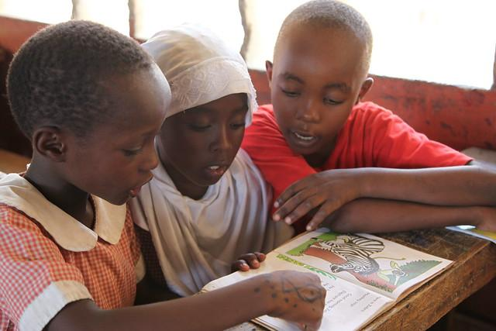
Tutor – some suggestions for a creative and positive message:
Positive behaviour - supportive language for less confident learners and a non-critical ‘parenting role’ but ‘adult to adult’ with parent/carers:
“I like the way you …”
“That’s good/thoughtful/creative etc”
Creativity - space and time to think and play with ideas
Accept adults’ and children’s feelings and emotions - friendly rapport
Laughter and fun - encourage a desire to share and help each other
Give confidence by stretching learners and focusing on strengths

Slide 23
Environment – some suggestions for a good atmosphere
Secure and welcoming environment - good lighting - not stuffy
Visually friendly - affirmations and colourful posters on walls
Access to water and comfort facilities
Tidy and well organised for group needs but
room for movement
Comfortable chairs and table arrangements if indoors
This Photo by Unknown Author is licensed under CC BY-SA-NC

Slide 24
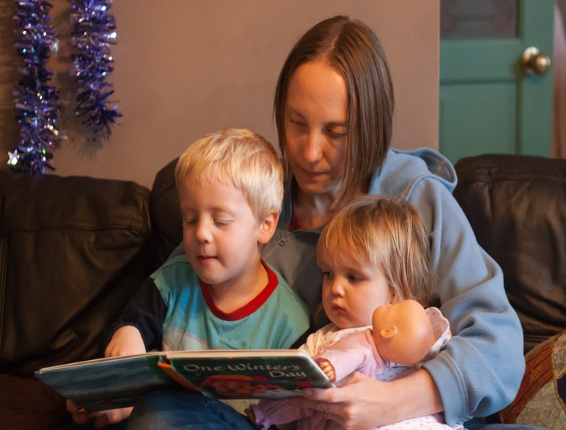
Other considerations – some general suggestions
Calm atmosphere – participants create rules - behaviour expectations ‘owned’ by group - routine and structure so learners know what to expect
Positive language - ‘Please keep phones on silent’ not ‘Don’t keep phones on’
Good variety of learning materials for different learning styles
Tutor knows learners’ backgrounds - aware of their goals
Talk about and use new vocabulary to raise confidence
Tutors are aware of ‘roles’ within a group dynamic

Slide 25
Tea and coffee break

Slide 26
Money Matters and the activities
Thinking skills
Financial skills and knowledge
Money Matters resources

Slide 27
Thinking skills - Financial skills and knowledge
 | Thinking skills self-control working memory problem solving | Financial habits good money management habits | Financial knowledge and decision-making skills factual knowledge research decision making skills
Early childhood - ages 3-5 |  | Early values and habits | Basic numeracy
Middle childhood - ages 6-12 |  |  | Basic money management
Adolescence and young adulthood - ages 13-21 | Development continues | Development continues
Adapted from: CFPB (2016) Building Blocks to help Youth achieve Financial Capability. Consumer Financial Protection Bureau.
Available at https://files.consumerfinance.gov/f/documents/cfpb_building-blocks-youth-financial-capability_measurement-guide.pdf

Slide 28
Activity M1.8 Thinking skills or Financial skills?
Put the purple skills cards under the headings of either:
Financial skills
Thinking skills
If you are not sure or think they have both skills, put them in the middle
Use either:
Online - the Drag and Drop Activity
In Class - use printed handout to link skills with headings
Please ask the tutor if you need any help

Slide 29
Activity M1.9 Money Matters scenarios and financial skills
Look at one of the
three scenarios
With a partner, identify the financial or thinking skills involved in your scenario
Some are indicated but there are probably more
Image source: https://piggybankproject.eu/elearning/course/view.php?id=2&section=3

Slide 30
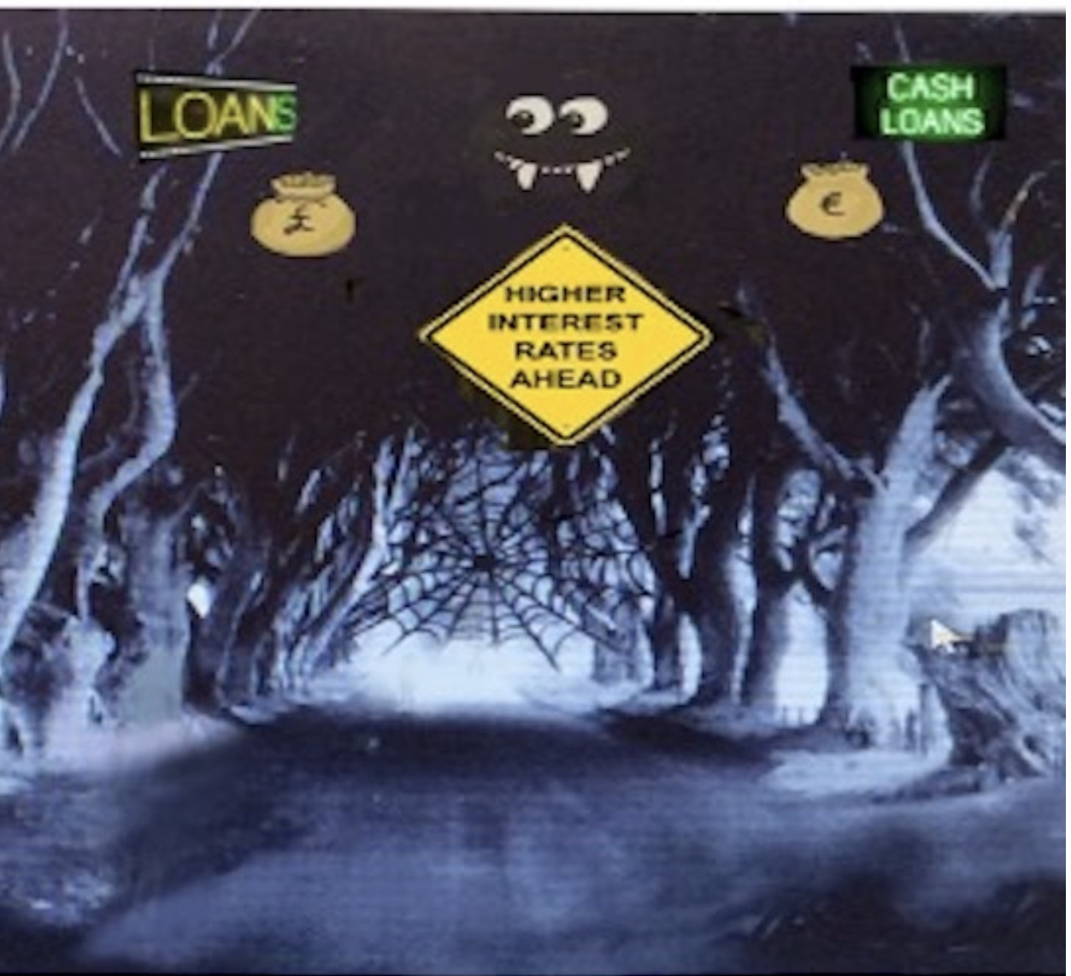
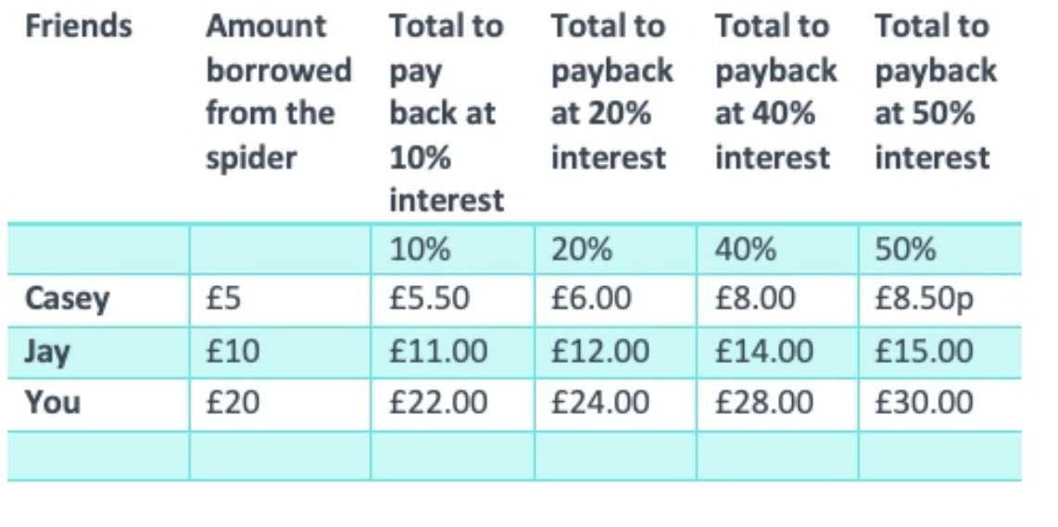
Linking thinking and financial skills with Money Matters
M1.9a
Credit cards - spending and paying back the lender
Can you think of any more financial skills involved?
Ability to think about the long-term consequences of actions

Slide 31
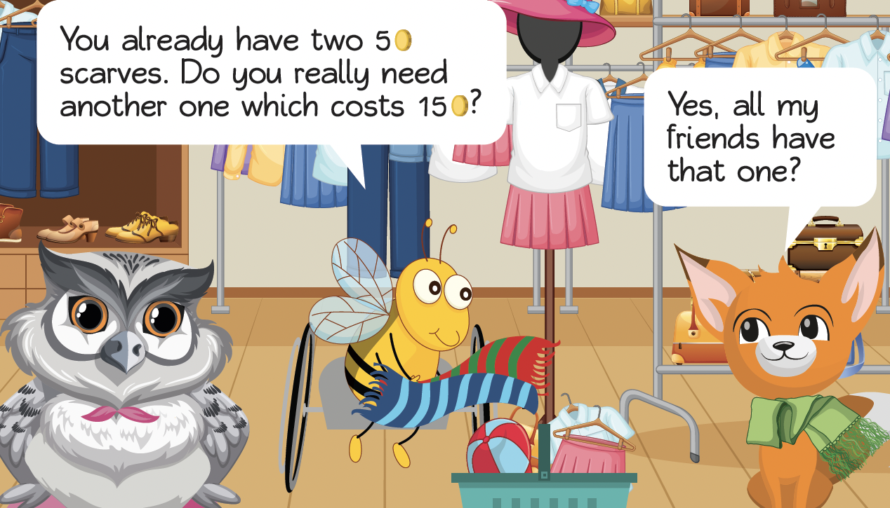
Linking thinking and financial skills with Money Matters
M1.9b
Window shopping / comparing prices
Can you think of any more thinking or financial skills involved?
Impulse buying

Slide 32
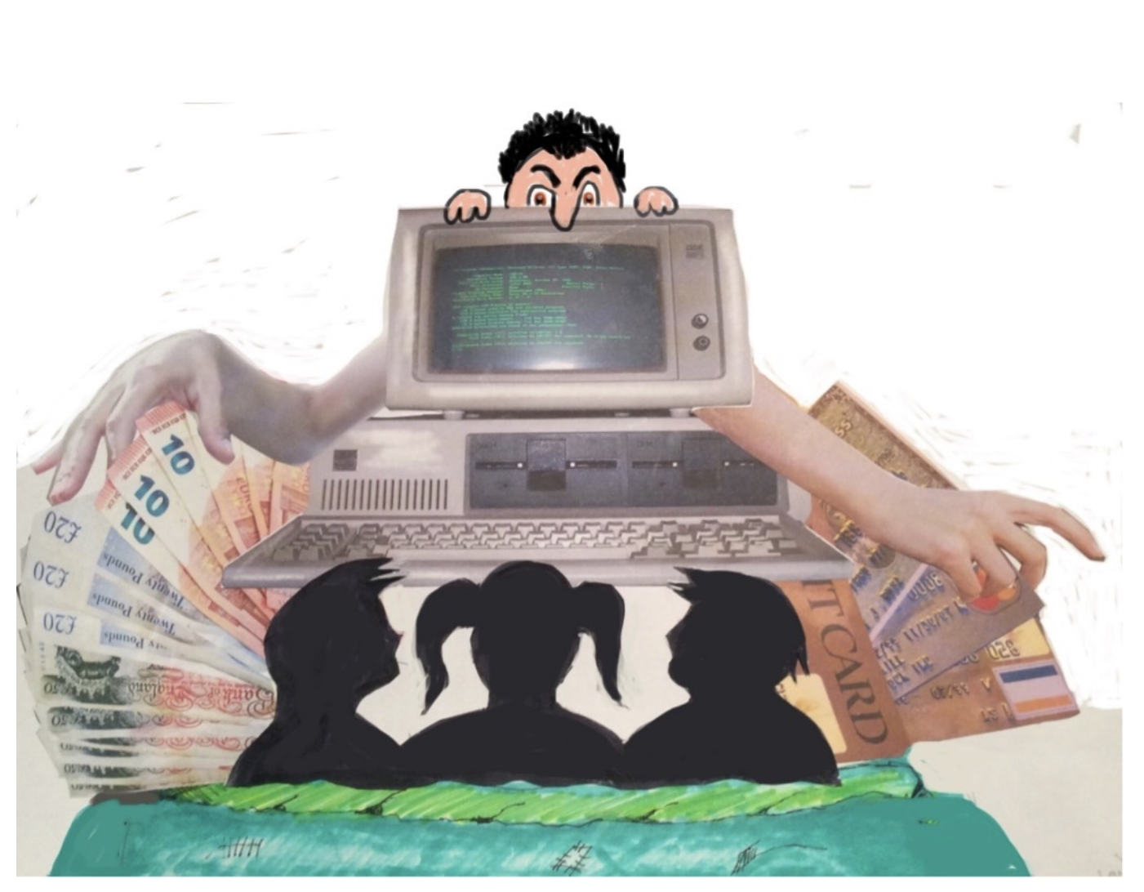
Linking thinking and financial skills with Money Matters
Activity M1.9c
Scam Alert - Too good to be true?
Can you think of any more thinking or financial skills involved?
What are the long-term consequences?

Slide 33
Talking about financial skills with Money Matters
Think about when you might start talking about these sorts of problems with children
2. Suggest which Money Matters approach Comic
books, Escape rooms or Apps might be best for
these three age groups?
6-12 years 13-18 years 19-25 years

Slide 34
Activity M1.10 Linking thinking and financial skills with Money Matters
In your group explore the resources developed for the Money Matters programme
What skills are involved?
How might you use these in a family learning situation?
Have you some ideas of your own?

Slide 35
Self study tasks:
Read Transactional analysis handout and consider your own delivery and learning styles.
Go online to the Money Matters Financial Literacy Library to complete the Digital Badge for Module 1.

Slide 36
Thank you for attending, we hope you find this useful.

