Slide 1
IO3: Financial Literacy Training for Parents
Module 1: Financial Vocabulary

Slide 2
Financial Vocabulary Learning Outcomes
After completing this module, parents and carers will be able to:
describe the meaning of the most common financial words
explain different types of debt and inflation
describe some bank services and other financial agencies

Slide 3
Financial Vocabulary Visual Plan
Introductions
Financial vocabulary
Activity - ideas
End
Break – 10 min.
Inflation
Reflective exercise
Activity - debt

Slide 4
Financial Vocabulary Warmer
Activity M1.1
Meet the neighbours
Introduce yourself to the people sitting next to you on either side
Tell them something about yourself

Slide 5
Financial Vocabulary
Activity M1.2
Financial vocabulary
Look at your card for a word or a description
Find the participant who has the word to match your description

Slide 6
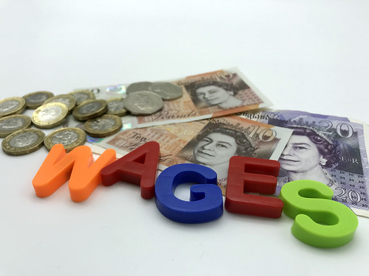
Financial Vocabulary
Financial vocabulary: descriptions of common financial words
WAGES : payment earned for work or services often paid on a daily or weekly basis
SALARY: payment earned for work or services often paid on a monthly basis.
INCOME: money a person earns or receives in benefit or pension, or other means sometimes known as ‘unearned income.’
EXPENSES: money a person spends on food or bills and other things.

Slide 7
Financial Vocabulary
Financial vocabulary: descriptions of common financial words
CREDIT: used to describe money in 2 different ways:
when money is given for use in a loan
money you have in your bank account and you are ‘in credit’
DEBT: represents the money owed by a person. The person who has a debt is known as a debtor or borrower.
INTEREST: used to describe money in 2 different ways:
money a person pays back in order to borrow money
money a bank pays a person when they deposit money into a bank account giving interest
CASH OR DEBIT CARDs: used to pay for goods or services. You must pay on time or be charged interest
CREDIT CARDS: used to buy things and pay for them over time. For this service you have to pay the money back plus some charges and interest

Slide 8
Financial Vocabulary
Activity M1.3
Banking services
Here are some banking words. In small groups decide how you would explain the meanings to a child between the ages of 6 years and 12 years and suggest ideas for resources you might use e.g. real money or other ideas?
Loan
Cheque account
Savings account
Wire transfers
Credit cards
Charge cards
Debit cards

Slide 9
Financial Vocabulary
Other financial institutions/nonbank financial companies
MICROFINANCIAL COMPANIES
Also called MICROCREDIT this represents a type of financial service that provides loans to unemployed or low-income individuals or groups who otherwise would have no other access to banking services.
The goal is to give less affluent people the opportunity to become self-reliant by lending them small amounts of money.
Like conventional lenders, they charge interest on loans and set up specific repayment schedules.

Slide 10
Financial Vocabulary
Other financial institutions/nonbank financial companies
What Are Nonbank Financial Institutions?
CREDIT UNIONS: These are financial institutions that offer various banking services and are often owned by the contributors.
ENERGY COMPANIES: These may offer services to support customers struggling with bills.
INSURANCE COMPANIES: Among the most familiar non-bank financial institutions are insurance companies which protect against financial risk, secured through insurance payments.
COMMUNITY ARRANGEMENTS: These are different depending on the community…can you think of any?

Slide 11
Financial Vocabulary
Coffee and Tea Break

Slide 12
Financial Vocabulary
Activity M1.3
Debt….
Is there such a thing as ‘good’ or ‘bad’ debt?

Slide 13
Financial Vocabulary
Good Debt and Bad Debt
GOOD DEBT: represents an investment that could benefit someone.
BAD DEBT: when you get yourself in financial trouble because you cannot pay the money back that you owe.

Slide 14
Financial Vocabulary: Good Debt and Bad Debt
Activity M1.4
Good debt
Suggest 2 types of ‘good’ debt which might suit you or a family from the list below.
Write them in the first column and try to explain why in the second column.
MY FUTURE GOOD DEBTS COULD BE: | WHY:
educational loan
house mortgage
buying essential items
medical care treatments
small business loans for investments

Slide 15
Financial Vocabulary: Good Debt and Bad Debt
Activity M1.5
How to manage a small budget
REFLECTIVE EXERCISE:
In small groups discuss how you might behave in the following situation:
You only have £300/euros left for this month, but you will receive your next salary in 15 days.
Your washing machine is broken. Obviously you will have to buy everyday goods (food, medicines, petrol for your car, etc.) You have a credit card with a very high interest rate (15%).
What are you going to do? Choose one of this options and explain why:
You will pay for everything using both cash and credit card.
You will borrow from friends or family with no interest.
You will borrow from the friend of a friend who offers cash with interest to be paid.
You will buy a new machine immediately on your credit card.
You will reduce everyday goods you buy and save for a new machine.

Slide 16
Financial Vocabulary
Time travel …how does inflation affect my money?
What does ‘inflation’ mean?

Slide 17
Financial Vocabulary
Inflation
Definition:
Inflation is the overall increase in prices of goods and services over time.

Slide 18
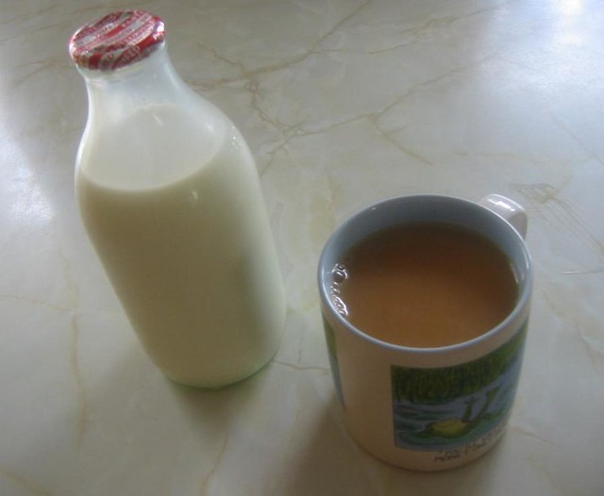
Financial Vocabulary
Activity M1.6
Time Travel
Where have you heard the word ‘inflation’ before?
Have you seen an increase or a decrease in food and other prices recently?
How much do you think a loaf of bread cost in the 1950s?
Do wages always increase with the cost of living?
Use your phone to look up the cost of petrol in the 1950s
5d = 5 old pence

Slide 19
Thank you for attending. For more resources, visit the Money Matters website: https://moneymattersproject.eu/

Slide 20
Financial Vocabulary
Additional resources:
https://www.nerdwallet.com/article/banking/checking-vs-savings
https://www.wellsfargo.com/financial-education/college/?linkLoc=fn
https://www.investopedia.com
https://www.debt.org
https://www.experian.com/blogs/ask-experian/what-is-good-debt/
https://www.youtube.com/watch?v=RwC-EMh2-Z4 (how to write a cheque)

