Slide 1
IO3: Financial Literacy Training for Parents
Module 2: Family Financial Management

Slide 2
Family Financial Management Learning Outcomes
By the end of this module parents and carers will be able to:
find a balance between their earnings and expenditure
think about involving children in family budgeting
find a possible way to make savings by calculating their expenditure and earnings

Slide 3
Family Financial Management Visual Plan
Activity - Mindmap
Activity - Budgeting
Activity – Budgeting with children - Money Matters Comic Strip
End
Break – 10 min.
Activity – discussing a family financial situation
Expenditure and earnings - Top Tips
Activity - Debt

Slide 4
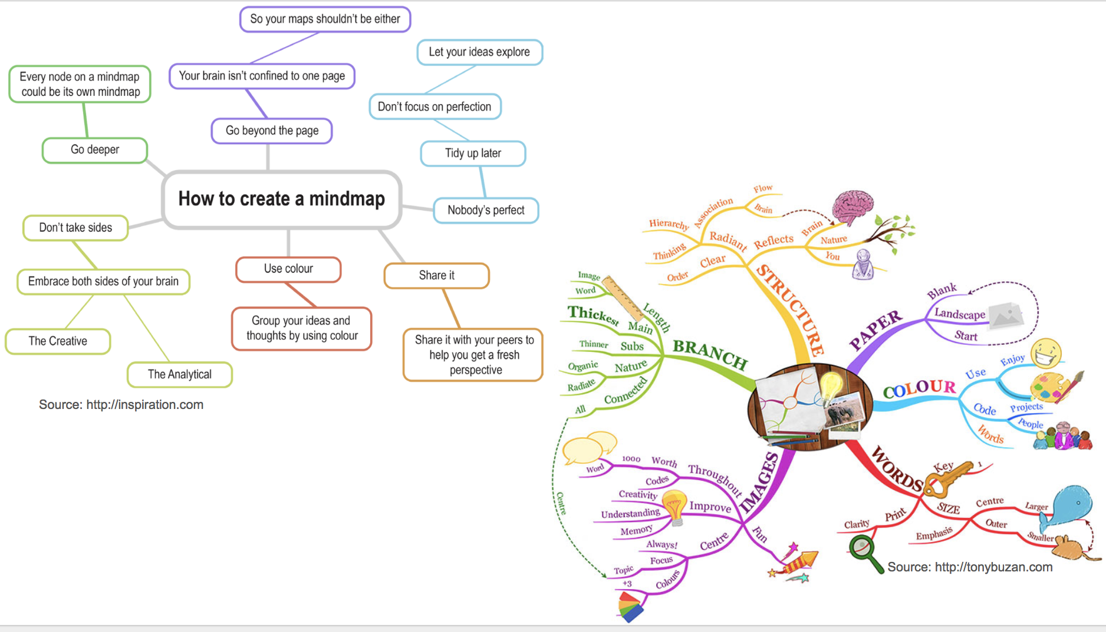
Family Financial Management Warmer
Activity M2.1
Mindmap
In pairs create a mindmap of the idea of money including some financial words from
the last session
You can use:
Drawings
Diagrams
Words
Colour

Slide 5
Family Financial Management
Activity M2.2
The importance of knowing how to manage the family budget
Managing money for family expenses, such as daily purchases and bills, is an essential skill in everyone’s life, along with the ability to save money. Knowing how to manage money for your family helps you to deal with life events and emergencies with more confidence.
Discuss in pairs:
What is a budget?
Why do we need budgets?
How do you create them for yourself?
Feedback different ideas

Slide 6
Family Financial Management
Activity M2.3
What can a budget look like?
Fill in the imaginary weekly family budget sheet in pairs
A BUDGET helps:
to prioritise expenses and needs
to understand how to save money
to set aside money for unexpected expenses and avoid overspending
to keep your eye on prices and price rises
Share your ideas with others.

Slide 7
Family Financial Management
Budgeting for adults
MAIN GOAL OF THE BUDGET: spending less than you earn!
There are different steps:
1
LIST YOUR EARNING SOURCES and MONTHLY AMOUNTS
LIST YOUR TOTAL MONTHLY EXPENSES:
fixed expenses e.g. standing orders for rent/mortgage, council tax, phone, insurances etc.
variable expenses e.g. clothes, holidays, medical expenses, petrol/travel or a tax bill if self-employed etc.)
You can check all the expenses over the last year and find an average - dividing by 12 (or by the number of months taken into account). This could help you to understand your usual spending habits.
2

Slide 8
Family Financial Management
Budgeting for adults
These calculations will help you to understand if you are currently spending more or less than what you have as earnings or income.
If you are spending less it can be useful to see how to save and HOW TO USE YOUR SAVINGS.
If you are spending more it is helpful to understand WHICH FAMILY EXPENSES CAN BE CUT.
If it includes DEBTs like mortgages, credit cards etc. and you don’t know how to manage then follow the tips on the next slide!

Slide 9
Family Financial Management
A budget worksheet for adults Have a look at the Money Matters App too
BLANK MONTHLY BUDGET WORKSHEET
The following is monthly budget worksheet. You can use it as you plan your own budget. whit suggestions and tips.
INCOME/MONEY RECEIVED Earnings: _________________
Allowance: _______________
Other income: ____________
TOTAL: __________________
he facilitator will help them
EXPENSES/MONEY SPENT
Food: ____________________
Other bills:________________
New clothes: ______________
Other expenses: ___________
Debts:____________________
TOTAL: ___________________
EXCESS/MONTHLY TOTAL
Income: _____________
Expenses: _____________
TOTAL: _____________

Slide 10
Family Financial Management How can we help children learn about budgeting?
Activity M2.4
Budgeting for children (6-12 year olds)
In pairs read through Comic Strip 3 ‘Save now…Spend later’
List 3 ways that could you use this with a child to help them understand budgeting
Feedback

Slide 11
Family Financial Management
Tea and Coffee Break

Slide 12
Family Financial Management
How to manage debt
Managing debt can be easier if you understand how debt work and know how to control money.
Understand when you have crossed the line!
To see if you have too much debt, you can calculate monthly earnings against debts.
STEP A:
If the difference is too high, you can examine spending habits and MAKE A PLAN in order to manage debts without worries! This plan would include identifying any unnecessary purchases or habits such as frequently eating in restaurants, uncontrolled credit card spending or use of several cards at once etc. When unnecessary expenses have been identified they can be controlled and you can try to AVOID THEM.
STEP B:

Slide 13
Family Financial Management
How to manage debts: top tips
Make a list of monthly debts, including student and car loans, credit cards, and mortgage
Make a list of monthly debts including all loans e.g. credit cards, car purchase, mortgages or student loans.
Make a monthly budget to determine how much you can afford to pay towards your debt. You’ll want to pay as much as you can to bring down your debt.
Make a monthly budget to determine how much you can afford to pay towards your debt. You’ll want to pay as much as you can to bring down your debt.
Continue to pay all your debts, because if you miss payments, you may be charged fees and even higher interest rates.
Continue to pay all your debts, because if you miss payments, you may be charged fees and even higher interest rates.

Slide 14
Family Financial Management
How to manage debts: top tips
Avoid using credit cards for new purchases. Put your credit cards away until you have paid off your debt. If you continue to add new charges to your credit card debt, it will increase and it is unlikely that you will pay it off.
If you get a raise, increase your savings instead of increasing your spending.
Don’t use all of your savings to pay off debt. You’ll want to keep a small amount of savings for any unforeseen emergencies. Savings will prevent you from having to charge these emergencies to your credit card.

Slide 15
Family Financial Management: Needs and Wants
Activity M2.5
Thinking about family saving during periods of inflation
Knowing how to save money while raising children isn't easy especially with inflation. There are so many things to consider that you may not know where to start. Below you can find some suggestions:
With your family, decide which spending could be cut e.g. some goods that you don't really need to buy (needs and wants).
Instead of throwing away the items you no longer use, try selling them first to earn some extra cash.
Try to buy second-hand items or refurbished technology products instead of new expensive items.

Slide 16
Family Financial Management
How to save as a family: Top Tips
Take good care of your health. Prevention is better and possibly
cheaper than cure.
Organise your purchases by making a list of the things you need to buy. It will help you not to be overwhelmed when you go shopping, avoiding buying unnecessary things.
Keep home heating costs under control. You can use a thermostat to keep heat at a regular temperature (suggested at around 22° degrees)

Slide 17
Family Financial Management
How to use savings: some suggestions
It is very important to have extra family savings in order to cope with unforeseen situations and long - term expenses.
But when you get extra money for your family, how can you use it?
Any recomendations would depend on your family‘s goals and needs
EMERGENCY FUND: this is very important in order to be financially prepared for unexpected situations
PLAN LONG-TERM GOALS: like educational goals, moving home, starting a family or retirement etc.
INVESTMENTS: Some money might be put in a high interest savings account, government bonds or invested in something with a likely (though not guaranteed) value increase over time such as a house.

Slide 18
Family Financial Management
A difficult family financial situation
Activity M2.6
Jan and Elain's family consists of 3 children and Elain's mother who lives with them and contributes a small monthly pension. Jan works part-time in a fast-food restaurant and Elain works as a full time secretary in an architect‘s office so there are 3 incomes.
The 3 children all go to school and the parents are worried because the expenses for the children are growing (sports equipment, conputer games, phones etc.) they have to pay the mortgage and the health of Elain's mother is slightly deteriorating and there are future health care implications.
Elain is starting to feel very stressed, because she does not know how to handle this situation and she feels she cannot deal with it alone.
What are the issues? What could Elain do?
Share 3 suggestions from your group discussion.

Slide 19
Family Financial Management
A good family budget plan
Marie and John have a son. Marie is a saleswoman and John a delivery driver. After an unexpected expense for their car they decide to create a budget plan to figure out which expenses to cut or keep. They aim to save money for 2 goals: 1. to create an emergency fund for unexpected expenses 2. to save money to pay future college tuition for their son Usual expenses: they both use credit and debit cards for non-essential items they go shopping and eat out every month and often buy different things which they may not need they usually use the car for journeys.... including short trips to the shops their normal regular household expenses are: taxes, food, rent, heating and petrol for the car How could Marie and John control their expenses and save money? by using their credit and debit cards less by reducing their non-essential shopping and eating out by reducing household expenses possibly buying cheaper brands by avoiding using their car for very short trips

Slide 20
Family Financial Managment
A good family budget plan
Now let's see how Marie and John will organise their future family money management, after making a BUDGET PLAN Marie and John realised they were spending too much on their cards, which were charging them very high interest rates for their expenses so they decided to just use their debit cards and spend within their means. Thanks to the budget plan, they also realised they were spending too much on petrol for their car and decided to use public transport instead (where possible). They also decided to buy fewer new items and think about their usefulness before buying them. This way they expected to be able to set aside enough money each year to equip themselves with the emergency fund and be able to pay future college fees for their son.

Slide 21
Thank you for attending. For more resources, visit the Money Matters website: https://moneymattersproject.eu/

Slide 22
Family Financial Management
Additional resources:
https://raisingchildren.net.au/grown-ups/family-life/managing-money/managing-money
https://www.mvorganizing.org/what-is-the-importance-of-family-budget
https://www.delraycc.com/budgeting/the-importance-of-a-household-budget/
https://www.sofi.com/learn/content/saving-my-family-money/
https://www.discover.com/online-banking/banking-topics/7-ways-to-save-money-on-family-expenses/

