Slide 1
Financial Literacy for Families
Train the Trainer Module 2
Identify key financial vocabulary and concepts and consider financial relationships in different communities

Slide 2
Module Aim is to identify key financial vocabulary and concepts and consider financial relationships in different communities
Learning Outcomes
Participants will be able to:
Feel confident to use and explain key financial language and vocabulary.
Consider financial relationships in different communities.
Feel able to explain and discuss budgeting, planning, saving, debt, borrowing and spending.

Slide 3
Module 2 Visual Plan for the session
Learning
outcomes
Warmer
Financial Vocabulary
Money and Culture
Money Matters App
Budgeting
End

Slide 4
Activity M2.1 Warmer Introductions and share ideas
Introduce yourself if you are next to someone new
Share your experiences or ideas for teaching financial literacy

Slide 5
Key Financial Language and Vocabulary

Slide 6
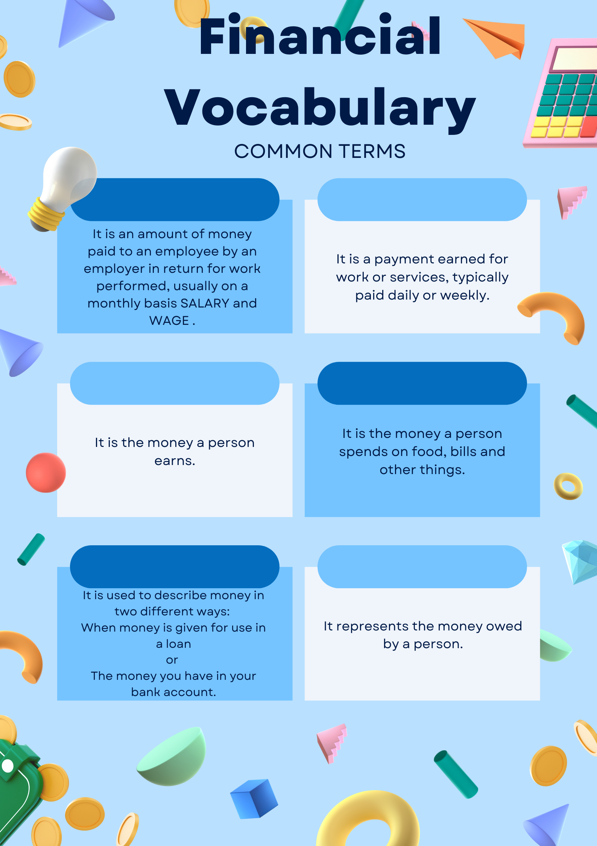
Activity M2.2 Financial vocabulary Financial Vocabulary and a resource you can use with your learners to check their knowledge Participants can identify known financial terminology and concepts using Handout M2.2

Slide 7
Concepts
Salary An amount of money paid to an employee by an employer in return for work performed, usually on a monthly basis SALARY and WAGE.
Income The money a person earns.
Debt represents the money owed by a person
Wages Payment earned for work or services, typically paid daily or weekly.
Expenses The money a person spends on food, bills and other things
Credit Cards Used it to buy things and pay for them over time. You have to pay the money back with some charges and interest

Slide 8
Concepts
Credit This can be money given for use in a loan or money you have in your bank account
Interest Money a person pays to borrow money or the money a bank pays a person when they deposit money into the bank
Budget Income and expenses. A plan of how much money should be spent over a week or a month
Loan Money borrowed (bank or building society) and must be paid back usually with extra interest
Inflation Inflation is the increase in the cost of living
Cash or Debit Card
Pays for goods or services

Slide 9
Activity M2.3 The Money Matters App
Exploring the Money Matters App and introducing the vocabulary matching activity

Slide 10
Tea and coffee break
while you download and explore the Money Matters App

Slide 11
Money and Culture

Slide 12
Money and Culture
Activity M2.4a
“The truth is every aspect of your finances is directly impacted by your identity and culture”*
Take a personal approach to this sentence: “Think about your history, your community, what your day-to-day financial activities are.”
Can you outline Sharia Law and borrowing?
Do you know of families where only the men or only the women control the family finances?
Which groups have community attitudes to support family finance e.g. ‘Susu’, ‘Pardnas’, ‘Roscas’ ‘Tandas’
*Source: Dorsainvil, R. (n.d.). Why We Can’t Talk About Money Without Talking About Culture. Forbes. Retrieved March 8, 2022, from https://www.forbes.com/sites/riankadorsainvil/2019/06/28/why-we-cant-talk-about-money-without-talking-about-culture/?sh=13ba4b185e8d
‌

Slide 13
Money and Culture
Activity M2.4b
“The truth is every aspect of your finances is directly impacted by your identity and culture”
Identify the historical and community elements of your identity to understand the "baggage of money you have on the table.“
Does your community influence your financial choices?
Do you have a family financial story?
Clarify useless or negative stories about money you have learned in the past.
Before making any financial decision, remember the story you want to tell yourself.
Source: Dorsainvil, R. (n.d.). Why We Can’t Talk About Money Without Talking About Culture. Forbes. Retrieved March 8, 2022, from https://www.forbes.com/sites/riankadorsainvil/2019/06/28/why-we-cant-talk-about-money-without-talking-about-culture/?sh=13ba4b185e8d
‌

Slide 14
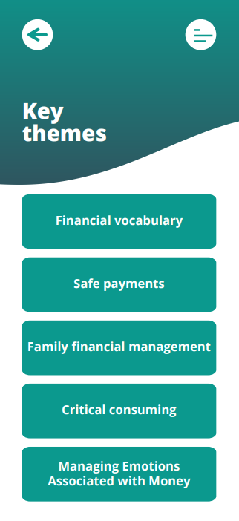
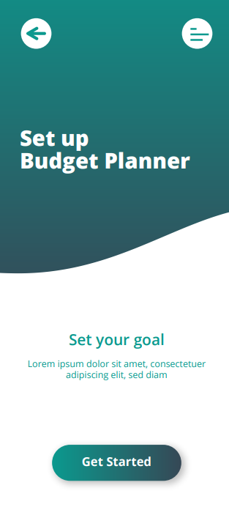
Budgeting and the Money Matters App
Budgeting is the process of planning for how you will spend your money.
A budget is the name given to this spending plan.
Making this spending plan allows
you to know ahead of time whether you will have enough money to do the things you need or want to do.
Money Matters App

Slide 15
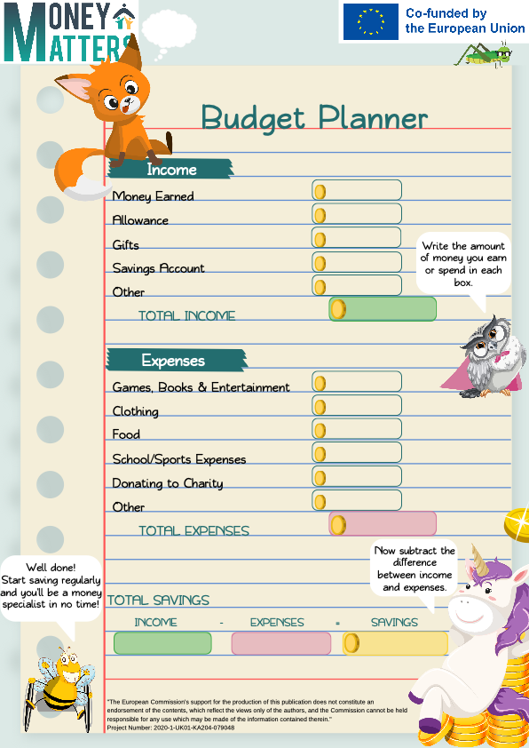
Activity M2.5 Budgeting using the Money Matters App or Comic strip
Have a look at these resources.
Think about ways of using them as a Family Learning teaching resource.
Feedback 3 ideas to the group.

Slide 16
Self study tasks:
Complete your own budget plan and consider how you would support parents to do this.
Explore the Parent Induction Training materials for Sessions 1 & 2
Go online to the Money Matters Financial Literacy Library to complete the Digital Badges for Module 2.

Slide 17
Thank you for attending we hope you find this useful.

Slide 18
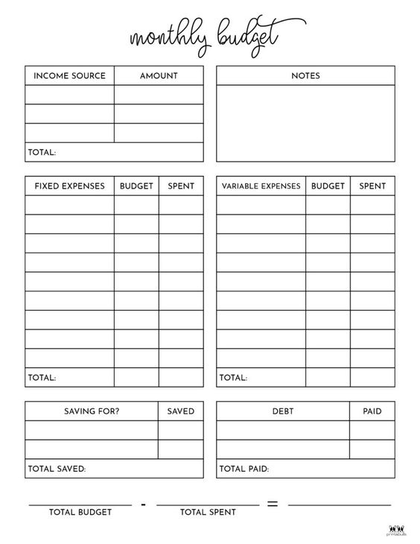
Additional activity M2.6
Budget planning
To make your own budget plan, you should include:
Salary
Fixed expenses
Variable expenses
Extra expenses
Saving
Take this activity with you! Try to make your own plan at home!

