Slide 1
Train the Trainer Module 3
Financial Literacy for Families
Managing risks and emotions associated with money

Slide 2
Module 3 Aim is to manage risks and emotions associated with money
Learning Outcomes
Participants will be able to:
explain how to keep money secure and avoid fraud and scams on and offline
signpost to sources of advice
feel confident to explain the emotional impact of money with individuals and groups
recognise that individuals and families may have different priorities and long term goals related to finances

Slide 3
Module 3 Visual plan for the session
Warmer
Activities about money security
End
Activities about emotions attached to money

Slide 4
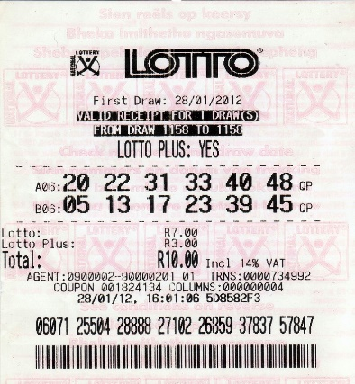
Activity M3.1a Warmer Big Lottery Win
Imagine…
Imagine that you have just won the lottery of 25 million euro or pounds.
List all the things you would do with the money and add one statement of what it means or why it is important for you.
There is no limit to the number of things you can put down, as long as you can write them within 5 minutes.

Slide 5
Activity M3.1b Big Lottery Win
Now…
Sort the items into the following categories:
Material items
Friends and family
Travel and luxury
Other________

Slide 6
Activity M3.1b cont. Big Lottery Win
Lastly…
Which of those categories do you recognise as priorities and which as long-term goals?

Slide 7
Activity M3.2a Keeping money secure
Let’s play!
Benefits or Risks
Hold up your response to the facilitator’s statements.

Slide 8
Activity M3.2b Keeping money secure
Let’s play!
Notes:
Optional if facilitator creates their own?

Slide 9
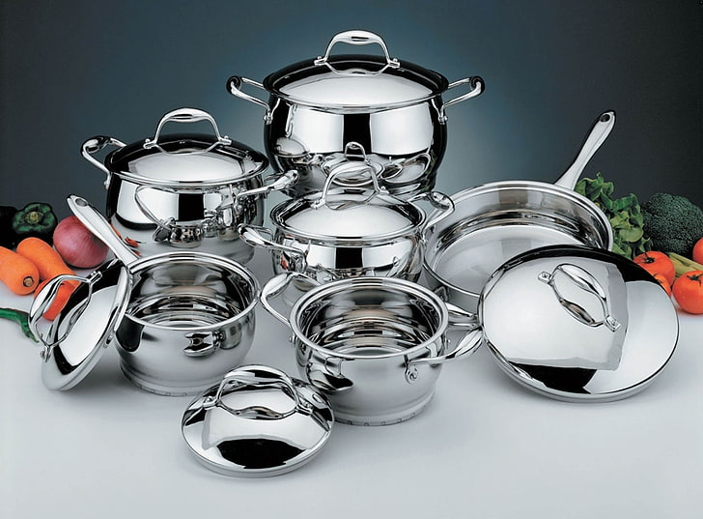
Activity M3.3 Fraud. To do or not to do?
Fraud Scenario
Read the handout about Marina’s online purchase to see the story.
How could you use this story with a group to elicit what to do differently?
Notes:
I’ve reduced the content but would suggest a handout for this task

Slide 10
Some tips on how to recognise a trustworthy website
Have a good anti-virus on your PC and smartphone
Check the connection is encrypted
Ensure there is an SSL Certificate, a protecting protocol
If you see a gray or green padlock and https: // the connection is secure
If there is a red triangle with an exclamation mark on the navigation bar
this means that the connection is not to be considered secure
Enter a secure site and make use of one of the main security measures envisaged by the EU legislation such as Strong Customer Authentication (SCA)
Check web reputation by visiting online portals e.g. trustpilot, google, etc.

Slide 11
Some more tips on how to keep secure while shopping online
Keep your card and the PIN code in a safe place.
If you lose your card then immediately call the bank to block or freeze it.
Create a habit of checking your account balance regularly.
Avoid using the same credentials in every website you use.

Slide 12
Activity M3.4 Online Payment
Which is the most common way by which you make your online payments?
Responses
a)
b)
c)
d)
e)
f)
PayPal
Google pay
Wise
Bank transfer
Cash on delivery
f) Other:___________________
Notes:
Use a whiteboard or flipchart

Slide 13
Tips when using different online payment methods
BANK CARDS
Keep cards safe: avoid loss and keep PINs secure. If you lose your card → block it by calling your bank. This is essential for CONTACTLESS CARDS.
Check your account balance regularly: you can still be the victim of fraud and need to detect unauthorised activities. If anything is wrong → call your bank.
Use different passwords for websites to avoid information being stolen by web-thieves when your password is the same as your email password.

Slide 14
Online Payment
Tips when using different online payment methods
PAYMENT SYSTEMS (Paypal, Google Pay, Wise, etc.)
These services are intermediaries between your bank/card and the online seller.
These services make it possible to allow safe purchases as they verify the reliability of the e-commerce site.
This way, anyone who transacts online is not required to disclose sensitive data.
In addition, this service guarantees the refund of the purchase made in case of problems with the products.

Slide 15
Online Payment
Tips when using different online payment methods
BANK TRANSFER
Online payment by a bank is safe as it tracks and guaranteespayment in case of scams or problems.
However, it is not the best payment method in the case of e-commerce as it is slower - the transfer takes a few days to be credited and your order will take longer to reach you.
Always type the IBAN carefully as a service provider is not responsible for failure or incorrect execution of the payment by the customer.

Slide 16
Online Payment
Tips when using different online payment methods
CASH ON DELIVERY
This is a safe payment method that allows you to pay when you receive the product at your home.
However, the cash on delivery often has a higher cost than other online payment method, and it is not always offered by online sellers.
Never give away any personal information unless trusted or essential

Slide 17
Tea and coffee break

Slide 18
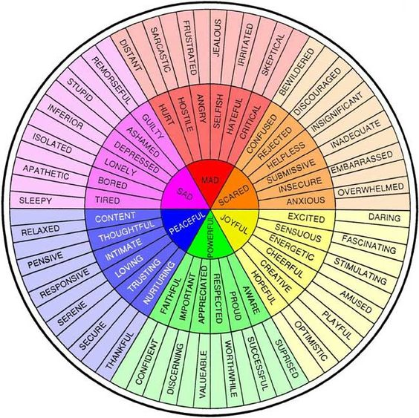
A wheel indicating words to depict a wide range of emotions
The Wheel of Emotions identifies and labels feelings. It also uses colour to suggest emotions.
Notes:
The Wheel of Emotions was introduced in the 1980’s to demonstrate how our emotions can be mixed together to create more emotions.

Slide 19
Activity M3.5 Identifying emotions related to money
The Wheel of Emotions
What emotions do you think link to these words?

Slide 20
Linking the concept of emotions and financial decisions
Emotions and Financial decisions
Your electricity bill arrives
If you are experiencing negative emotions, it can be easy to run away from them, or avoid the challenges that you are having with regards to money.
Although you may have a sense of relief in the short-term from not paying your bills, over the long-term, your bills will increase.
This process, known as the Avoidance Cycle, can result in anxiety and more debt in the long term. can be easy to run away from them, or avoid the challenges that you are having with regards to money.
Although you may have a sense of relief in the short-term from not paying your bills, over the long-term, your bills will increase.
This process, known as the Avoidance Cycle, can result in anxiety and more debt in the long term.
In a few weeks, your next bill arrives, leaving you more in debt.
You worry about how you will pay for it
You relax.
You avoid the bill by hiding it in your kitchen cupboard.
The bill is out of sight, and out of mind.

Slide 21
Activity M3.6
Create an example of emotions and finance such as binge shopping, gambling or obsessive saving
Activity
In pairs, create your own circle.
Identify examples of something you, or people you know, have done.
Discuss how these behaviours make matters worse for the individual or the family.
When you are ready, present your findings to the group.

Slide 22
Activity M3.7 Emotions Management
Activity: Reflection
Reflect upon your own personal life experiences and share one situation where you feel your emotions affected your decision related to money and one situation where you feel that you didn’t allow your emotions to affect your decision.

Slide 23
Useful Strategies to regulate emotions during potentially stressful discussions about money.
As humans, although we cannot fully control our emotions, we can influence how we are feeling.
There are many different strategies that we can use to regulate our emotions during money-related decisions, including:
Doing mindfulness to regulate our emotions
Rethink the situation to see if it can be seen through another perspective.
Suppressing how we are feeling
Accepting how we are feeling

Slide 24
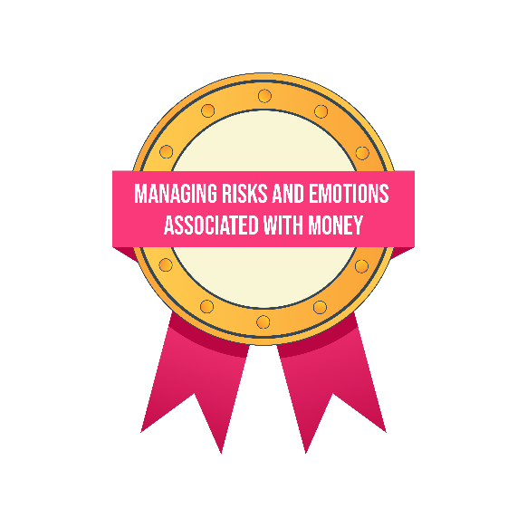
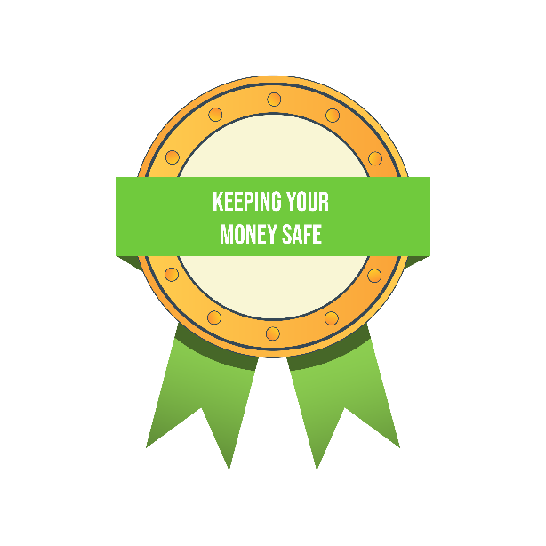
Self study tasks:
Complete your own character strengths survey at: https://www.viacharacter.org/survey/account/register
Explore the Parent Induction Training materials for Sessions 3 & 4.
Go online to the Money Matters Financial Literacy Library to complete the Digital Badges for Module 3.

Slide 25
Thank you for attending we hope you find this useful.

