Slide 1
Financial Literacy for Families
Train the Trainer Module 4
Managing money during critical life periods

Slide 2
Module 4 Aim: Managing money during critical life periods
Learning Outcomes
Participants will be able to:
Identify money challenges during critical life periods
Describe how societies raise and spend money
Discuss critical consumerism and the circular economy

Slide 3

Module 4 Visual Plan for the session
Learning
outcomes
Warmer
Money challenges and critical life periods
How societies earn & spend money, circular economy and critical consuming
Needs vs Wants
and Budgets

Slide 4

Activity M4.1a
Warmer Money Challenges
1. Introduce yourself to a partner and share ideas about stress and money
2. Write down times in peoples’ lives when they are worried or stressed about money
What are Critical Life Periods?

Slide 5
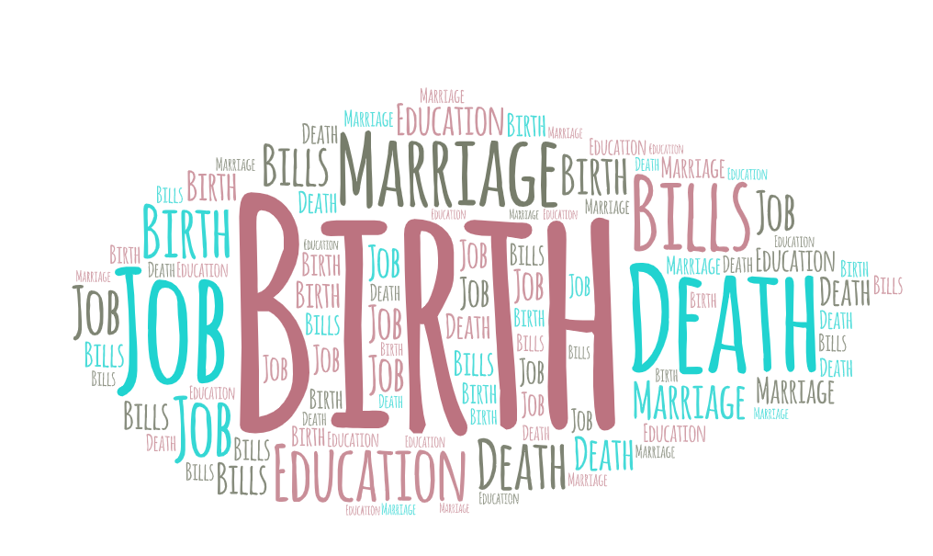
Activity M4.1b
Warmer Money Challenges
What are Critical Life Periods?
We face lots of different challenges in our daily lives that put pressure on our finances:
Unexpected bills
Births, marriages and deaths
Going back to school or education
Redundancy
Starting or ending a job
Reaching pension age
Finance and forming long-term relationships
Purchasing or renting a house or flat

Slide 6
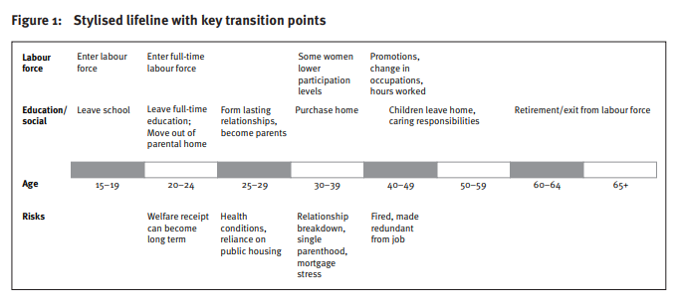
Source: Ryan, C. (2012)
Notes:
Source: https://www.dss.gov.au/sites/default/files/documents/09_2012/op41.pdf

Slide 7
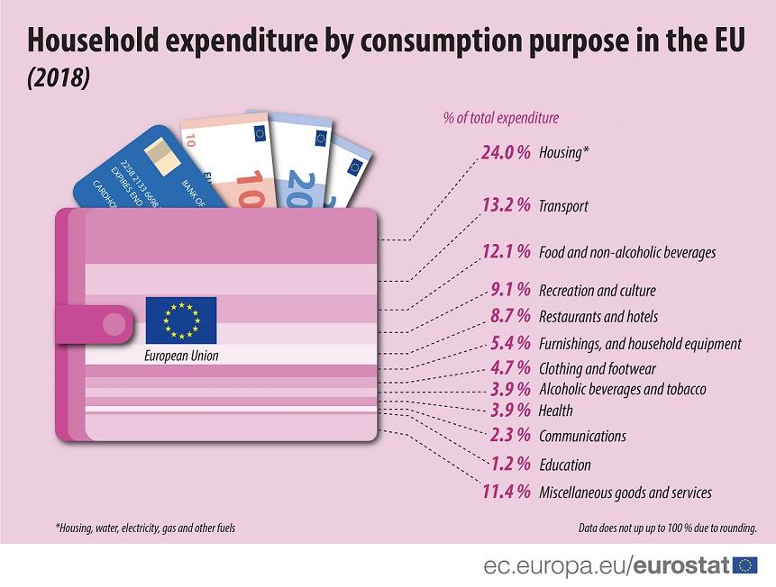
Activity M4.2
Managing Money Needs and Wants
Identifying Financial Needs and Wants
Group 1: What feelings do people have during critical life periods?
Group 2: How would you manage money during critical life periods?
Group 3: How are financial needs different for different age groups?
Notes:
Read this article: https://www.theatlantic.com/business/archive/2013/11/your-brain-on-poverty-why-poor-people-seem-to-make-bad-decisions/281780/?fbclid=IwAR3tKge9Qim0UpeokpIK3uy2clk4h7P4xFe8sd_Ngr4wUC2DtAzSFkpZmzg
Watch this YouTube video : https://www.youtube.com/watch?v=DUyyS2rjpJY&ab_channel=SciShowPsych
Source: Eurostat, https://ec.europa.eu/eurostat/web/products-eurostat-news/-/DDN-20191127-1

Slide 8
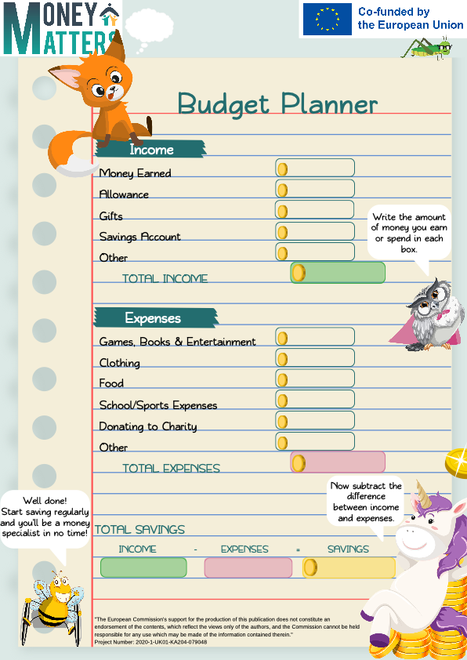
Activity M4.3
Managing Money
Looking at the comic strips on budgeting and needs and wants
Look at the comic strip and in pairs or groups discuss how you would use this tool to talk about ‘needs and wants’ and budgeting with young children or families.

Slide 9

Coffee and
tea break

Slide 10
Activity M4.4
Taxation discussion
How Societies raise and spend money
Group 2: What are the different ways governments raise money and spend it?
Group 3: Are taxes important for a society or not and why?
Group 1: Where does money come from?
Watch this YouTube Video: https://www.youtube.com/watch?v=w5wtCAaLFtY&ab_channel=CNNBusiness
Notes:
Watch this Youtube Video: https://www.youtube.com/watch?v=w5wtCAaLFtY&ab_channel=CNNBusiness

Slide 11
Activity M4.5
Managing money during critical life periods
Taxes
What are the most important services taxes pay for during critical life periods?
  Social Security and benefit system
  Pensions
  Maternity benefits
  Carers allowances
  Healthcare
  Education
What kinds of benefits and other financial assistance is available in your country?

Slide 12
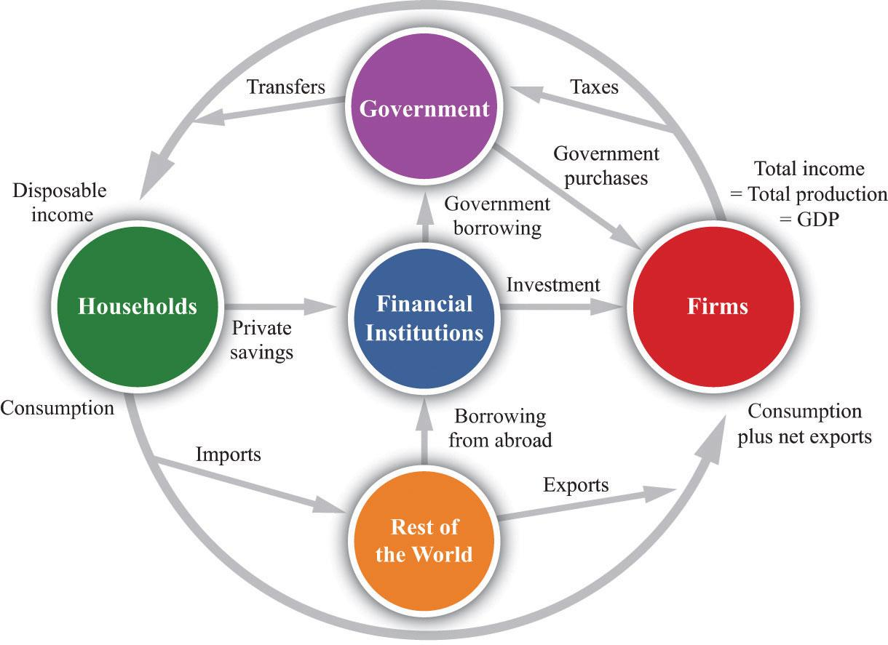
Managing Money and Taxation
How do societies raise and spend money?
Notes:
Source: https://saylordotorg.github.io/text_economics-theory-through-applications/s35-27-the-circular-flow-of-income.html

Slide 13

Activity M4.6 What is a critical consumer?
Discussion
As a whole group share ideas of what a critical consumer considers before buying anything.

Slide 14
Managing Money
What is a Critical consumer?
Critical consumer is every person who takes into account one or more of the following before buying anything :
  Price
  Quality
  Environmental factors
  Ethical beliefs
  Political beliefs
  Workers’ rights
  Social effects
  Sustainability
What is a critical consumer?

Slide 15
Activity M4.7
Managing money and the critical consumer
Marketing and Advertising
What makes a ‘good’ advert?
Think of an advert that you remember and why?
How can one be less vulnerable to advertising tricks?
How are people influenced by advertisements and why?

Slide 16

Activity M4.8
What do you understand by the term ‘Circular Economy’?
Discussion and feedback

Slide 17
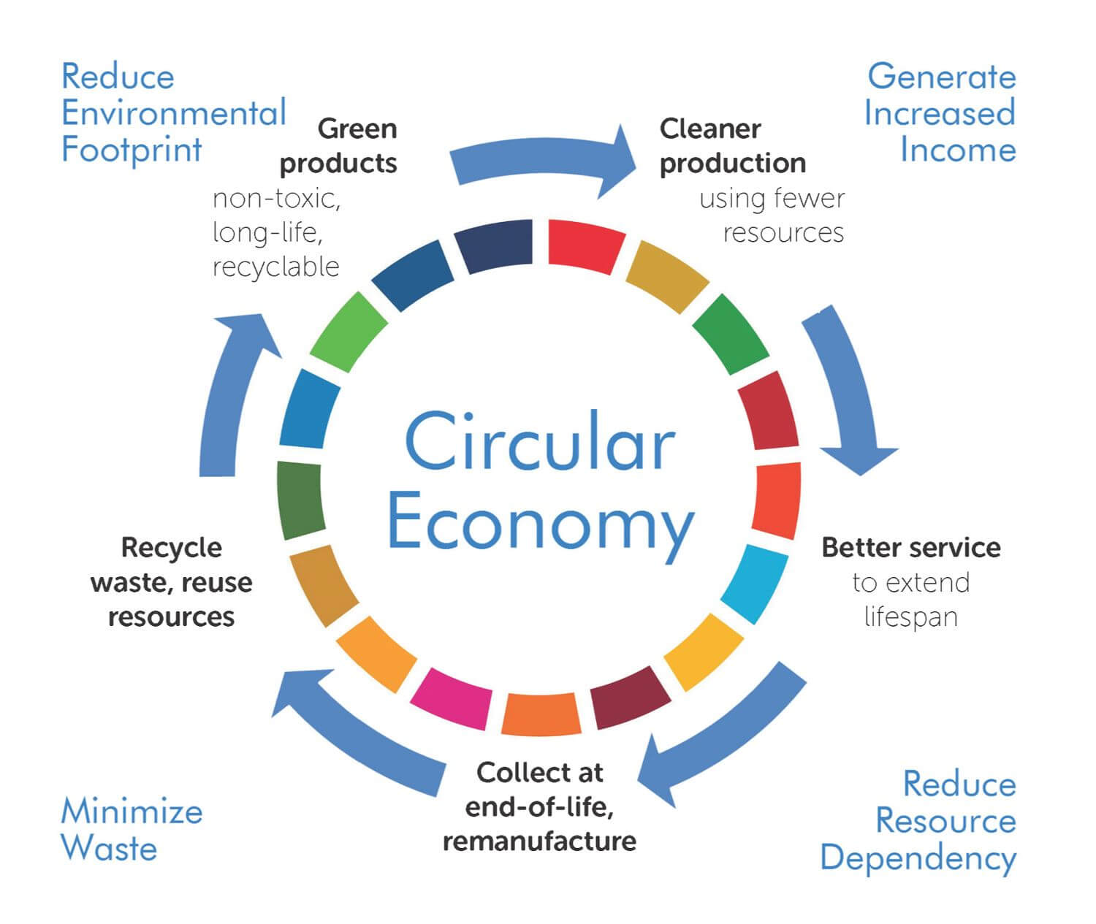
What is a ‘circular economy’?
Circular Economy
Notes:
Source: https://hub.beesmart.city/en/strategy/the-circular-economy-and-smart-city-solutions

Slide 18
The Circular Economy: How to start the discussion with young children
Money Matters comic strip 12

Slide 19


Self study tasks:
Explore the links on handout M4.9.
Explore the Parent Induction Training materials for Sessions 5 & 6.
Go online to the Money Matters Financial Literacy Library to complete the Digital Badges for Module 4.

Slide 20
Thank you for attending, we hope you find this useful.

