Slide 1
Financial Literacy for Families
Train the Trainer Module 5
The role of money in our lives, numeracy and its relevance in Financial Literacy

Slide 2
Module Aim is to Explore the role of money in our lives, numeracy and its relevance in Financial Literacy Learning Outcomes
Participants will be able to:
support their learners in discussing attitudes towards financial numeracy skills
demonstrate how parents can positively support their own and their children’s financial numeracy development
have an awareness of online tools that use numeracy to support financial decisions

Slide 3
Module 5 Visual Plan for the session
NUMERACY AND ITS RELEVANCE IN FINANCIAL LITERACY
HOW CAN PEOPLE IDENTIFY THEIR NUMERACY CHALLENGES?
Warmer
PARENTS AS FINANCIAL TEACHERS
BREAK
END

Slide 4
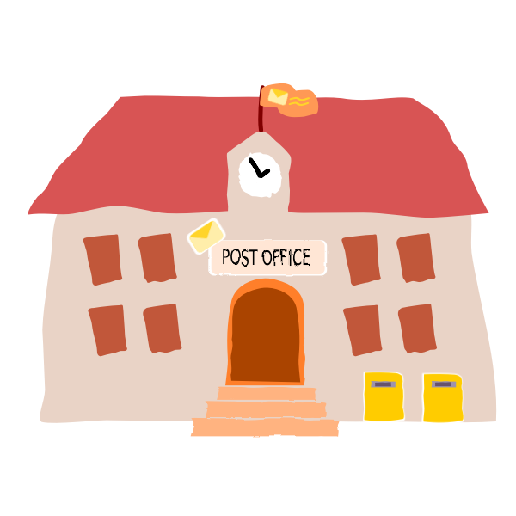
Activity M5.1
Warmer Numeracy skills
In our daily lives we need to do different types of calculations.
What did you do this morning?
What are numeracy skills and their relationship with financial literacy

Slide 5
The importance of numeracy skills in managing money
Activity M5.2
What do you consider to be the most common uses of maths in daily activities for your learners? Try to rank the following daily actions in order of importance:
Understanding documentation containing statistics, prices and figures.
Keeping close account or note of change and receipts when buying things.
Shopping for the best price.
Understanding the value of personalised budgets or direct payments, wages, welfare benefits etc.
Being aware of how income affects taxation.
Knowing how to weigh things and use scales accurately, e.g., to cook or to manage a specific diet.
Figuring out distance, time and costs for travel.

Slide 6
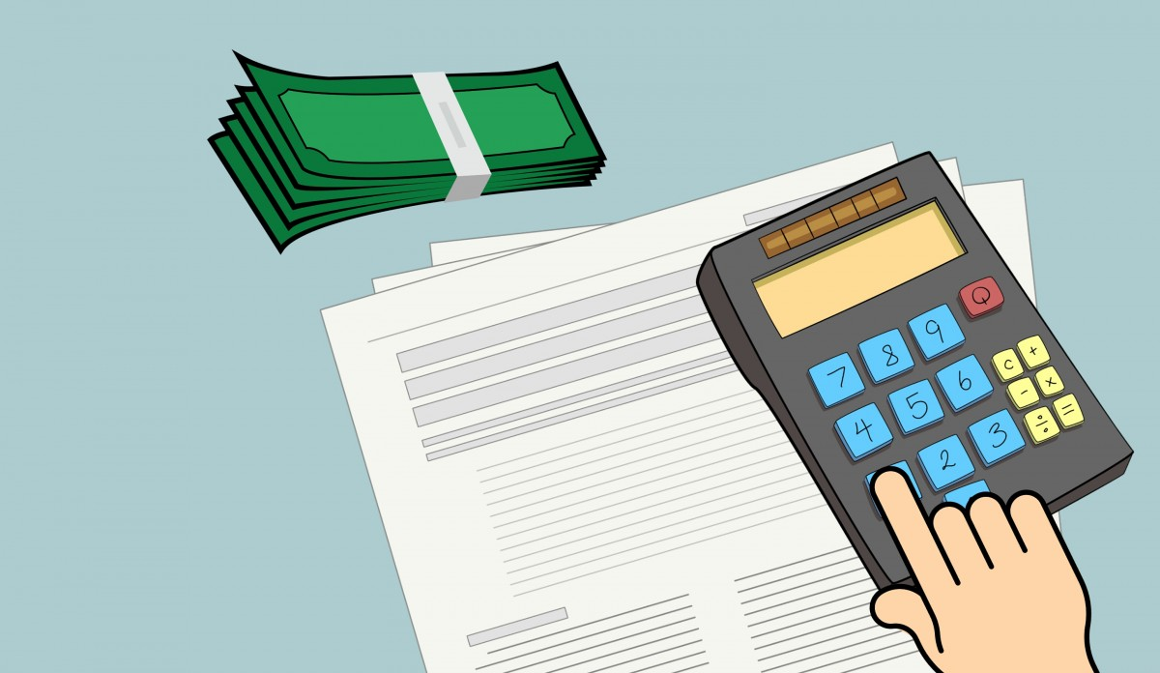
The role of money in our lives, numeracy and its relevance in Financial Literacy
As researchers stated that the level of numeracy in the adult population gives reasons to worry: it is very low and particularly severe among some already vulnerable groups in the population, such as the elderly, women, and those with low educational attainment.
Numeracy, Financial Literacy, and Financial Decision-Making ANNAMARIA LUSARDI-George Washington University
Now more than ever, numeracy and financial literacy are lifetime skills that everybody needs to have to be able to live and operate in today’s complex economic environment.

Slide 7
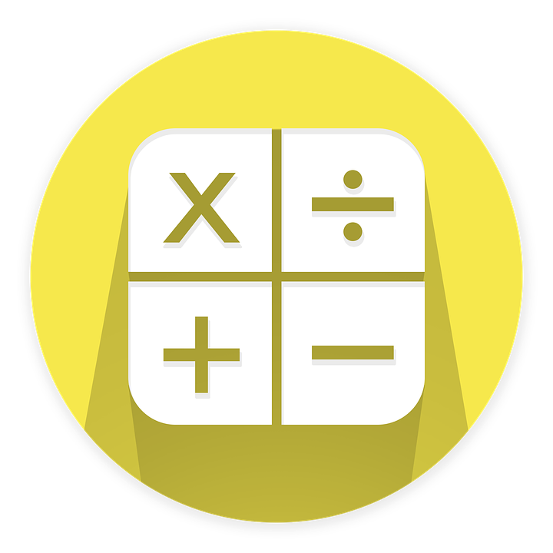
What are numeracy skills and their relationship with financial literacy?
UNESCO Institute for Lifelong Learning in its Adult numeracy: assessment and development 2021 states that building adult numeracy skills is key for our well-being and active participation in modern society. It contributes to significant economic and social outcomes.
Making effective financial decisions often depends on our ability to do mathematical calculations, both simple and complex.

Slide 8
What are numeracy skills and their relationship with financial literacy?
FINANCIAL
LITERACY
NUMERACY
This relationship is very important and can depend on factors such as gender, level of education, level of financial education, language, parental involvement, community, parental education, family income, etc.
It is therefore necessary to consider the strengthening of mathematical skills as one of the means to improve financial literacy.

Slide 9
The importance of numeracy skills in managing money
Now let’s watch a video explaining the meaning and usefulness of numeracy:
https://www.youtube.com/watch?v=zTlR9amvk1U&t=33s

Slide 10
Activity M5.2
Numeracy and financial literacy
Thinking about money, with a partner suggest:
What scenarios is calculating interest useful for?
Where and how do you use measuring skills?
In financial calculations, when do you use mental arithmetic?
When do you use addition and subtraction?
Do you ever use percentages?

Slide 11
Examples of maths/numeracy connection in daily life: real life scenarios
MANAGING MONEY: one important skill families should learn is how to calculate interest
Families can use this skill to:
manage their money
pick the best bank account
decide which credit card is best
decide on loans and understand different interest rates

Slide 12
Examples of maths/numeracy connections in daily life: real life scenarios
GENERAL SHOPPING: when families buy a new item, they need to figure out which store offers the best price or offer (comparison)
Also, stores often have sales that give a percentage of the original price. It is helpful for people to know how to to calculate savings and discounts and buy an item at the best price offered.

Slide 13
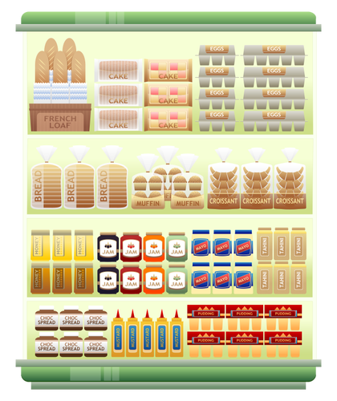
Examples of maths/numeracy in daily life: real life scenarios
PURCHASE OF FOOD: The supermarket is the best place to practice math! Shopping for food involves the application of many mathematical concepts, from multiplication to estimation and even percentages
When you calculate the price per unit, try to figure out the value of the discounts and percentages, weigh the products (additions), and estimate the final cost, you are using math to make your shopping experience easier. Without this knowledge, shopping can be very difficult and confusing, so these basic concepts are really helpful.

Slide 14
Examples of maths/numeracy connections in daily life: real life scenarios
COOKING can be a great time to practice some math. The recipes you follow are all based on important mathematical calculations, aimed at creating something tasty.
Here are some operations that are usually done when cooking:
Converting a recipe from metric (ml) to units such as a teaspoon, spoon, or cup
Multiplying / dividing the quantities according to the number of people
Calculation of cooking time
Proportions in cooking times
Measure the ingredients

Slide 15
The importance of numeracy skills in managing money
Do you have any suggestions on any other common uses of maths in the daily life of the families you work with?

Slide 16
Tea and coffee break

Slide 17
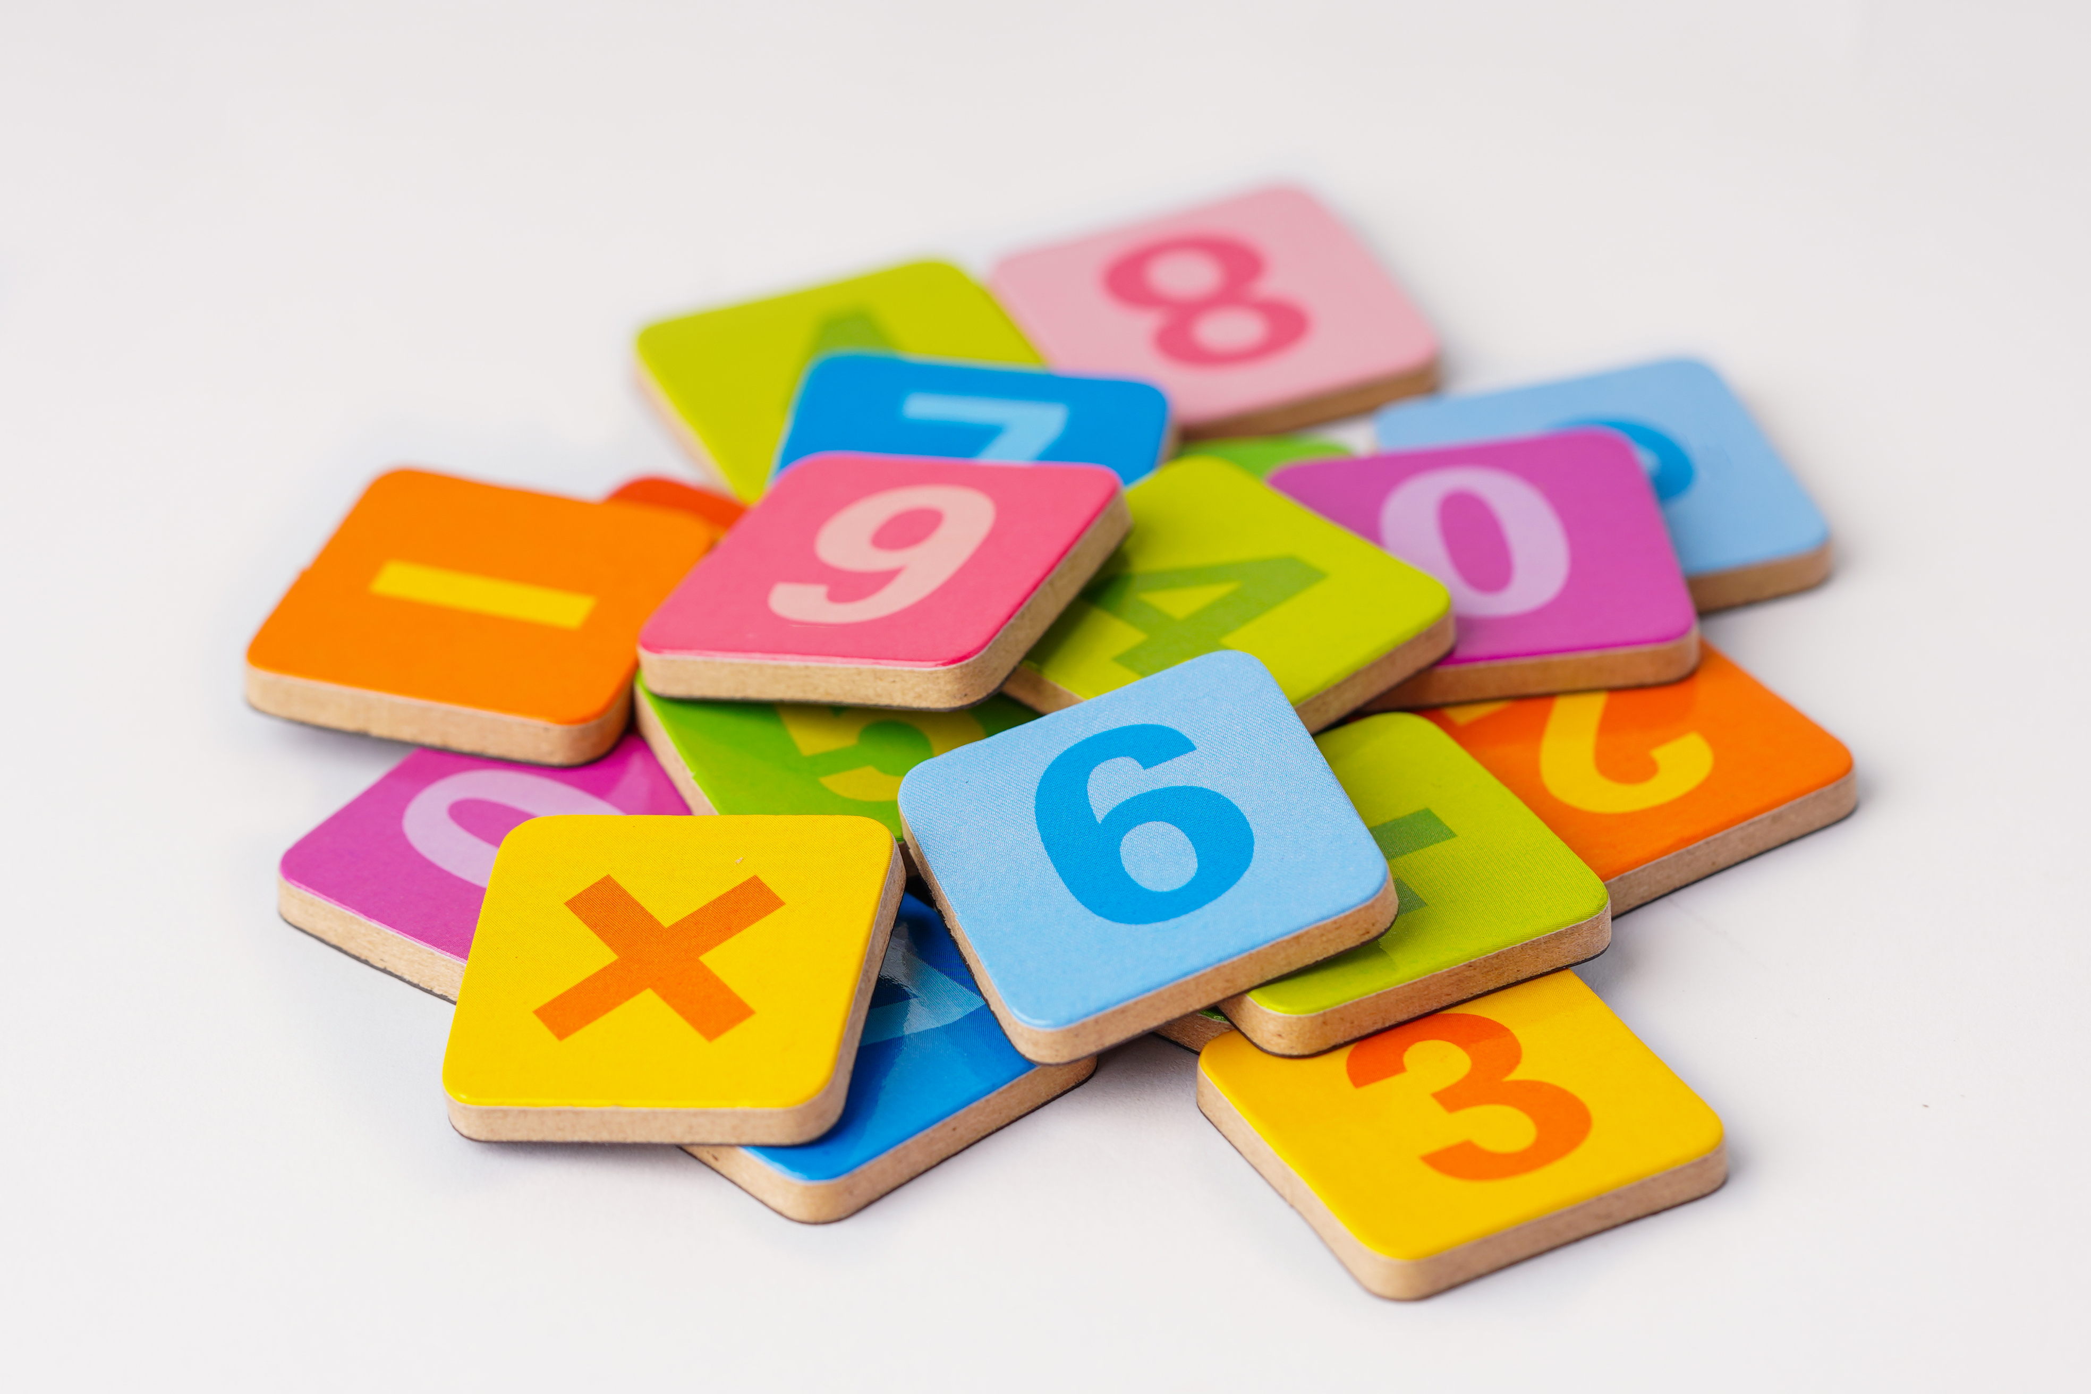
How can people identify their numeracy skills?
If you are working with families in need of financial literacy, it may be very helpful to identify THEIR MATHS LEVEL
BUT HOW??????
In fact, checking maths knowledge might be a bit tricky!

Slide 18
How can people identify their numeracy skills?
There are many online tools designed to test and teach maths and they can be fun and useful! Let’s see some of them:
https://www.bbc.co.uk/bitesize/articles/znsmxyc Parents toolkit
https://www.bbc.co.uk/bitesize/topicszjkphbk/articles/zf4sscw For children (Karate Cats)
These are BBC Bitesize web channels with various resources and games for children

Slide 19
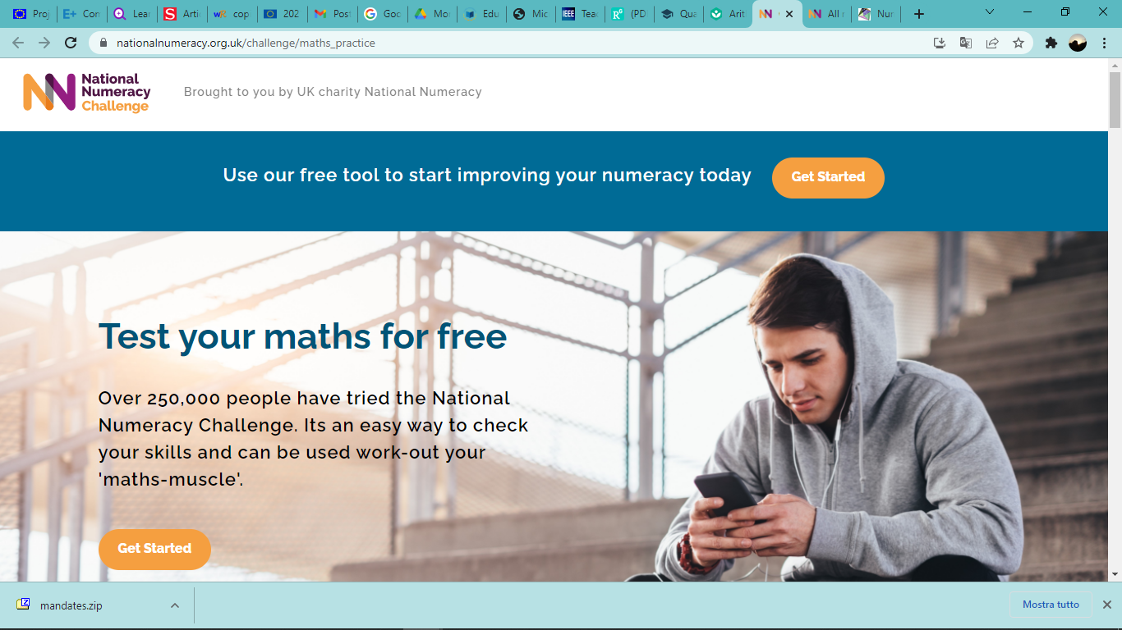
How can people identify their numeracy skills?
https://www.nationalnumeracy.org.uk/challenge/maths_practice
PW: MONEYMATTERS22 User: smanus82@hotmail.it – Name: Manu S.
Here you can test your maths level, learn how to teach maths to children, get further useful links to resources, and also find videos of people speaking about their difficulties with numeracy

Slide 20
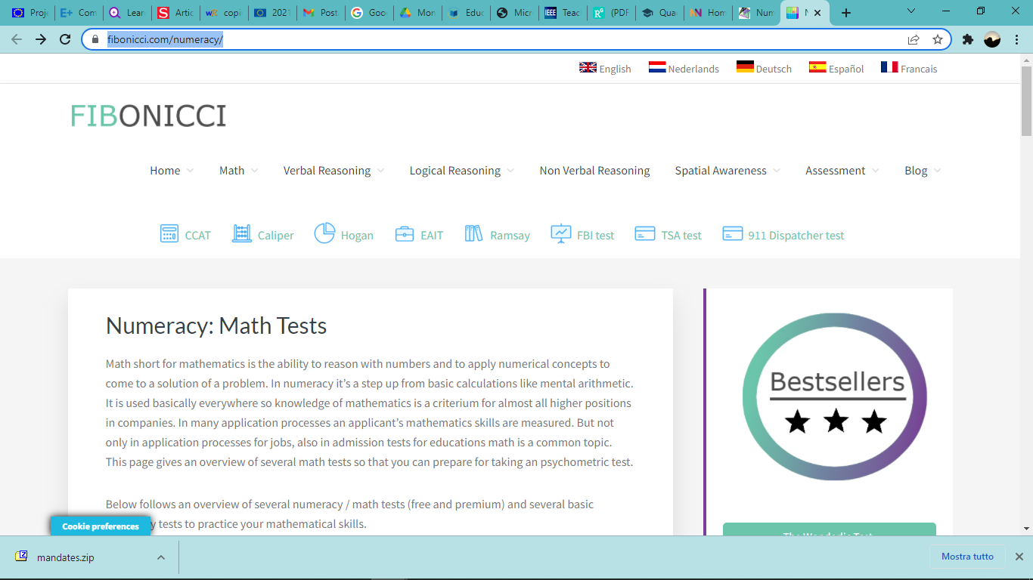
How can people identify their numeracy skills?
https://www.fibonicci.com/numeracy/
This is another very useful tool to check your maths level

Slide 21
Activity M5.3 Check the links in your own time.
You can find more useful links to resources on the HANDOUT M5.3
How can people identify their numeracy skills?
https://www.test-questions.com/qts-skills-test-numeracy-10.php
https://www.cgpbooks.co.uk/resources/cgp-s-free-online-10-minute-tests
https://www.basic-mathematics.com/second-grade-math-test.html
https://www.scie.org.uk/workforce/careskillsbase/files/skillschecks/18_usingnumbersincarework1.pdf
https://www.incharge.org/financial-literacy/resources-for-teachers/financial-literacy-for-kids/
https://www.mathcentre.ac.uk/resources/uploaded/numeracy-professional-skills-test-1-questions.pdf

Slide 22
How can people identify their numeracy skills?: CLASS EXERCISE!
Activity M5.4 Group discussion
How do you feel about checking your maths?
How might family learners feel about checking their maths?
TRY YOURSELF...CHECK YOUR MATHS LEVEL!
See the ACTIVITY SHEET M5.4

Slide 23
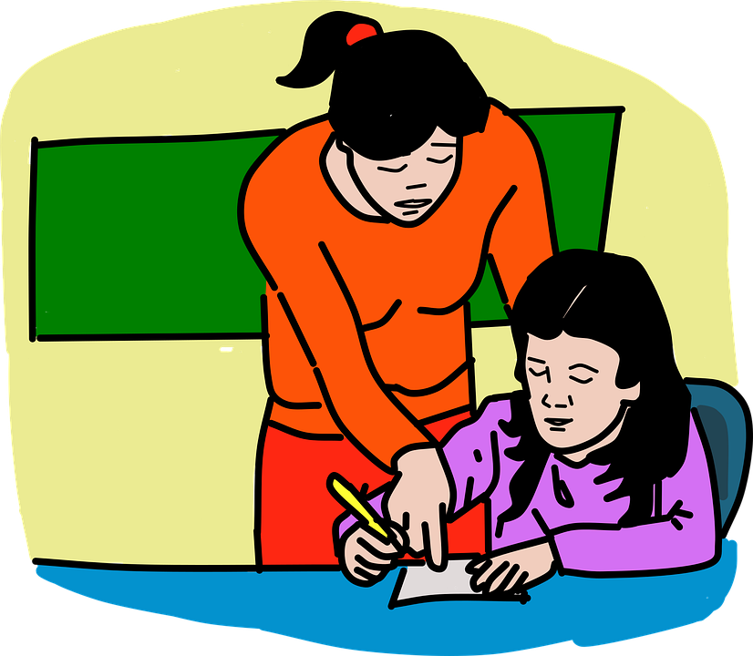
Parents as financial teachers
It is very important to provide children with adequate financial education in order to enable them to manage money and make good financial choices for their future.
The role of parents or guardians in teaching financial issues, is very important, as they can teach children how to manage money in a powerful way.

Slide 24
Parents as financial teachers: CLASS EXERCISE!
Activity M5.5
The financial topics to teach children often depends on their age.
Can you identify some financial topics to teach children depending on their age?
Please try to fill in ACTIVITY SHEET M5.5

Slide 25
Pre-schoolers
2-3 YEAR OLD children can learn the shape of coin money and how it is used. They can understand that:
money is the medium of exchange for most goods
different coins (and paper money) have different names
different coins have different shapes
different coins have different values
Notes:
I have schanged this to make more sense

Slide 26
Pre-schoolers
Parents can use online resources to start teaching numeracy to 2-3 yr olds
https://www.zerotothree.org/resources/3117-math4littles-earlymath-activities-for-two-and-three-year-olds contains a lot of useful tips and games to play with toddlers
https://www.parents.com/toddlerspreschoolers/development/intellectual/math-games-for-your-toddler/
https://www.youtube.com/watch?v=dihlSqall3k VIDEO «Learn to count with Number Farm”

Slide 27
Pre-schoolers
4- 6 YEAR OLD children can learn about the concept of money
children know numbers and can usually count (how many coins or other items are on a table)
parents can talk about concepts such as the difference between NEEDS and WANTS
NEEDS are things the family must have to survive
WANTS are things you like but could do without.
To explain to parents how they can teach their children the difference between NEEDS and WANTS let’s watch the following video: https://youtu.be/J8P3sCooGg0
Notes:
Layout changed

Slide 28
Pre-schoolers
SAVINGS: at this age, children can learn to divide their money into categories such as ‘save’, ‘spend’ and ‘share’
This way they will begin to learn how to delay gratification when it comes to money

Slide 29
School age
6 - 12 YEARS OLDs earning POCKET MONEY. This is the right age to start learning that money is earned and is limited in quantity.
It is useful to help children understand that in order to obtain small amounts of money it is necessary to do small tasks. This helps them to understand the link between work and money.
USEFUL LINKS: https://myboredtoddler.com/counting-activities-for-toddlers/ a lot of games to play with children to teach them maths
https://www.youtube.com/watch?v=gWT2m08lSfk a very interesting video full of tips!
MONEY MATTERS COMIC STRIPS!!!

Slide 30
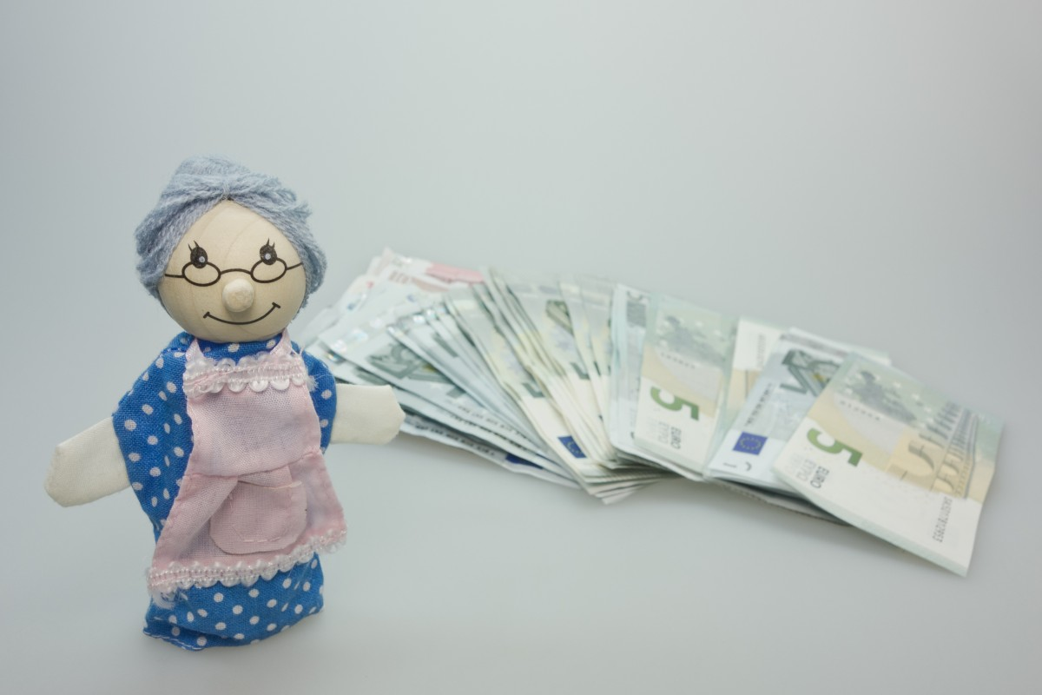
School age
6 - 12 YEAR OLD children at elementary/primary school learn to add, subtract, multiply and divide.
This is the time when children can manage small amounts of money and keep track of their small purchases.
Useful thing to do with children:
give them small allowances or pocket money
help them understand written spending plans or budgets
encourage them to keep track of their money and spending on their needs
and wants
ALL THESE ACTIONS WILL HELP CHILDREN TO BECOME FINANCIALLY RESPONSIBLE ADULTS.
Notes:
As above

Slide 31
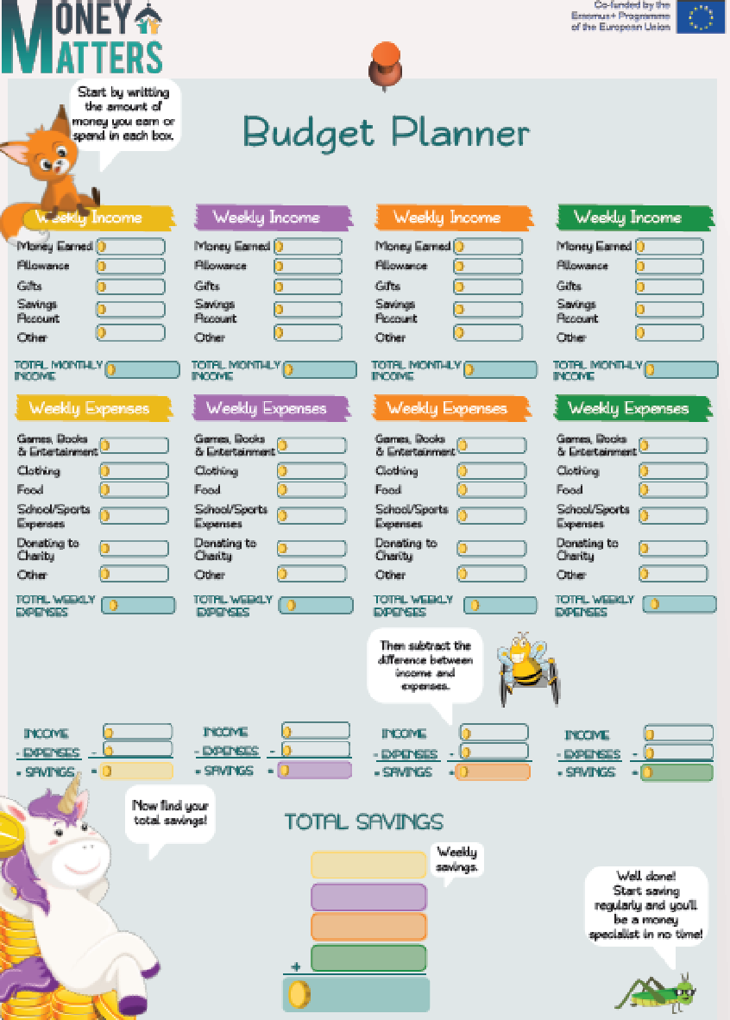
School Age: Money Matters Comics
You can use the MONEY MATTERS BUDGET PLANNER!
This is helpful for teaching children how to spend and save money each week/month/etc

Slide 32
School age and teenagers
13-18 YEARS OLD: teenagers are mature enough to learn different financial concepts such as:
the importance of not being heavily influenced by advertising
money management and the danger of debt
Planning and budgeting
USEFUL RESOURCES :
https://moneymatters.ccpc.ie/wp-content/uploads/2020/09/2020.09.10-S4-Case-Study-Alex.pdf
MONEY MATTERS ESCAPE ROOMS!!!

Slide 33
Young adults
19 YEARS OLD ONWARDS are young adults and the ‘child’ has begun a path towards independence from parents. In this period they may ask for more money to out with friends or buy something they want.
They can be encouraged to do a part-time job to understand that they have to earn money and it is better not to waste it.
It is important to teach them how to save and manage their money effectively and possibly use a personal PLAN.
MONEY MATTERS APP!!!

Slide 34
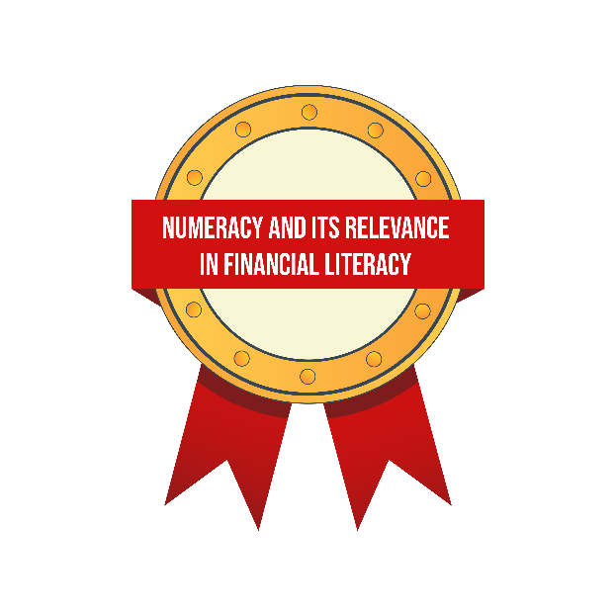
Self study tasks:
Explore the links on handout M5.3.
Explore the Parent Induction Training materials for Sessions 7 & 8.
Go online to the Money Matters Financial Literacy Library to complete the Digital Badges for Module 5.

Slide 35
Thank you for attending, we hope you find this useful.

