Slide 1
Financial Literacy for Families
Train the Trainer Module 6
Creating and using digital resources

Slide 2
Learning Outcomes: Creating and using digital resources
Learning Outcomes: Participants will be able to:
Consider the benefits and challenges of using digital resources
Explore some digital resources

Slide 3
Module 2 Visual Plan for the session
Learning
outcomes
Warmer
Using and creating digital resources
Introducing an Escape room
Motivation and digital learning
Creating your own Escape room
Looking at the Money Matters App
End

Slide 4
Activity M6.1 Warmer Draw how you feel!
How do you feel today?
Online: Whiteboard Offline: Draw it!

Slide 5
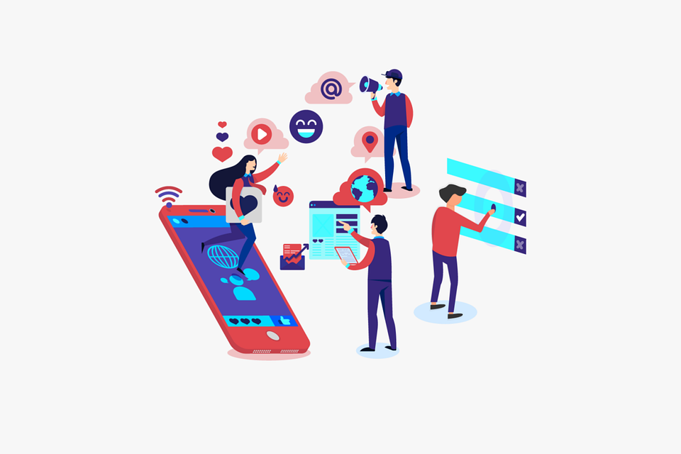
Activity M6.2 Using digital resources
How and what digital resources could help individuals to upskill in financial literacy and accelerate their learning?

Slide 6
Creating digital resources e.g. A Quiz
A useful digital resource to assess learning is through the creation of a quiz. Online quizzes can be created across a multitude of online platforms including:
Google Forms
Socrative
Kahoot
Quizzes help with concentration, identify gaps in knowledge, build confidence and help learners to retain information.

Slide 7
Creating Digital Resources e.g. A Video
Introducing media-rich video resources can facilitate visual learning. Videos can demonstrate skills and talk about topics in engaging ways. You can create videos online through the following platforms:
PowToon
Animoto
Canva
Videos tend to create discussion, engagement and reflection opportunities within learning environments.

Slide 8
Motivational digital learning models
Blended, flipped learning
Learning models can promote learner engagement and may motivate individuals to become more financially literate.
Learning models will differ with target groups.
Learning Models
Online, live instruction
In-person instruction
Technology-based learning

Slide 9
Using digital resources as a ‘Learning Accelerator’
Below are three approaches to using digital resources that can support the effective delivery of financial education:
1) Blended Learning
Allows students to engage with the material at their own pace.
2) Personalisation
By understanding the needs of each student, you can target the areas that require focus.
3) Collaboration
Development of higher-level thinking, communication, self-management, and leadership skills..

Slide 10
Benefits of digital learning:
Build 21st century skills.
Open learning environments beyond the physical classroom.
Gain learners’ interest and curiosity through inquiry-based learning.
Develop effective self-directed learning skills.
Facilitates personalised learning.
Builds interest and self-confidence.

Slide 11
Challenges associated with using digital resources
Teaching using digital resources can create non-traditional learning environments.
However, it is necessary to be aware of the challenges that can arise in order to overcome potential learning barriers.

Slide 12
Activity M6.3 Challenges associated with digital resources
What challenges could you face with digital resources?
Consider online and offline digital settings…

Slide 13
Challenges associated with digital resources
Adapting content to a digital or online format (material design, class length, etc.)
Adapt:
Finding new ways to engage with and motivate learners.
Engagement:
Feeling competent to teach through digital technologies.
Upskill:
Addressing and overcoming a possible lack of digital skills among learners.
Enhance Digital Skills:
Considering personal data protection issues in a digital environment.
GDPR:

Slide 14
Activity M6.4 Digital learning resources – Introducing an escape room
Identify any digital resources you have used to teach financial literacy
Let’s take a look at a Money Matters Digital Escape Room:
Money Matters - Interplanetary Interchange Digital Escape Room

Slide 15
Tea and coffee break

Slide 16
Creating your own Digital Escape Room
A Digital Escape Room comprises a series of linked mini-games, challenges, questions and puzzles for learners to answer. It is an immersive online experience.
They work on the same basis as an ‘Escape Room’, where learners need to think on their feet to solve challenges and escape. This is simulated through an online scenario.
Digital Rooms are often presented using
Google Forms Creating a Digital Escape Room

Slide 17
Activity M6.5 Creating your own Digital Escape Room
Step 1: Split into groups of 2 or 3 people.
Step 2: Pick from one of the following topics:
Financial planning.
Debt management.
Dealing with financial institutions.
Step 3: Create a Digital Escape Room with 3 challenges.
Step 4: Share with the group.
This Photo by Unknown Author is licensed under CC BY-SA-NC

Slide 18
Activity M6.6 Looking at the Money Matters App
This is a digital resource that explores:
financial vocabulary
savings plans
budgeting
links to financial management resources and help

Slide 19
How could you use the Money Matters Digital Resources?
For Parents
and Guardians
A training programme aiming to tackle financial literacy using a workshop-based approach
Support for parents and guardians to use the family learning model
For Youth
19 to 25 years old
A mobile App encouraging learners to develop financial plans to respond to financial situations
A personal or family budget planner
Links to local support agencies
For Teenagers
13 to 18 years old
Six Online Educational Escape Room challenge -based learning resources
Their scenarios will be related to effective financial management
For Children
6 to 12 years old
12 monthly editions of themed comics
Covering some basic good financial principles
Notes:
Delete

Slide 20
Considerations
In your teaching sessions you can use the Money Matters digital resources or create your own to engage your learners to build financial literacy skills:
Firstly, find out which digital tools are best for you and which ones will support your training.
Secondly, specific uses for resources vary. Some will streamline processes, facilitate activities or create virtual educational spaces.
Thirdly, these resources can make learning processes more entertaining for participants.

Slide 21
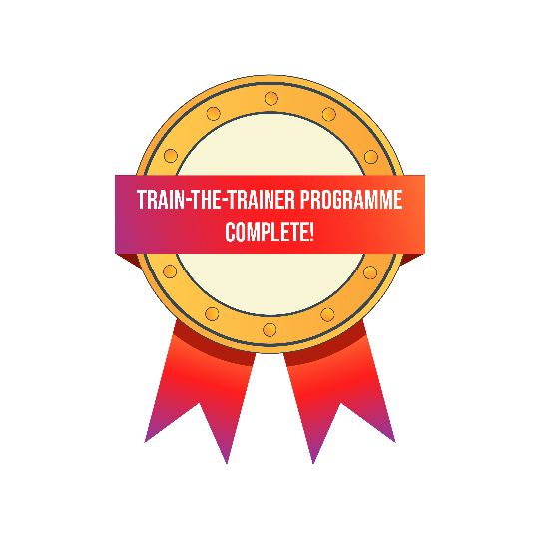
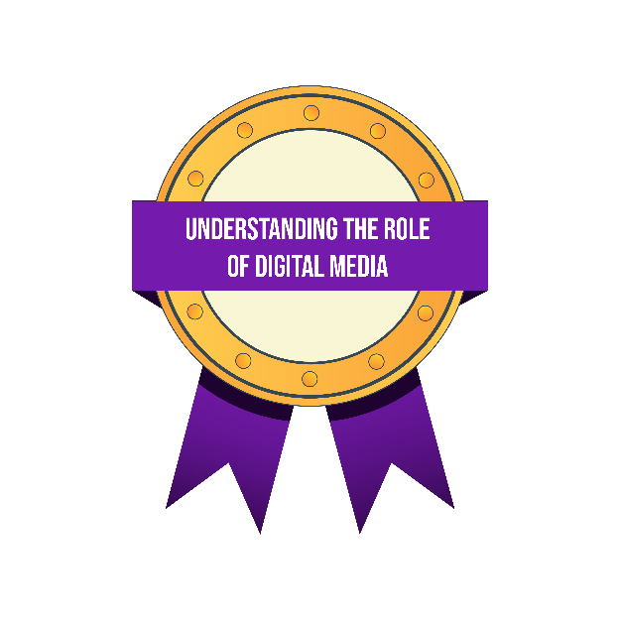
Self study tasks:
Have a go at creating your own digital learning resources – an online quiz, wordsearch or escape room.
Go online to the Money Matters Financial Literacy Library to complete the Digital Badges for Module 6.
A final training survey will be sent to you to complete.

Slide 22
Thank you for attending, we hope you find this useful.

