Slide 1
IO3: Financial Literacy Training for Parents
Module 3: Financial Online Resources and Tools

Slide 2
Financial Online Resources and Tools Learning Outcomes
By the end of this module, parents and carers will be able to:
describe the risks related to electronic and online payments
recognise a trustworthy site for online payments
use the most common platforms safely
pay safely by avoiding fraud, scams and phishing etc.

Slide 3
Financial Online Resources and Tools Visual Plan
Activity – Find Someone Who..
Risks and benefits of online shopping
Making payments when shopping
End
Break – 10 min.
Activity – Discussion
Activity – Avoiding frauds and scams
Security for online purchases

Slide 4
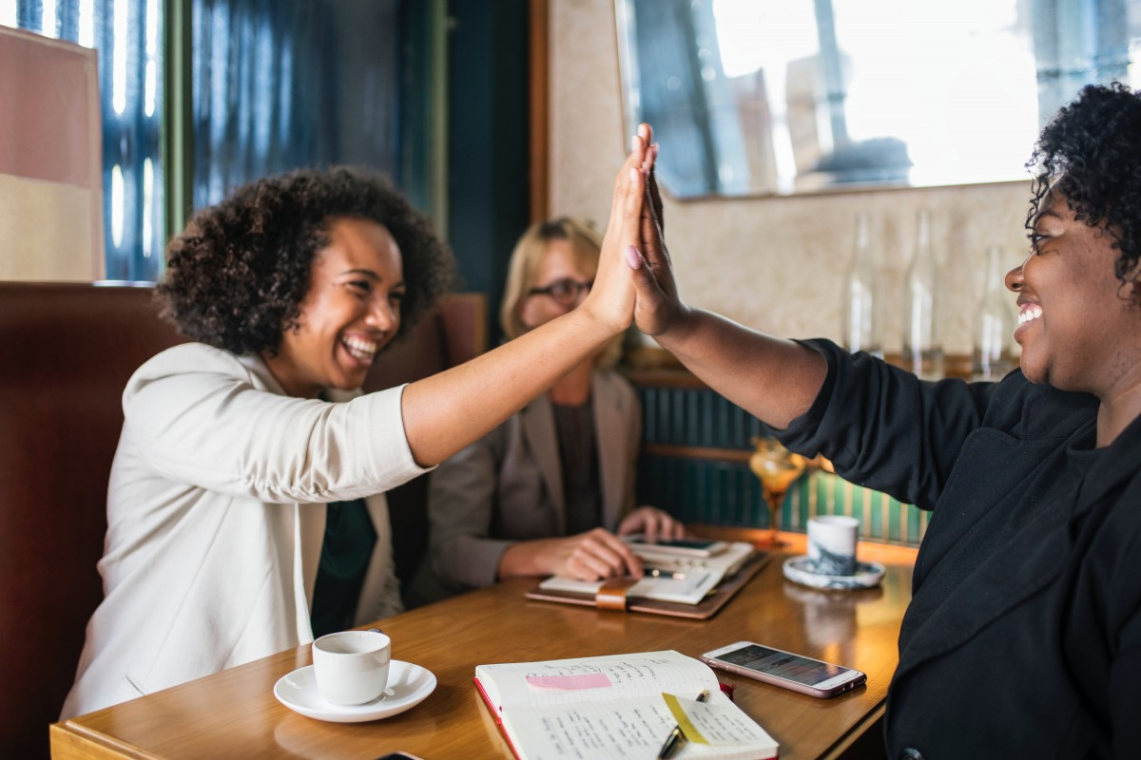
Financial Online Resources and Tools Warmer
Activity M3.1
Find Someone Who….
Find someone who matches the description on your card and find out their name and something else about them so that you can introduce them to the group.

Slide 5
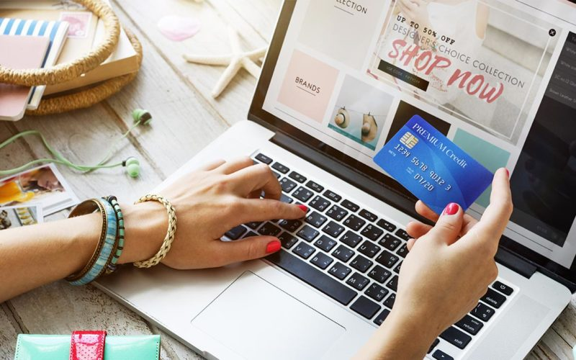
Financial Online Resources and Tools
Activity M3.2
Are online payments safe?
In small groups list as many risks and benefits of online shopping that you can think of. Share these with the group.

Slide 6
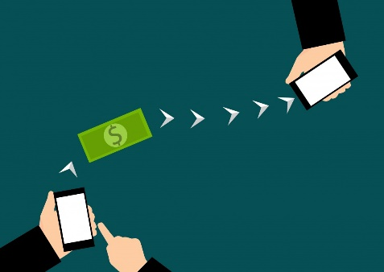
Financial Online Resources and Tools
Risks related to electronic and online payments
Thanks to the internet, our lives today are more interconnected than ever. This includes our financial choices and actions which have become increasingly digital.
Like everything this has both benefits and risks:
BENEFITS
RISKS
Comparable Information: People can check and compare different types of offers for the same product
Comfort: People can buy almost anything from their sofa
Efficiency: You can buy the goods very quickly
Inclusion: More people than ever can buy things using their laptop or smartphone
Exclusion: The digital divide
Impulsive use: People may buy more unnecessary things
Fraud and scams: Through electronic or online purchases there are more opportunities for frauds and scams to claim victims
Data loss: Online payments require the provision of a lot of personal information

Slide 7
Financial Online Resources and Tools
Risks related to electronic and online payments
ARE ELECTRONIC/ONLINE PAYMENTS SAFE? This is a very common question asked.
The answer is YES! Electronic payments are safe, but it is necessary to take certain precautions in order to avoid frauds, scams and mistakes.
In this module we will discuss how to manage online tools for making electronic payments without problems.
THE FIRST THING BEFORE BUYING ANYTHING ONLINE IS TO HAVE
GOOD, UP-TO-DATE ANTI-VIRUS SOFTWARE ON YOUR PC and SMARTPHONE !!

Slide 8
Financial Online Resources and Tools
Websites
Activity M3.3
Find a website on your smartphone or tablet that you use to make online payments.
How do you know this website is secure and safe to use?

Slide 9
Financial Online Resources and Tools
Making safe payments
Before buying anything online, make sure the website is trustworthy by checking if the connection is encrypted. This ensures that your credit or debit card details are not intercepted while connected to internet thanks to the latest security standards, such as Verified by Visa, MasterCard Secure Code, Norton Secured.
If you see a gray or green padlock and https: // the connection is secure.
If there is a red triangle with exclamation mark on the navigation bar, this means that the connection is not to be considered secure.
To understand if the connection to a website is safe and to avoid those sites that have the aim of stealing sensitive data from its visitors, it is essential to ensure the presence of the SSL Certificate, which is a protecting protocol.
HOW?
By looking at the address on the navigation bar.

Slide 10
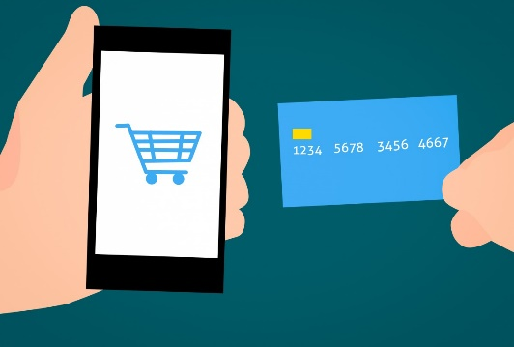
Financial Online Resources and Tools
Entering a secure site
SECURITY MEASURES FOR ONLINE PAYMENTS
Among the main security measures envisaged by E.U. legislation there is strong customer authentication (SCA) based on the use of at least two of the following factors:
something that the user knows (e.g. a password)
something that the user owns (e.g. a token or similar)
something about them (e.g. a fingerprint);
For greater security with internet payments, it is envisaged that authentication generates a dynamic and unalterable code, also called 2-factor authentication (2FA) e.g. when there is a one-time code sent to your phone in addition to asking for password)

Slide 11
Financial Online Resources and Tools
Activity M3.4
Websites
Find a shopping website on your smartphone or tablet
How do you know the website is secure and safe to use?

Slide 12
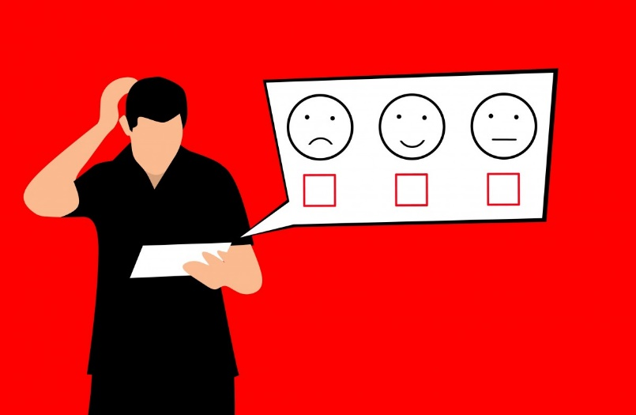
Financial Online Resources and Tools
How to safely use the most common store platforms
To shop online safely, you must first check the reliability of e-commerce to avoid making purchases on online stores run by cybercriminals
HOW?
After verifying if the website is secure, it is important to check the
Web reputation of the website.
To do that, you can visit some online portals where users express their opinion on the webstore or on suppliers e.g., Trustpilot, google, etc.

Slide 13
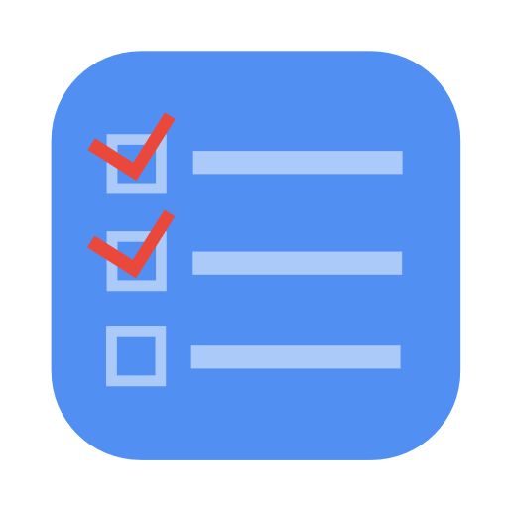
Financial Online Resources and Tools
Activity M3.5
Online safety
Look at the list of payments on your handout.
List the issues ‘for’ and ‘against’ each method.

Slide 14
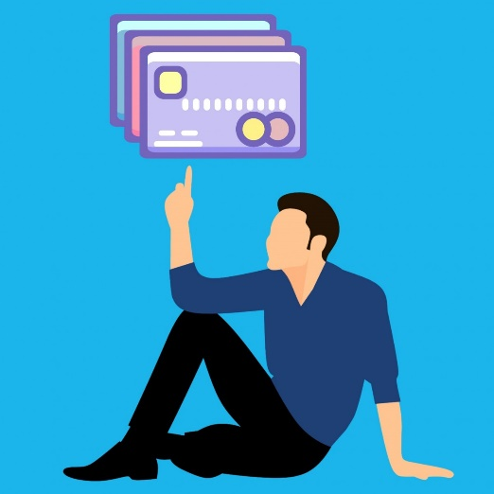
Financial Online Resources and Tools
How to pay safely…… it depends on the type of payment made….
BANK CARDS (credit/debit/pre-paid)
Pay attention to the card:
avoid losing it!
keep the PIN safe,
if you lose your card immediately block it by calling your bank.
This is very important with contactless cards which can be used
for small amounts without a PIN.

Slide 15
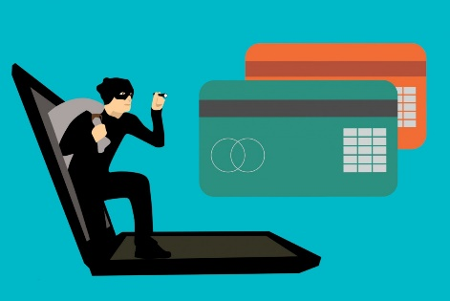
Financial Online Resources and Tools
How to pay safely
BANK CARDS (credit/debit/pre-paid)
Check your account balance regularly: despite all precautions you can still be the victim of fraud. That is why it is important to check your account balance regularly. Then you can detect unauthorised activity. If there is something wrong, you should immediately call your bank.
Use different passwords or codes for each website and your bank: it is important to use different passwords for each website you visit to avoid your personal information being stolen by a web-thief discovering that your banking password is the same as your email one.

Slide 16
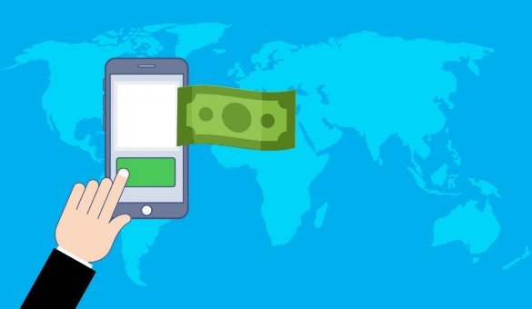
Financial Online Resources and Tools
How to pay safely
PAYMENT SYSTEMS (Paypal, Google Pay, Wise, etc.)
These services act as an intermediary between your bank / card and the online seller. Thanks to this service it is possible to make purchases safely because it verifies the reliability of the e-commerce site.
This way, anyone who makes payments online does not have to disclose their sensitive data. In addition, this service guarantees a refund of the purchase in case of problems with the products.

Slide 17
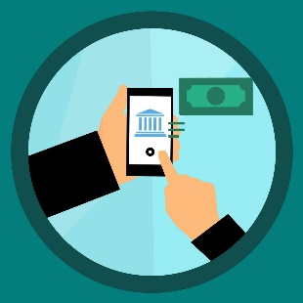
Financial Online Resources and Tools
How to pay safely
BANK TRANSFER OR POSTAL TRANSFER
Online payment by bank transfer or postal transfer is a very safe method, because it tracks and guarantees the payment made in case of scams or problems.
However, it is not necessarily the best payment method for e-commerce as it can be a slow method. The transfer may take longer so your order will take longer to reach your home.
Also, it is important to type the IBAN or account number carefully as a service provider is not responsible for the failure or incorrect execution of the payment if the details provided by the customer are incorrect.

Slide 18
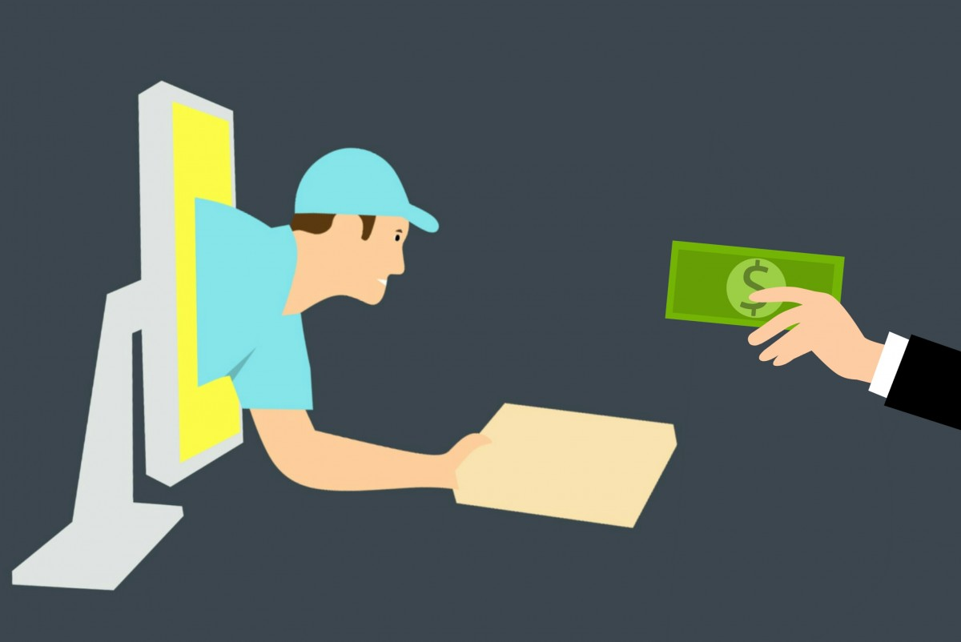
Financial Online Resources and Tools
How to pay safely
CASH ON DELIVERY
It is a very safe payment method that allows you to pay when you receive the product at your home.
However, the cash on delivery often has a higher cost than other online payment methods and is not always offered by online sellers.

Slide 19
Financial Online Resources and Tools
Tea and Coffee Break

Slide 20
Financial Online Resources and Tools
Making a secure online purchase … The O’Connors buy a washing machine
The O'Connor family needs to buy a washing machine and they order it online.
Firstly, they search for the most suitable model for them by checking the descriptions on the internet.
Secondly, they check for a web store and for suppliers that are more reliable in terms of secure payments through:
web reputation of the shop and suppliers using an online review website
the security of the web shop’s page by checking the address bar of the website to see if there is a red triangle or red padlock

Slide 21
Financial Online Resources and Tools
Activity M3.6
Making a secure online purchase....The O’Connors buy a washing machine
After verifying the site, the O'Connor Family purchase their washing machine using a prepaid card as the safest payment method available to them as they have no Pay Pal account. In a week they receive the washing machine at home!
Reflective questions:
Which kind of payment do you prefer for online purchases?
Do you know any webpage for webstore reviews?
Have you ever bought something online without checking before the reliability of the webstore?

Slide 22
Financial Online Resources and Tools
Part A: Making a secure online purchase? Michael makes an online payment
Michael receives an email from his bank asking for an immediate payment of £85/euros which has been suspended and could increase if not paid immediately. In the email is the payment link. Michael, alarmed, immediately clicks on the link and makes the payment using his card details.
A few days later his bank calls to say they have noticed suspicious, repeated payments of £600 /euros at a time. At that point Michael realises he has been scammed and asks the bank to immediately block his card and get back the money lost in the scam.
The bank replies it will try but is not at all sure the money can be returned.

Slide 23
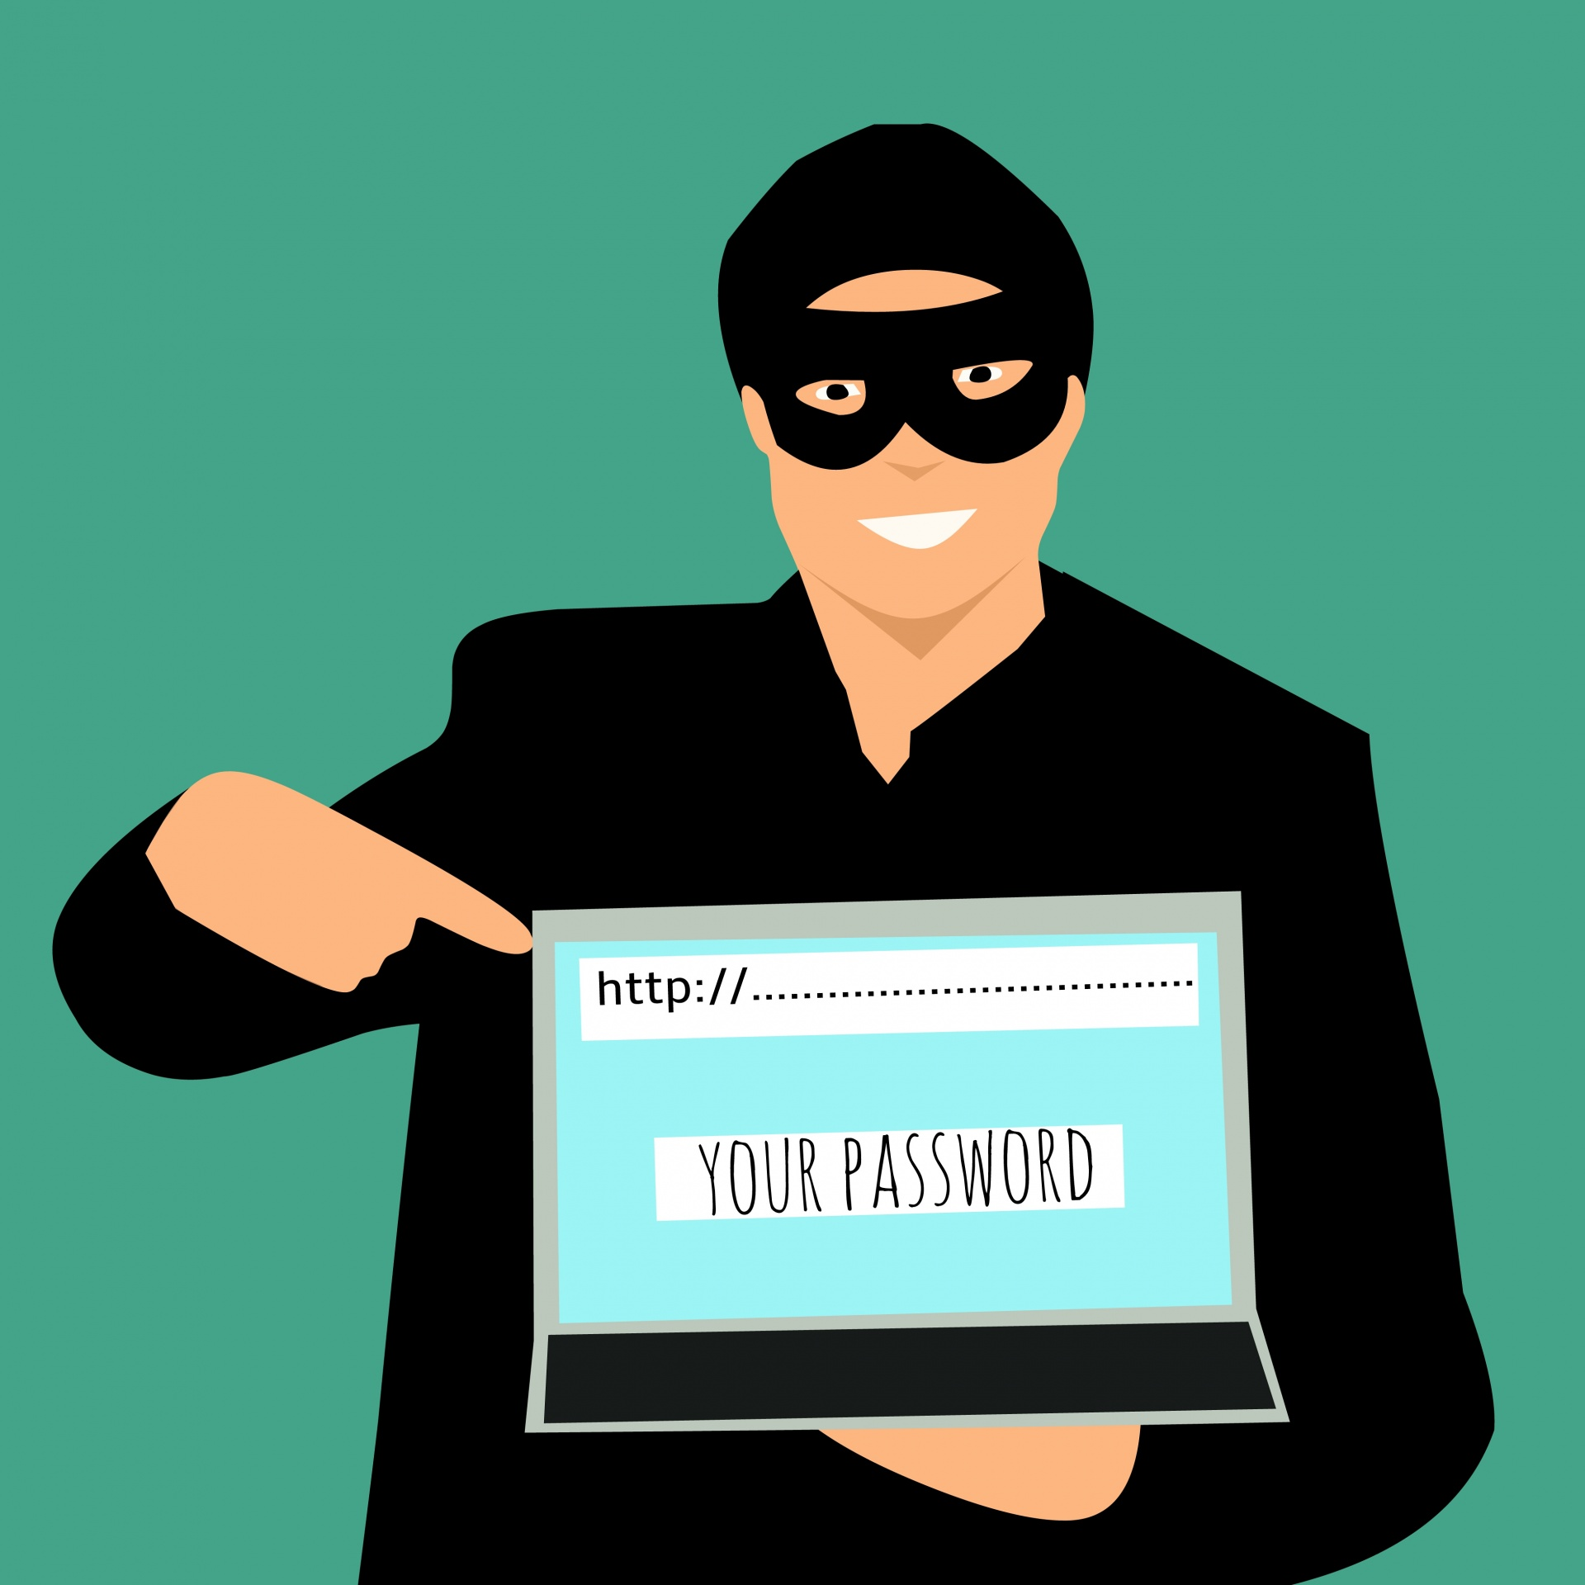
Financial Online Resources and Tools
Activity M3.7
Part B: Consider the reflective questions in the handout
Part A Michaels online payment
Part B Reflective questions
Part C What should Michael have done to avoid the scam?
----------------------------------------------------------------------------------------------------------------------------------------------
Part C What should Michael have done to avoid the scam?
Do not open the email Yes, never open any suspicious emails, especially if they have a strange phrase in the subject line.
Open the email but don't click on the link provided Absolutely yes! Never open a payment link received from a bank email without calling the bank first for confirmation.
Open the link but do not write the card credentials While it is not recommended to open any suspicious link, it is essential to at least not write the details of the card.
Call the bank immediately Yes, if you have any doubts, better call your bank.

Slide 24
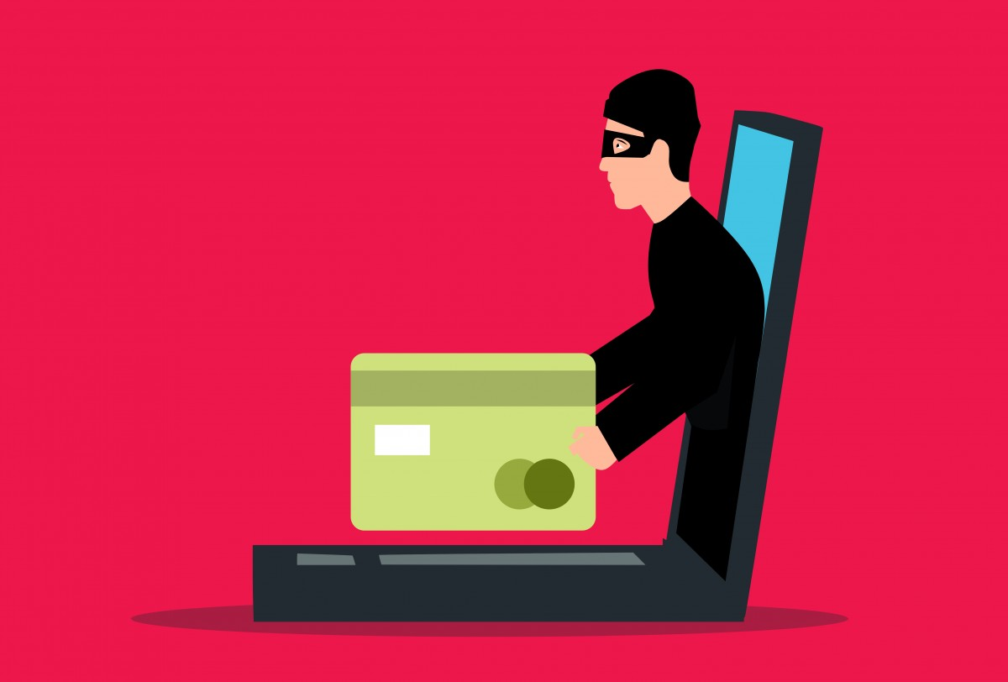
Financial Online Resources and Tools
How to pay safely
WHAT IS PHISHING?
Phishing is a scam with the purpose of stealing personal data e.g credit card number or access keys to the home banking service.
It is carried out by scammers who send fake emails that appear to come from a bank or credit card company. The e-mails invite the recipient to connect via a link to an Internet site similar to that of the bank and to enter confidential information.
With the data obtained by deception the scammer can carry out banking transactions in the victim's name or exploit his credit card.

Slide 25
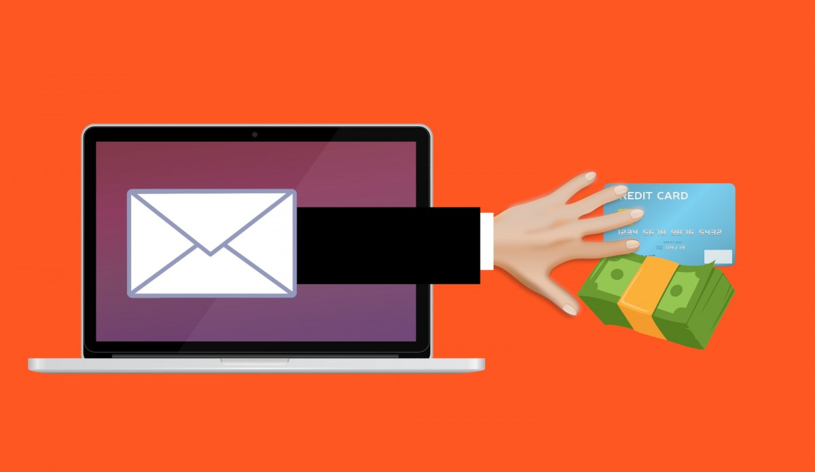
Financial Online Resources and Tools
How to pay safely
PROTECTION FROM PHISHING
NEVER open suspicious links or emails. These are often impersonal, have spelling and grammar errors, no deadlines and often ask for personal data or bank account details.
NEVER provide your bank or personal details unless you have verified the request.

Slide 26
Financial Online Resources and Tools
Activity M3.8
Discussion
Divide the participants into small groups:
Each group represents either the SELLER in possession of a furniture shop which offers e-commerce services
or the BUYER who has £1,000/euros to spend
Activity - Identify the most suitable form of payment for the Seller and alternatively the Buyer considering:
the buyer does not have a prepaid card only a debit card,
the buyer has a computer but is unsure of the effectiveness of their anti-virus software,
the buyer wants the cheapest option available.
Discuss the issues as groups from the viewpoints of both seller or buyer.

Slide 27
Thank you for attending. For more resources, visit the Money Matters website: https://moneymattersproject.eu/

