Slide 1
IO3: Financial Literacy Training for Parents
Module 7: Family Learning

Slide 2
Family Learning Learning Outcomes
By the end of this module, parents and carers will be able to:
Discuss with their children the importance of the appropriate use of money using the right vocabulary and methods.
Explore using financial online tools with their children including those provided by the Money Matters project.

Slide 3
Family Learning Visual Plan
Word Search
Activity – discussing money with children
Pre-school children and money
End
Break – 10 min.
Activity – Teenagers and money
Money Matters Comics and Escape Rooms
School-age children and money

Slide 4
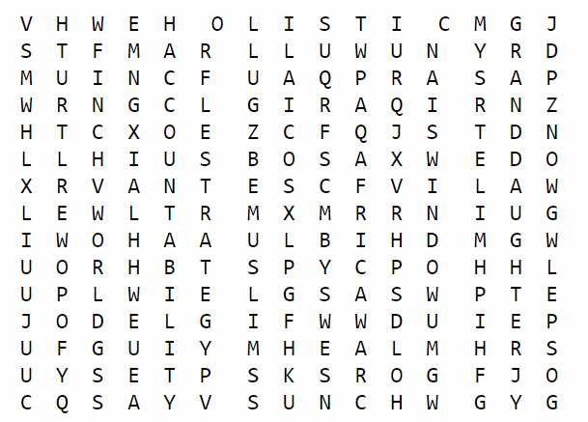
Family Learning Warmer
Activity M7.1
Word Search
Find a partner who you have not worked with before.
Together complete the word search M7.1.
Check your answers.
Discuss what age children might play this word game and how might you use it?

Slide 5
Family Learning
Introduction
Parents are their children’s first and most effective teachers, so the family is the perfect environment to teach children how to manage money in a powerful way. Not all parents are financial experts, but they are experts in their children.
It is important to provide children with good financial education to enable them to manage money and make good financial choices for their future. This module will support parents and guardians to talk to their children about money using some simple strategies.

Slide 6
Family Learning
Activity M7.2
Children and money
Do you usually talk to your children about money?
What age do you start to teach children about money?
What do you teach them in terms of concepts?
What methods, and how do you teach them at various ages?

Slide 7
Family Learning:
Activity M7.2 cont.
Pre schoolers teaching activities
Group 1: Identify 2 money games for 2-3 year olds
Group 2: Identify 2 money games for 4-6 year olds

Slide 8
Family Learning
Preschoolers
The financial topics to teach to our children depend on their age:
PRESCHOOL AGE - 2-3 years old: the first ideas to teach children are:
some basic words such as pounds/euros, pennies/cents, piggy bank, savings, purse etc.
basic concepts around money such as:
the shape of real money
a place for money
helps children to understand that money is real and solid
helps children to understand you can put money in or take money out of a bank

Slide 9
Family Learning
Preschoolers: Play games with children
Games to play: 2-3 years old:
You can draw money with your children (both coins and notes) at home.
Explain the different values and what sweets or toys you can buy with each value.
Ask them to guess which coin or notes you can buy more items with.
They can practice with you when you go to the cash machine or bank to get money.
Play with real or pretend money (but beware of swallowing small coins).
Give them a piggy bank for savings to rattle and shake.

Slide 10
Family Learning
Preschoolers
4-6 years old: at this age, children are able to learn the concept of money as they learn numbers and can recognise, for example, how many objects or coins there are on a table. From this moment parents could start talking with children about concepts such as:
The difference between NEEDS and WANTS:
NEEDS are things the family must have to survive
WANTS are things you like but you could survive without

Slide 11
Family Learning
Preschoolers
4-6 years old cont:
savings and budgeting: with a set amount of money buy the necessary things first and then you can choose whether to spend anything left over (if any) on what you would like or you can save it
how to earn money: by explaining the meaning of the work (or the government support) and then where money is kept (bank).

Slide 12
Family Learning
4-6 years: Play games with children
Games to play: 4-6 years old:
Plan a day out together within a set budget.
Set up a little shop with toys as the customers.
Create a play shop using cardboard boxes and write out imaginary prices.
Explain to your child why you decide to buy certain things and not others.
Involve your child at home in the choice of things to buy (perhaps from a catalogue) talk together about what is a good deal and what is not so good.
Describe which things your family needs and which they don’t. (You can say why you prefer healthier fruit juice instead of a fizzy drink for the same price).

Slide 13
Family Learning
Tea and Coffee Break

Slide 14
Family Learning
School age and pocket money
BETWEEN 6 AND 9 YEARS OLD: This is a good time speak about what children can purchase with a given amount of money and the importance of choosing between different options.
Children will now be learning to add and subtract and it helps them to understand how much money is needed to buy something. Also, at this age, parents might increase financial rewards or pocket money for doing small jobs, tidying their room (or even doing their homework).
TIPS:
Many children have a piggy bank to practice saving. This way, children can start planning how (and how much) to save in order to buy something they want (see Money Matters comics)

Slide 15
Family Learning
Activity M7.3
School age: Cash machine or role play
Teach children to understand how selling works.
Create a pretend shop, maybe with a cash machine where you play the buyer and your child the seller (or vice versa).
Using fake or real money, pay for the items and ask your child to give you the correct change.
Help your child to check change and maybe ask them to tell you if you gave them the correct change if you are the seller.

Slide 16
Family Learning
School age
FOCUS ON: POCKET MONEY
Through pocket money, children begin to understand the value of money. This allows them to understand both the positive (e.g. saving to buy ‘needs’ or wants’) and negative (e.g. losses) consequences of managing their money.
HOW MUCH GIVE TO YOUR CHILD?
It depends on:
the age of your child
your family’s income
which kind of purchases the pocket money should cover
The most important thing is to explain these decisions to your children to help them understand your reasoning.

Slide 17
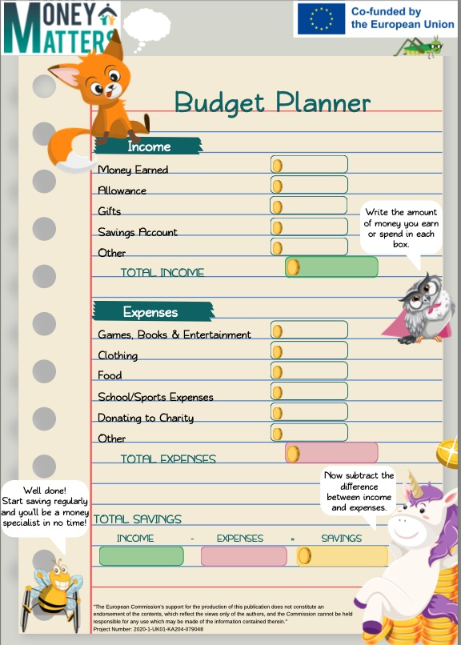
Family Learning
School age
You can use the MONEY MATTERS BUDGET PLANNERs with your child!
This could be helpful to teach them how to spend and save money each week/month/etc.

Slide 18
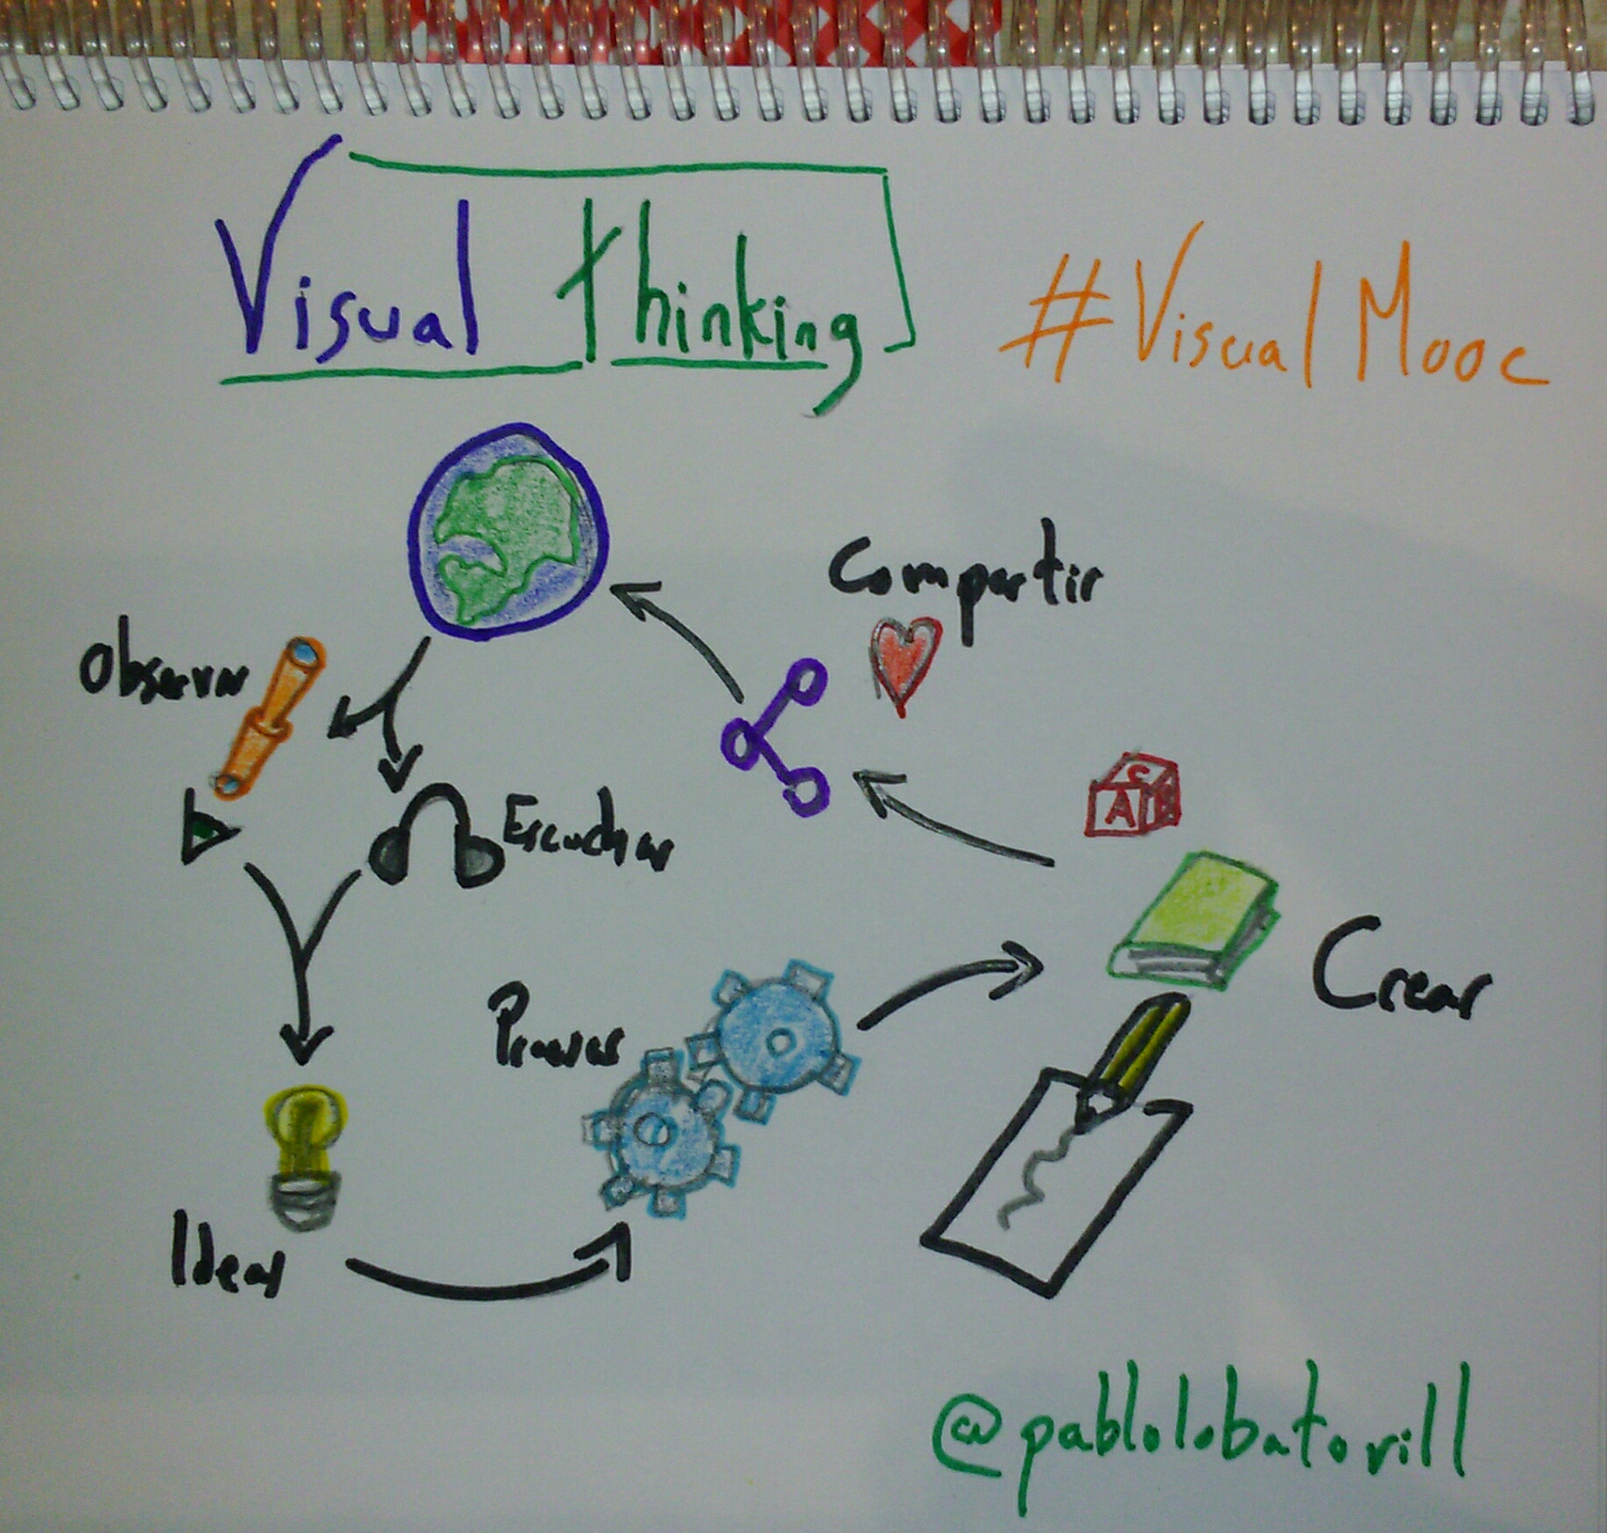
Family Learning
Activity M7.4
Discussion and visual representation
What are some of the financial issues for older children and young teenagers?
In small groups:
create a mindmap
or a chart
or any visual representation
…that represents some of these issues.

Slide 19
Family Learning
PRE and early TEENS
BETWEEN THE AGES OF 10 AND 15, young people understand financial concepts:
As children grow up they can get more freedom over their money and how they spend it.
It is important to guide children towards saving money rather than spending it all.
This is the perfect time to:
Talk about the importance of not being influenced by advertising.
Let children start managing their money.
Teach them about the danger of debt.
Support them to plan and manage their budgets.

Slide 20
Family Learning
PRE and early TEENS
The Money Matters Library of resources covers all of the points we have discussed in the comic strips and the escape rooms – take a look at all the resources online.

Slide 21
Family Learning
Activity M7.5 Optional
A demanding teenager
Marie and John’s 17-year-old son Eric is going through a difficult time in his life. He refuses to go to college and look for a job. It seems that his only goal is to go out with his friends. That’s why every week he asks his parents for money to have fun with his group of friends.
Marie and John do not have enough money to meet Eric’s demands and are really concerned about the behaviour and lifestyle of their son and do not know how to do.
Think about what you might suggest to Marie and John about his demands for money.
See Handout M7.5

Slide 22
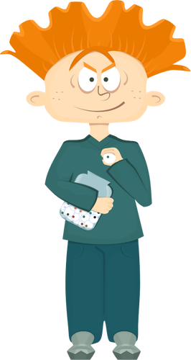
Family Learning
Teens
From the age of 16 onwards the "child" is an adolescent and has begun their path towards complete independence from their parents.
In this period teenagers often asks their parents for more money, in order to go out with friends or buy something they want.

Slide 23
Family Learning
Teens
It’s always crucial to set limits and make teenagers understand that they can't always get all the money they want and they must be careful how they spend their money.
Teenagers can be encouraged to do a part-time job so they can understand that they will have to earn money as they grow up and it is best not to waste it.

Slide 24
Family Learning
A responsible boy
Steve, an 18-year-old boy, needs extra money to afford his lifestyle of hanging out with his friends, buying new video games to play them, buying gifts for his new girlfriend and so on.
After talking to his parents, who told him they did not have enough money to support an increased allowance, he decided to build a personal budget plan. He planned on a monthly basis, to keep his money under control and also to try to save some.
In addition, he decided to find a part-time job to get extra
money for all his expenses while continuing to attend college.

Slide 25
Thank you for attending. For more resources, visit the Money Matters website: https://moneymattersproject.eu/

