Slide 1
IO3: Financial Literacy Training for Parents
Module 4: Managing Emotions Associated with Money

Slide 2
Managing Emotions Associated with Money Learning Outcomes
By the end of this module, parents and carers will be able to:
Deal with difficult discussions or situations in the family about money in a positive way and identify useful strategies to regulate emotions
Recognise emotional needs related to money and gratification
Discuss how spending money can impact on emotional wellbeing in different ways

Slide 3
Managing Emotions Associated with Money Visual Plan
Activity -Money and feelings
Talking about money and the Wheel of Emotions
Activity – Role Play
End
Break – 10 min.
Activity – Discussing money
Activity – The Avoidance Circle
Mental health and money

Slide 4
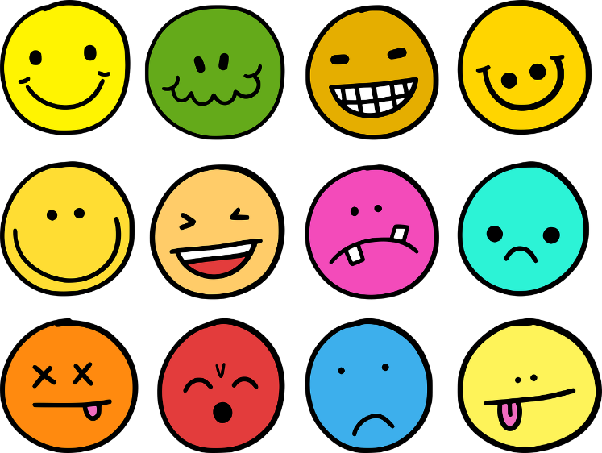
Managing Emotions Associated with Money Warmer
Activity M4.1
How do you feel about money?
Write down or draw how you feel when you hear the word ‘MONEY’ or think about it.

Slide 5
Managing Emotions Associated with Money
What are emotions?
Although there is not ‘one’ definition for the term emotions, they can be considered to be a core element in human psychology.
Emotions play an important role in how we live our lives as we tend to make decisions based on how we feel.
In the 1970s the psychologist Paul Eckman suggested 6 basic emotions:
Fear
Disgust
Anger
Surprise
Happiness
Sadness
The ‘Wheel of Emotions’ was introduced in the 1980s to demonstrate how our emotions can be mixed together to create more emotions.

Slide 6
Managing Emotions Associated with Money
Activity M4.2
What are Emotions? Opinions about the words are different….
Look at your empty ‘wheel of emotions’ handout and fill in these words in the central sections:
Fear
Happy
Mad
Sad
Calm
Strong
Write down some additional emotions related to the inner circle in the surrounding outer circle.

Slide 7
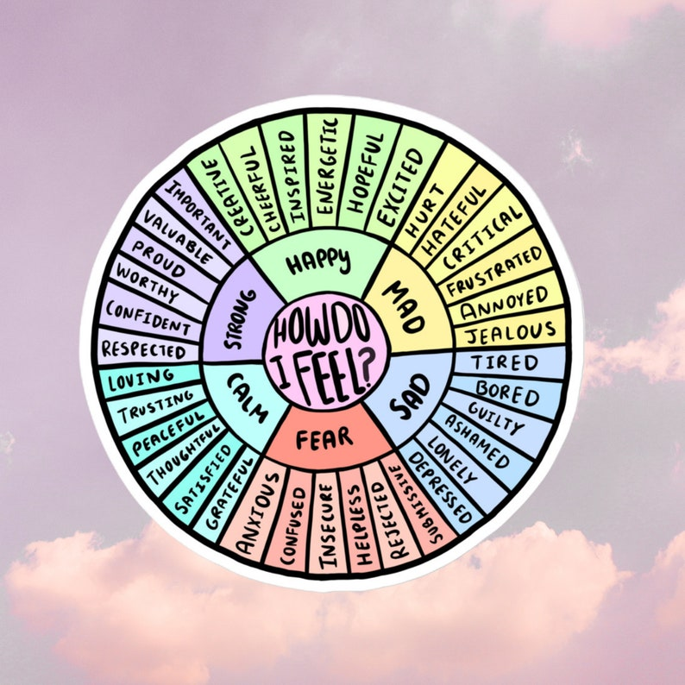
Managing Emotions Associated with Money
The Wheel of Emotions
Which ones have you identified?
Which ones can be associated with money?

Slide 8
Managing Emotions Associated with Money
Talking about money
Talking about money with others can be very challenging, especially when we have heightened emotions.
Some cultures teach from an early age not to discuss financial situations with others. In other cultures it’s normal to work abroad and send money home to the family.
When we worry about finances we can:
bottle up our emotions
overshare our financial situation with others
constantly check our bank balance or wallet to see
how much money we have.

Slide 9
Managing Emotions Associated with Money
Activity M4.3
How and when does your family talk about money?
In pairs identify situations where you might find it easy or hard to talk about money such as:
in the house, specifically at the kitchen table?
in the supermarket?
at the bank?
at the bus or train station?
when reading a bank statement?

Slide 10
Managing Emotions Associated with Money
Activity M4.4
Role play scenario
In pairs:
partner A explains to person B a difficult financial situation(Imaginary or real) and asks for advice
partner B offers advice (3 minutes)
Exchange roles
partner B asks for advice on a different difficult situation
partner A offers advice (3 minutes)
What feelings did you have either asking the questions or offering advice in this role play?

Slide 11
Managing Emotions Associated with Money
How do people use money to feel better or worse?
This Photo by Unknown Author is licensed under CC BY
This Photo by Unknown Author is licensed under CC BY-ND

Slide 12
Managing Emotions Associated with Money
What is gratification?
We may want new things e.g. the latest phone or gaming console
With the desire for possessions or experiences we often wish for instant gratification.
‘Gratification’ describes a desire to forego future benefits to get something now:
buying an ice-cream after lunch but not having money to buy milk later
buying a new phone but not having the money for an electricity bill next week
Short-term pleasure and gratification may be hard to avoid, especially for:
young people who may be more impulsive
some families in stressful circumstances
some people with mental health issues

Slide 13
Managing Emotions Associated with Money
Coffee and Tea Break

Slide 14
Managing Emotions Associated with Money
Mental health and money Do you agree or disagree with these statements?
The more you worry about money, the more difficult you may find it to manage your money
It is suggested that the more you worry about money, the more likely you are to have poor mental health surrounding money.
Questions to consider when thinking about money:
Do you tend to think about the ‘worst-case scenario’ of your financial decisions?
Do you think about the ‘best case’ scenario?
Worrying about your money
Having difficulties managing your money

Slide 15
Managing Emotions Associated with Money
Behaviour associated with money and worries about money
Have you, or anyone you know experienced any of the following behaviour or worries:
Behaviour:
I put bills in a drawer without reading them
I don’t have enough money to pay the bills
I tend to spend more money when I am emotional
Worries:
I spend over my limits – then worry
I fear my water or electricity may be cut off
I don’t want to think about my debts because it scares me
If you have, you are not alone. Others have also thought the same.
Worrying about your money
Having difficulties managing your money

Slide 16
Managing Emotions Associated with Money
If you are experiencing unsettling emotions, it can be easy to run away or avoid the challenges you are having with money.
Although you may have a sense of relief in the short-term from not paying bills, in the long-term your bills and debts will increase.
This process, known as the Avoidance Cycle, can result in anxiety and more debt in the long term.
The ‘Avoidance Cycle’
Your phone bill arrives
You worry about how you will pay for it
You avoid the bill by hiding it in your kitchen cupboard.
The bill is out of sight, and out of mind.
You relax.
In a few weeks, your next bill arrives, leaving you more in debt.

Slide 17
Managing Emotions Associated with Money
Activity M4.5
Create your own ‘Avoidance Circle’
Issue 1
Rational 1
Issue 2
Rational 2
Issue 3
Rational 3
Long-term issue
Activity in pairs:
Create your own avoidance circle
Identify an example of something you, or anyone you know, has done when trapped in an avoidance cycle
Identify how the behaviour has resulted in the situation becoming worse for the individual
Be ready to present your ideas to the group

Slide 18
Managing Emotions Associated with Money
Managing Emotions Associated with Money
Activity M4.6
Exploring the issues
Any comments or suggestions on the issues raised?
There is no one solution.....

Slide 19
Emotions and activities associated with money
Activity M4.6 cont
Exploring the some of the sources for these issues
Exploring the sources:
Advertising pressures
Peer pressure
Influencers
Social Media
Scam mail
High prices and low wages

Slide 20
Emotions and activities associated with money
Building confidence (Activity M4.7) Positive ideas from self-help suggestions and popular culture
Be very aware of your strengths and weaknesses (see Activity handout M4.7 for considering personal strengths and weaknesses after the session)
Recognise both flaws and unique capabilities to develop confidence and self-esteem
Some good affirmations:
I am ….
I can …
I spend …
I have achieved …
I have completed …
Encourage children to focus on their personal strengths and to use positive affirmations themselves

Slide 21
Managing Emotions Associated with Money
Activity M4.8
Managing emotions when having difficult discussions about money with children or teenagers
Devise a scenario with a partner where emotions could be difficult when talking to a child or
a teenager about money
Share your scenario with the group
What suggestions do you have to manage
the situation?

Slide 22
Thank you for attending. For more resources, visit the Money Matters website: https://moneymattersproject.eu/

Slide 23
Managing Emotions Associated with Money
Additional Resources:
Mental Health & Money Toolkit: https://www.mentalhealthandmoneyadvice.org/media/1397/mhm-toolkit-pdf-editable-version.pdf
Emotion Regulation Questionnaire: https://www.ocf.berkeley.edu/~johnlab/pdfs/ERQ.pdf
The Psychology of Money: What You Need To Know To Have A (Relatively) Fearless Financial Life: https://www.forbes.com/sites/prudygourguechon/2019/02/25/the-psychology-of-money-what-you-need-to-know-to-have-a-relatively-fearless-financial-life/?sh=35fa4103dfe8
3 Ways to Regulate Your Emotions: https://www.psychologytoday.com/us/blog/between-cultures/201709/3-ways-regulate-your-emotions

Slide 24
Managing Emotions Associated with Money
Additional resources: The Cognitive Emotional Regulation Questionnaire
The CERQ is a popular emotion regulation scale used by psychologists.
Over 10 questions, it examines and assesses how individuals control, regulate and manage their emotions.
The questionnaire focuses on two main elements of an individual’s emotional life:
Emotional Expression (or Cognitive Reappraisal) : How you feel (based on the stimuli that you are provided with)
Emotional Experience (or Expressive Suppression) : How you show how you are feeling, in your talking, gestures or behaviours (based on this stimuli)
By learning where your base line for emotional regulation is, you can understand and possibly have more control over emotions in the long term.

Slide 25
Managing Emotions Associated with Money
Additional resources: The Cognitive Emotional Regulation Questionnaire
Source: https://www.ocf.berkeley.edu/~johnlab/pdfs/ERQ.pdf

Slide 26
Managing Emotions Associated with Money
Additional resources: The Cognitive Emotional Regulation Questionnaire
To find out how you scored and where your base line for emotions is, follow the steps in the table below:
Cognitive Reappraisal of Emotions | Expressive Suppression of Emotions
Add up your score for items 1, 3, 5, 7, 8, 10 and get the average. | Add up your score for items 2, 4, 6, 9 and get the average.
Men averaged 4.60 Women averaged 4.61 | Men averaged 3.64 Women averaged 3.14
Notes:
Items 1, 3, 5, 7, 8, 10 make up the Cognitive Reappraisal facet.
Items 2, 4, 6, 9 make up the Expressive Suppression facet. Scoring is kept continuous.
Each facet’s scoring is kept separate.

