Slide 1
IO3: Financial Literacy Training for Parents
Module 5: Managing Money During Critical Life Periods

Slide 2
Managing Money During Critical Life Periods
Learning Outcomes
By the end of this module, parents and carers will be able to:
Identify critical life periods for families
Deal with unforeseen events and different types of family needs and expenditures
Plan personal and family spending and saving

Slide 3





Managing Money During Critical Life Periods
Visual Plan
Introduction
Managing Money During Critical Life Periods
Group Discussion
Personal Survival Budget
Activity
Useful Strategies to Manage Money
Additional Resources
End
Break

Slide 4
Managing Money During Critical Life Periods
Warmer
Activity M5.1
What are critical life periods?
In pairs discuss together any times in yours or others lives when there has been worry or stress about money.
Share some examples with the group.
As a group share ideas on the impact of financial stress on children in a family.

Slide 5

Managing Money During Critical Life Periods
Activity M5.2
What are unexpected costs that you cannot always plan for? Financial ‘tipping points’
A young single mum’s mobile phone dies or breaks, and she has no spare money for a replacement.
The father of a family with 2 children receives an unexpectedly large utility bill that they cannot afford.
A family has an unexpected dental bill but find that the savings have been used for gambling.
A care assistant’s car breaks down and they have no roadside assistance cover.
A young single mother spends all her money on an item advertised by an influencer.
Can you think of some more?

Slide 6
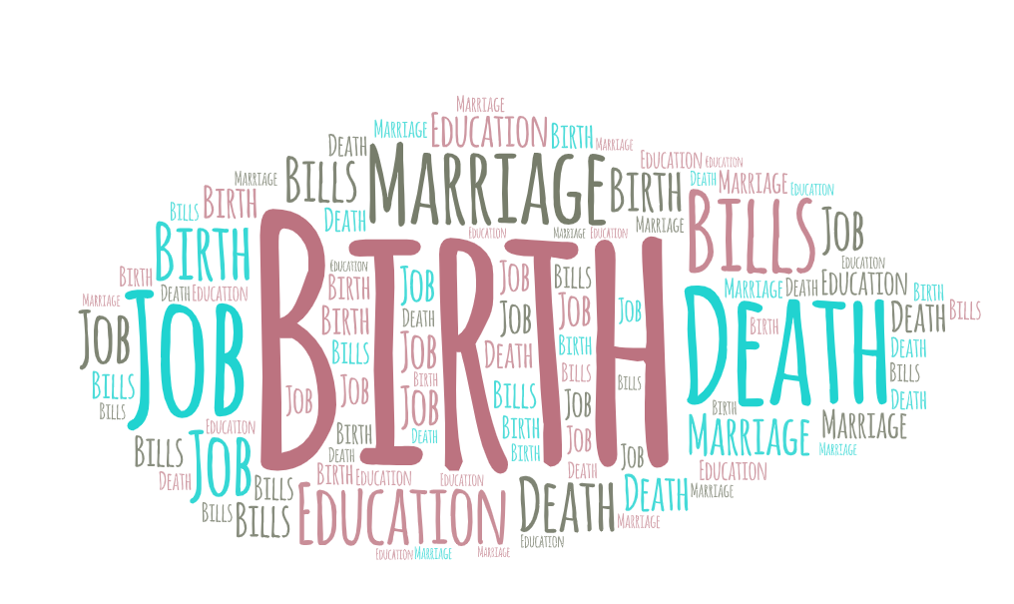
Managing Money During Critical Life Periods
What are ‘Critical Life Periods’ that you can plan for?
We are faced with different challenges in our daily lives that put pressures on our finances. These can be:
unexpected bills
celebrations and parties
purchasing or renting a flat or house
new arrivals into or departures from the family
returning to education
starting or ending a job
reaching pension age

Slide 7
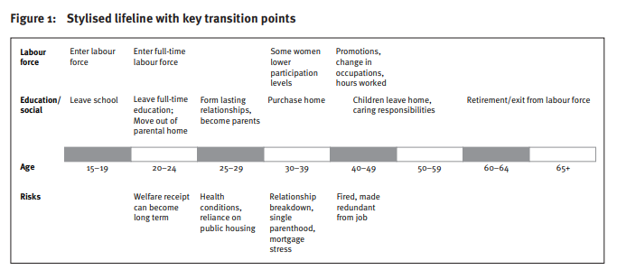
Managing Money During Critical Life Periods
Source: Ryan, C. (2012)
Notes:
Source: https://www.dss.gov.au/sites/default/files/documents/09_2012/op41.pdf

Slide 8
Managing Money During Critical Life Periods
How can financial needs be different for the following groups?
Families with 2 adults & more than 1 child.
Families with 2 adults & 1 child
Single-parent families
Working families;
A single person
An unemployed person

Slide 9
Managing Money During Critical Life Periods
Activity M5.3
Identifying financial ‘Needs and Wants’
https://www.youtube.com/watch?v=6OAqNtueu0U
Watch this video and consider how you might use it with children.
What might the discussion be?
How might you link this video for children to the really important
financial issues we have just discussed?

Slide 10
Managing Money During Critical Life Periods
Activity M5.4
What are your financial priorities?
Every person has different financial priorities and goals.
Some individuals might reduce their food waste to save money, whereas others might put on an extra jumper in the winter.
To help you set financial priorities, we recommend that you follow these 3 steps:
  Ask yourself – What is important to you?
  Set SMART goals to help you to achieve your financial goals.
  Review your list after a few weeks and see if you have achieved your goals.

Slide 11
Managing Money During Critical Life Periods
SMART Goals are a tool
Time Bound
  What is your timeframe?
Relevant
  Are these goals important in relation to your other goals?
Attainable
  Set goals that are in your reach
Measurable
  How much?
  How often?
Specific
  Who?
  What?

Slide 12

Managing Money During Critical Life Periods
Tea and Coffee Break

Slide 13
Managing Money During Critical Life Periods
Activity M5.5
Personal Survival Budget The Importance Of Budgeting - video
Video:
https://www.youtube.com/watch?v=dH-8yrzd8yc
Watch the video and identify and share 3 things that you found interesting in it.
Notes:
Source: https://www.youtube.com/watch?v=CU4l_rs50Kk

Slide 14
Managing Money During Critical Life Periods
Activity M5.6
Calculating a personal budget
Paul works as a nurse in the local hospital. He gets paid monthly and earns £1100/euros a month in wages and benefits. Paul’s family has the following bills:
TV subscription = £10/euros per month.
Rent = £450/euros per month.
Electricity = £100/euros per month.
Car (including car loan and fuel) = £100/euros per month.
Phone Bill = £50/euros per month.
Internet = £20/euros per month.
Savings = £15/euros per month.
Paul uses his remaining money to buy food and clothing. Create a weekly budget for his family and identify how much disposable income he has left. What could be his family’s priorities?

Slide 15
Managing Money During Critical Life Periods
Paul’s Monthly Survival Budget
Income |  | Expenditure
Wages | 1100 | TV subscription | 10
 |  | Rent | 450
 |  | Electricity | 100
 |  | Car (including car loan and fuel) | 100
 |  | Phone Bill | 50
 |  | Internet | 20
 |  | Savings | 15
Total Income | 1100 | Total Expenses | 745
Money left after paying the bills = income minus expenses | 1100-745 = 355, 355 divided by 5 (weeks in a month) = £/Euros 71 per week

Slide 16


Managing Money During Critical Life Periods
Not having a financial buffer
Imagine losing your job or source of income in the morning, how long would you be able to survive for without having to borrow money?
A financial buffer is a sum of money that you can access immediately, often in the form of savings.
It is recommended that you have at least 3 months of your monthly wages as a financial buffer.
Without a financial buffer, if you lose your job or face unexpected bills, you might not be able to survive comfortably.

Slide 17
Managing Money During Critical Life Periods
Activity M5.7
Strategies for personal survival
Here are 2 strategies:
The 80 / 20 Rule:
  When you receive your income put 80% for spending and use 20% for savings
The 50 / 30 / 20 Rule to use if you have a debt to pay off:
  When you receive your income put 70% for spending, 20% towards your debt and use 10% on savings
  In groups devise a game that you could play with a child using these ideas

Slide 18
Managing Money During Critical Life Periods
The ‘Hierarchy of Financial Needs’
  Unfortunately the time will come when we must think about passing on our assets to our loved ones when we die.
  Having a will or a trust set up will help with this final stage of financial planning.
(5) Legacy
(4) Financial Freedom
  In this stage, you have managed to create a little ‘nest-egg’ for yourself.
  You can think about saving for retirement or for your children's education.
(3) Accumulating Wealth
  Now that you have paid all of your bills and have saved some money for an emergency, you can start thinking about building your money.
  You can invest in bonds, stock, pensions or paying off your loans.
(2) Financial Safety
  Once you have managed to survive, you will need to have some money for emergencies.
  It is suggested that you should have at least 3-months of savings available to you.
(1) Cash Flow and Basic Needs
  These are the basic needs of our lives, that we all must pay for.
  Some of the most important elements include: food, shelter, transport, the cost of living.

Slide 19

Managing Money During Critical Life Periods
Top Tips
Here are some Top Tips that will help you !
  Just like you can improve your physical wellbeing with sport, you can improve your ability to manage money during critical life periods.
  Access supports that are available in your home country, through Citizens Information Organisations, your Banking provider, or even online information can help you to find financial wellbeing.
  What are the supports that you already know about?

Slide 20
Thank you for attending. For more resources, visit the Money Matters website: https://moneymattersproject.eu/

Slide 21
Managing Money During Critical Life Periods
Additional Resources:
Bank of Ireland (2020) Find financial wellbeing – Episode 1 – What is financial wellbeing? Available from: https://www.youtube.com/watch?v=3Ew9453gvJ8
Columbia College (2015) Needs vs Wants |Columbia College. Available from: https://www.youtube.com/watch?v=QyuU4wFIz3o&t=9s
Johnston, B. (2021) The hierarchy of financial needs. Available from: https://www.simplefp.co.uk/the-hierarchy-of-financial-needs/
Ryan, C. (2012) Responses to financial stresses at life transition points. Available from: https://www.dss.gov.au/sites/default/files/documents/09_2012/op41.pdf
Struggle Today Strength Tomorrow (n.d) Why you should keep a financial buffer in your bank account. Available from: https://www.struggletodaystrengthtomorrow.com/financial-buffer/
Vansomeren, L. ( 2021) The 50 / 30 / 20 rule of thumb for budgeting. Available from: https://www.thebalance.com/the-50-30-20-rule-of-thumb-453922

Slide 22

Managing Money During Critical Life Periods
The 50 / 30 / 20 Budgeting Rule

Slide 23
Managing Money During Critical Life Periods
The 50 / 30 / 20 Budgeting Rule
Based on your personal financial situation, the 50 / 30 / 20 Budgeting Rule states that you should allocate your money according to your needs, wants and saving goals.
  50 % of your income should go towards needs, such as rent and groceries.
  30 % of your income should go towards wants, such as hobbies and discretionary spending.
  20 % of your income should go towards savings and debt payments.
The 50 / 30 / 20 Budgeting Rule helps you to familiarise yourself with your personal finance and gain control of your money.

