Slide 1
IO3: Financial Literacy Training for Parents
Module 6: Becoming a Critical Consumer

Slide 2
Becoming a Critical Consumer Learning Outcomes
After completing this module parents and carers will be able to:
Identify some of the characteristics of critical consumers.
Recognise how advertising works to encourage spending by persuasion.
Understand the role of the circular economy.

Slide 3
Becoming a Critical Consumer Visual Plan
What is a ‘Critical Consumer‘
Activity - Advertising
Advertising and the Money Matters Comic Strip
The psychology of colour
Break
Money Matters resources Escape the Money Jungle
Money Matters resources and The Circular Economy
End
Types of consumers

Slide 4
Becoming a Critical Consumer
Activity 6.1
Warmer What type of consumer are you? Tell your neighbour and explain why….
The following are the most common five types of consumers in marketing:
• Loyal Customers - make up the bedrock of any business. • Impulse Shoppers - are those simply browsing products and services with no
specific purchasing goal in place. • Bargain Hunters - constantly look for ‘bargains’ whether they need them or not. • Wandering Consumers - will buy from anywhere randomly. • Need-Based Customers - just buy what is essential.
What type of consumer are you? Tell your neighbour and explain why…

Slide 5
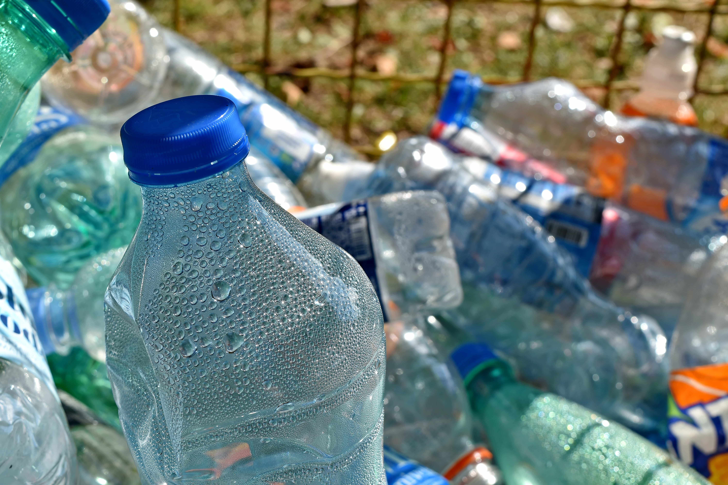
Becoming a Critical Consumer
Who is a critical consumer?
Critical consumers consciously choose whether they want to buy a product or not.
Critical consumers think about the ethical, social and environmental impacts of their decisions.

Slide 6
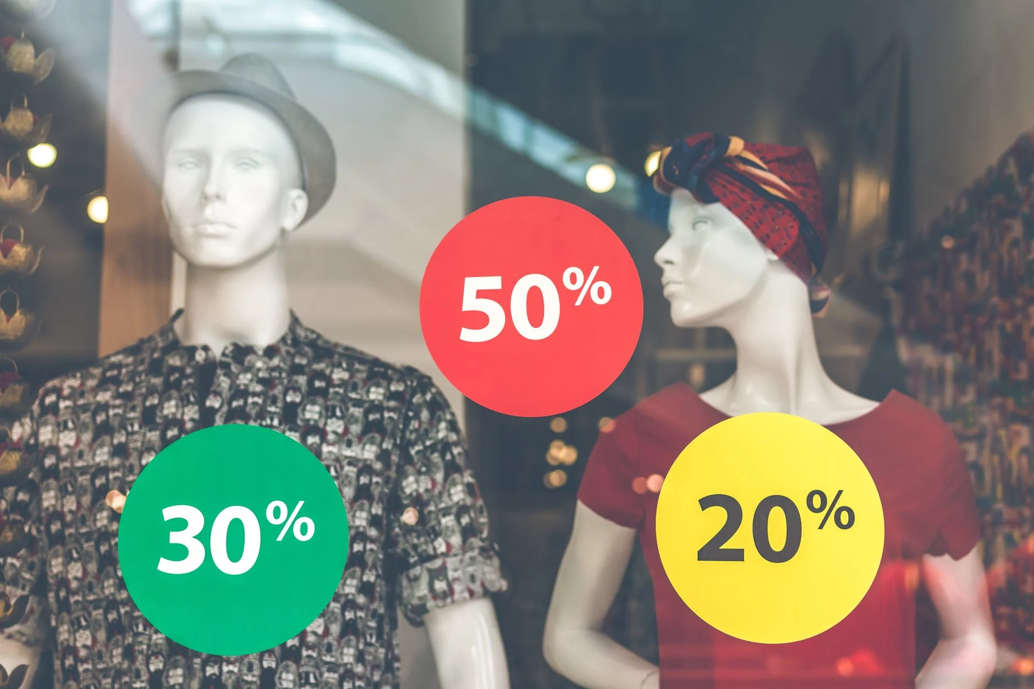
Becoming a Critical Consumer
Activity 6.2
Advertising
In pairs or small groups:
Think of an advert you remember seeing while coming to this session (or any that you can remember)
Any ideas as to why you remember it?
Now think of an advert that really annoys you..
Any ideas as to why the advert annoys you?
Buses TV Billboards Newspapers Online In the post etc.

Slide 7
Becoming a critical consumer
Advertising influences all consumers by:
Informing
Advertising informs consumers about their product and services.
Critical Consumers understand the goals and objectives of the company, and choose whether they want to support that company.
Persuading
Advertising encourages and influences consumers to spend their money.
Critical consumers understand this and make informed purchasing decisions.
Reminding
Advertising reinforces the brand image of a company so that they can remain competitive and attract new customers.
Critical consumers recognise this ‘sales-pitch’ and the false emotional calls for ‘brand loyalty’.

Slide 8
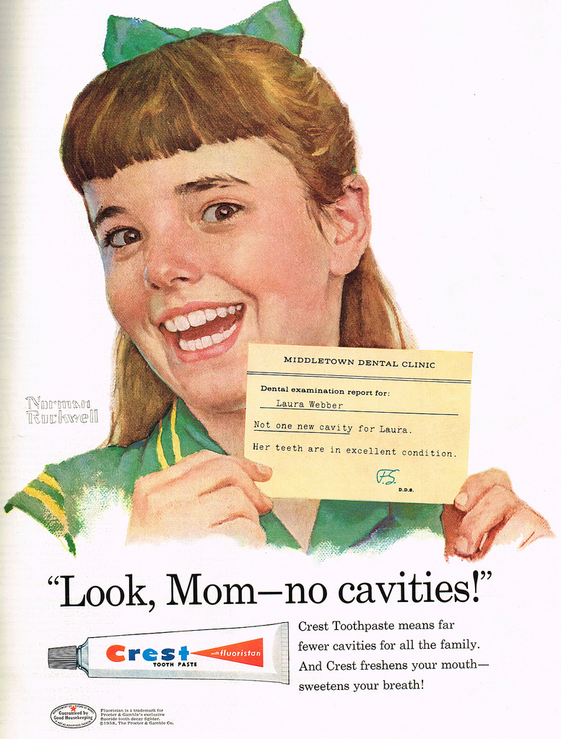
Becoming a Critical Consumer
The ‘Elaboration Likelihood Model’ – the ELM
Consumers can be persuaded by communication techniques:
1) Directly appealing to the consumer through facts, logic and thought:
The more a customer wants a product, the more they will be involved in or
engaged with the advertisement.
2) Indirectly appealing to the customer through superficial cues or gimmicks:
Colours, music, words, emotions, nostalgia and storylines can all influence consumers.
Amended from: She Made (2009) Psychology And Advertising: https://www.youtube.com/watch?v=EC7VLjIw8hY

Slide 9
Becoming a Critical Consumer
Activity M6.3
Advertisements that appeal to children or teenagers
In pairs or groups suggest one example of advertising that appeals to young children directly and another that appeals to teenagers. You can choose from a range of advertisements such as:
online advertisements
TV advertisements
product placement
print (magazines, brochures, newspapers)
outdoors including billboards
Present your ideas to the group

Slide 10
Becoming a Critical Consumer
Tea and Coffee Break

Slide 11
Becoming a Critical Consumer
Activity M6.4
Money Matters comic No 6: ‘Advertisements’
What are the key points about advertising made in this comic strip aimed at children?

Slide 12
Becoming a Critical Consumer
Activity M6.4 cont.
Money Matters comic No. 6: ‘Advertisements’
Inflation.
Discounts.
Peer pressure.
Influencers.
Bargains such as 2 for 1.
Lottery tickets.
Consumerism.
Other advertising techniques.

Slide 13
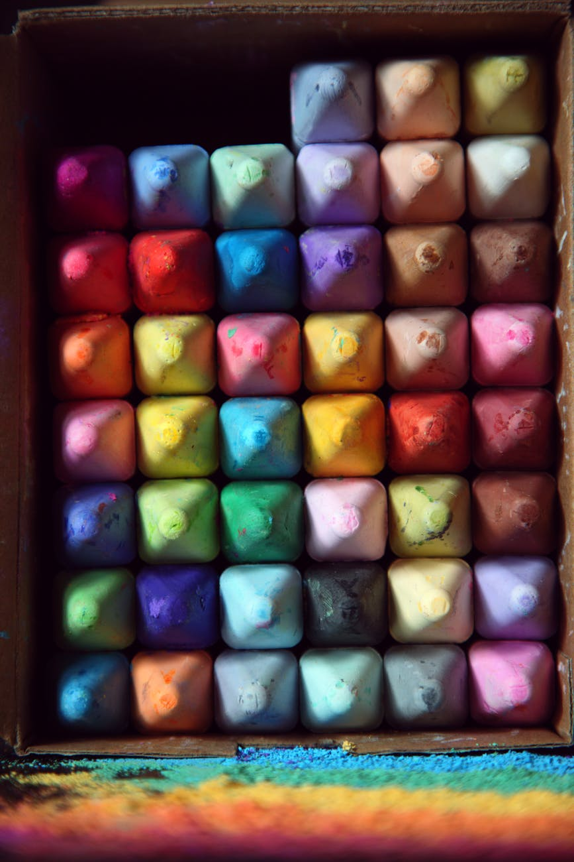
Becoming a Critical Consumer
How does advertising use psychology?.... for example colours
Did you know that colour plays an important role in our lives?
We express ourselves through colour
We eat colourful food
We buy items based on their colour
How do companies use colours to attract us to spend our money?

Slide 15
Becoming a Critical Consumer
Do you agree with psychologists who believe that:
Women love the colours:
Blue
Purple
Green
Women hate:
Orange
Brown
Gray
Men love the colours:
Blue
Green
Black
Men hate:
Brown
Orange
Purple
Source: https://buffer.com/resources/the-science-of-colors-in-marketing-why-is-facebook-blue/

Slide 16
Source: https://thelogocompany.net/wp-content/uploads/2020/12/Color_Emotion_Guide221.png

Slide 17
Becoming a Critical Consumer
Activity M6.5
Money Matters Resources: Escape the Money Jungle
Advertising can persuade us to spend money that we may not have.
Peer pressure can persuade us to spend money that we may not have.
Influencers can persuade us to spend money that we may not have.
If we do not have the money to buy things, we could be pressurised to borrow it from another source.

Slide 18
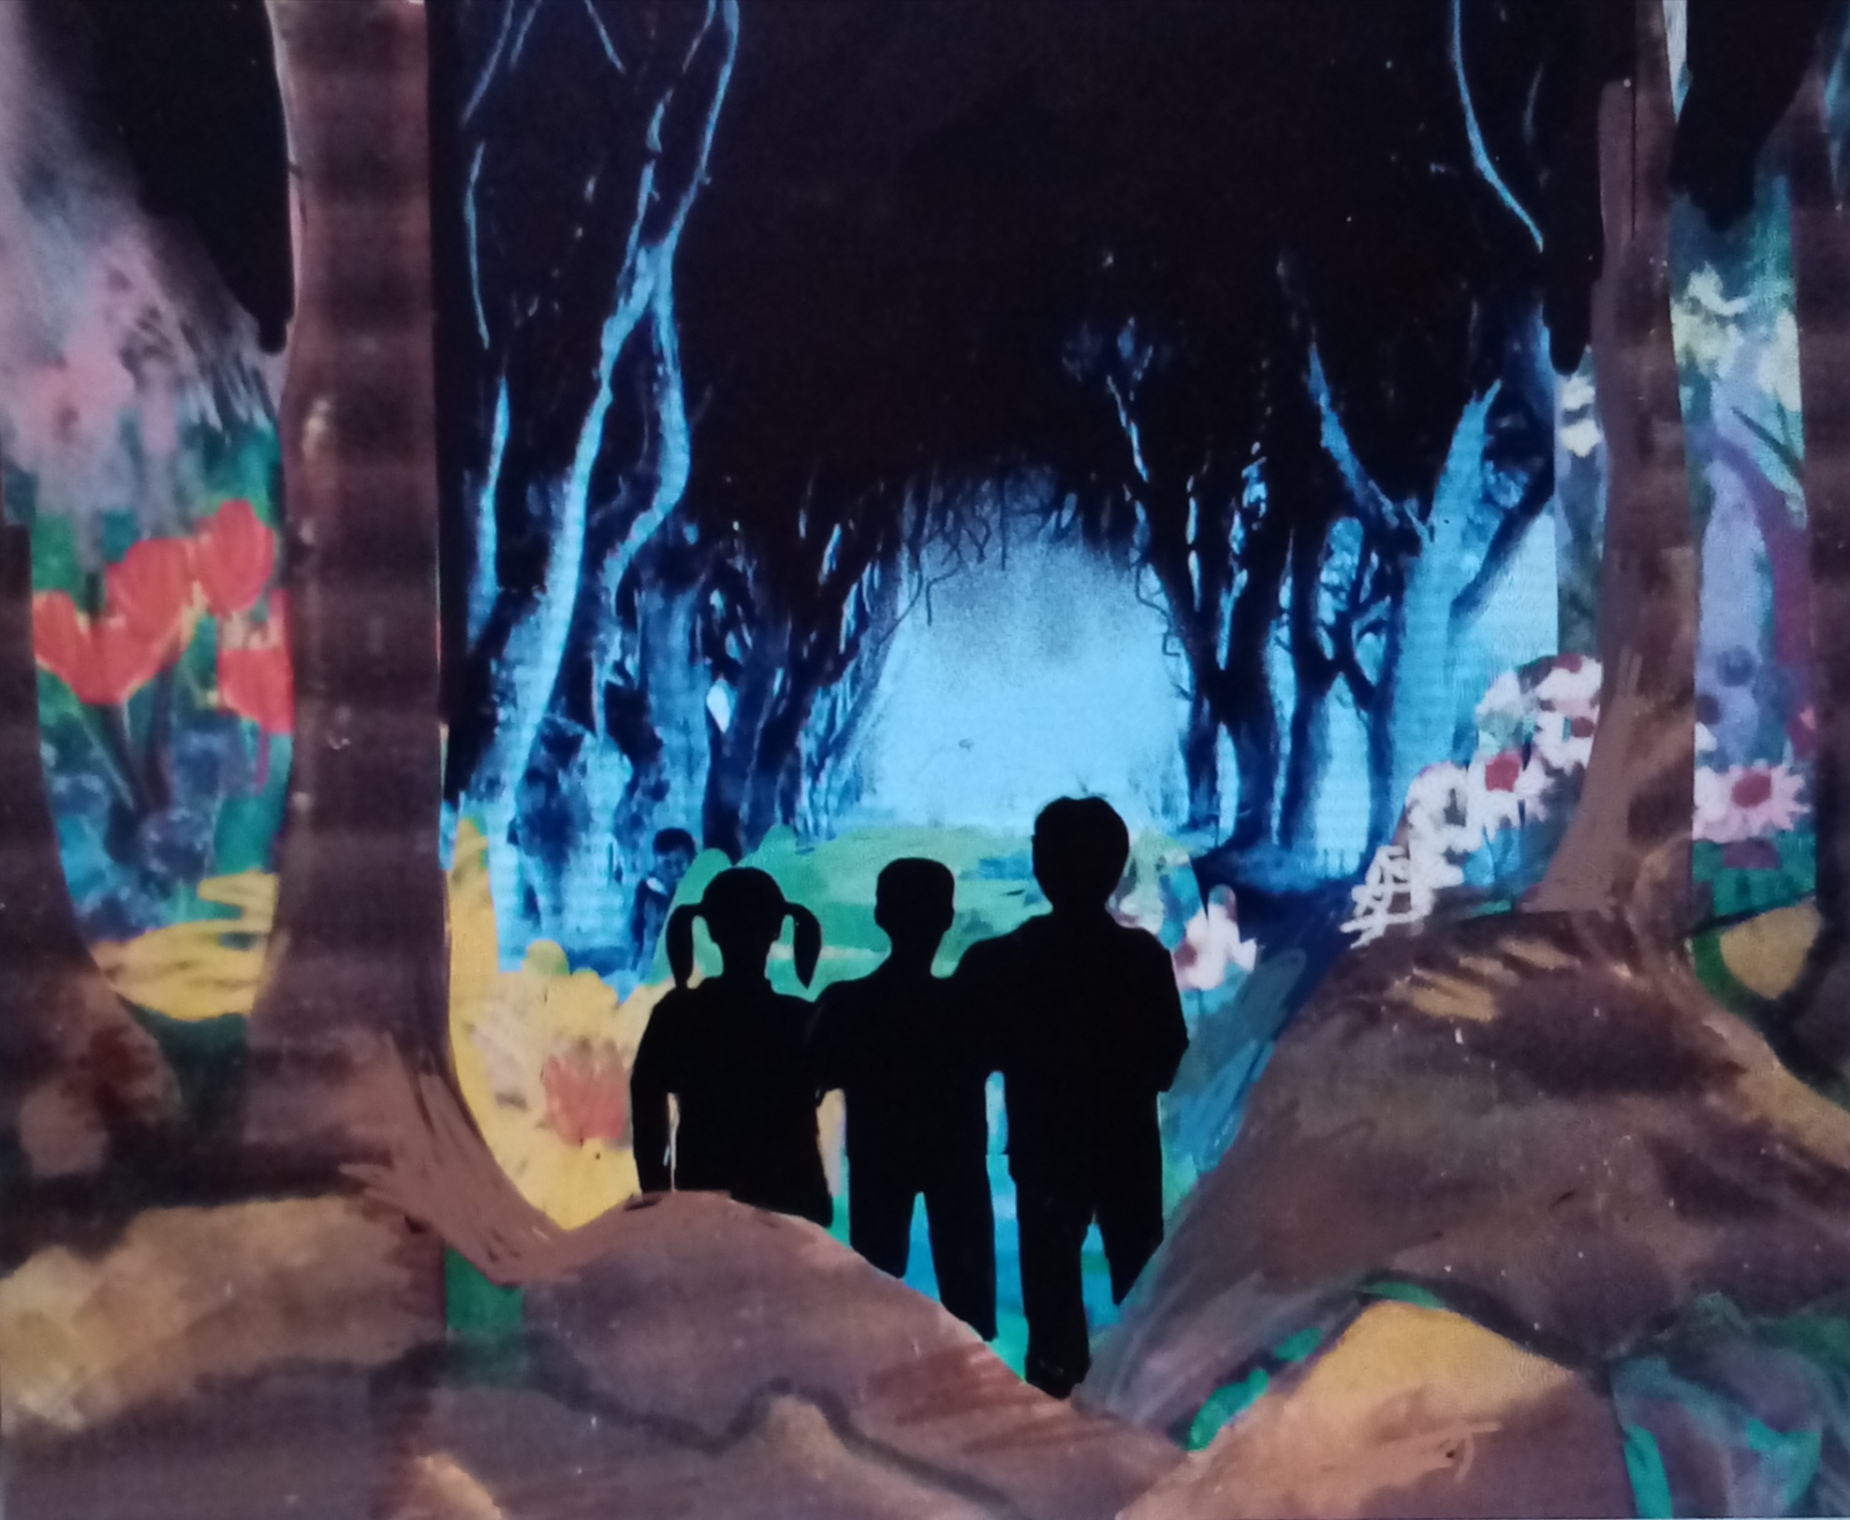
Becoming a Critical Consumer
Money Matters Resources: Escape the Money Jungle
https://forms.gle/7Ht4divX2EenTbVv7

Slide 19
Becoming a Critical Consumer
Activity M6.6
Money Matters Resources: Strategies to become critical consumer: The ‘Circular Economy’
Interplanetary Interchange:
https://forms.gle/1qNm9eD2mvmpbag46
What’s a financial CRISIS!?!
How do high interest rates trap us into debt?
How can we have a circular, green economy?

Slide 20
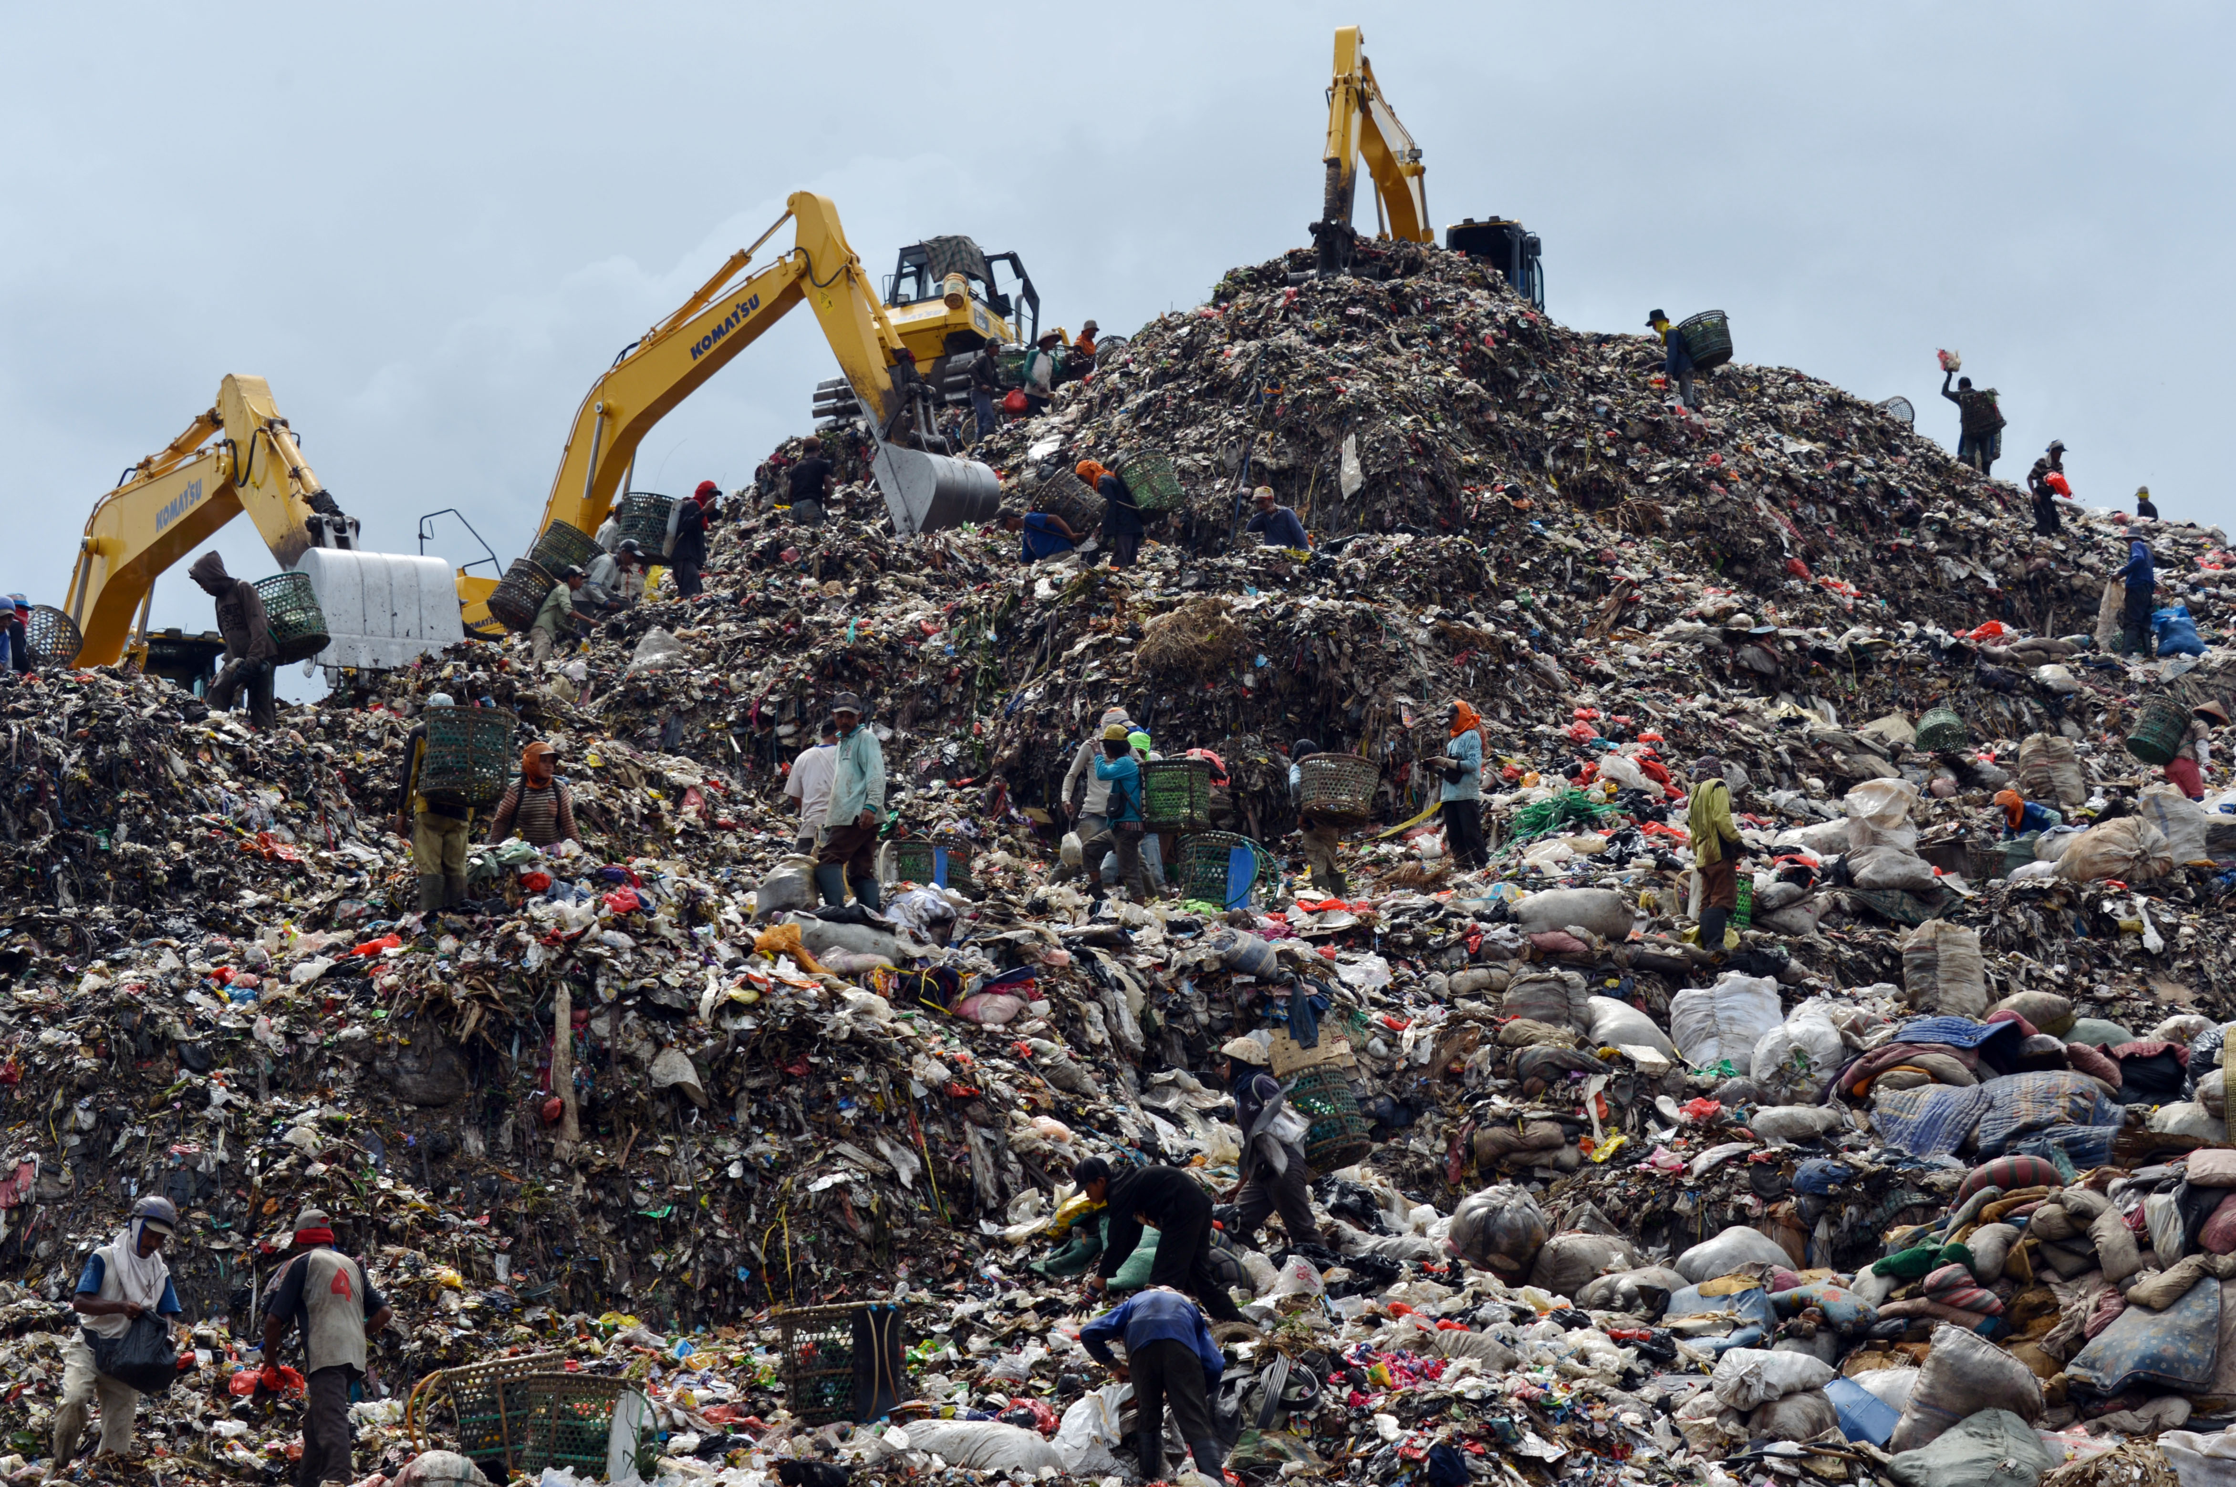
Becoming a Critical Consumer
Useful Strategies to help us to become critical consumers – The Circular Economy
This Photo by Unknown Author is licensed under CC BY-SA-NC

Slide 21
Becoming a Critical Consumer
Activity M6.7
Useful Strategies to help us to become critical consumers – The SUP Directive
The ‘Single Use Plastics’ (SUP) directive was introduced on the 3.7.2021 across Europe. The aim is to reduce the volume and impact of plastic products on the environment. Did you know that it is now illegal to purchase the following items?
Plastic cotton buds
Plastic cutlery/plates/chopsticks
Plastic straws
Be aware of advertising tricks, methods and strategies to make you buy things.
Recycle food waste or create garden compost from suitable waste.
Sell or gift rather than destroying unwanted items.
Have you any other ideas?

Slide 22
Thank you for attending. For more resources, visit the Money Matters website: https://moneymattersproject.eu/

Slide 23
Becoming a Critical Consumer.
Top Tips
Here are some Top Tips that will help you !
Social Media Influencers are individuals who use online social media platforms to share their personal opinions on a wide range of topics.
In the following slides, we have included some of the most well-known social influencers and financial experts across Europe, who discuss financial topics – including how to be a critical consumer.

Slide 24
Becoming a Critical Consumer
Social influencers across Europe
Portugal:
Finanças no Feminino: https://www.instagram.com/financas.no.feminino/
Poupança & Finanças Pessoais : https://www.instagram.com/cat.poupanca/
Finanças com Ella : https://www.instagram.com/financascomella/
Bárbara Barroso : https://www.instagram.com/barbarabarroso/
MoneyLab: https://www.instagram.com/moneylabpt/
Italy:
Io Investo : https://www.ioinvesto.com/ & https://www.youtube.com/channel/UCdxW9KZslNPIqlq9AZVZ8_A
Marcello Ascani : https://www.youtube.com/user/TheMARCELLEMME
Leonardo Pinna: https://www.instagram.com/leonpinn/
Pietro Micelangeli: https://www.youtube.com/results?search_query=Pietro+Michelangeli

Slide 25
Becoming a Critical Consumer
Additional Learning Resources
Greece and Cyprus:
Financialgreeks : https://www.instagram.com/financialgreeks/
Chris Tsounis : https://www.instagram.com/tsounischris/
Be Wealthy : https://www.instagram.com/bewealthyapp/
England and Ireland
Martin Lewis: https://www.instagram.com/martinlewismse/
Money Saving Expert: https://www.instagram.com/moneysavingexp/
Eoin McGee: https://www.instagram.com/eoin_mcgee/

