Slide 1
IO3: Financial Literacy Training for Parents
Module 8: Digital Toolkit Money Matters

Slide 2
Digital Toolkit Money Matters
Learning Outcomes
By the end of this module, parents and carers will be able to:
Develop the ability to use the Money Matters Digital Resources Toolkit and Money Matters mobile application.
Access the Money Matters library to explore the resources.
Gain access to the online Money Matters resources and share them with their children.

Slide 3






Digital Toolkit Money Matters
Visual Plan
Activity – teaching financial literacy
Money Matters Comic Strips
Break
Money Matters Mobile Application
Activity
Group Discussion
Exploring the Money Matters Library
Money Matters Digital Escape Rooms
End

Slide 4

Digital Toolkit Money Matters
Activity M8.1
Warmer: Have you taught financial literacy in your home before?
How?
Why?
Who?

Slide 5
Digital Toolkit Money Matters
Exploring the Money Matters Library
The Money Matters Library offers a wide variety of resources that promote intergenerational learning. This will work to provide you, as parents and carers access to the resources that can be explored within the family.
This will work to:
Develop the financial literacy capacity of parents and guardians.
Support parents and guardians in their role as facilitators of family learning within your family networks.

Slide 6
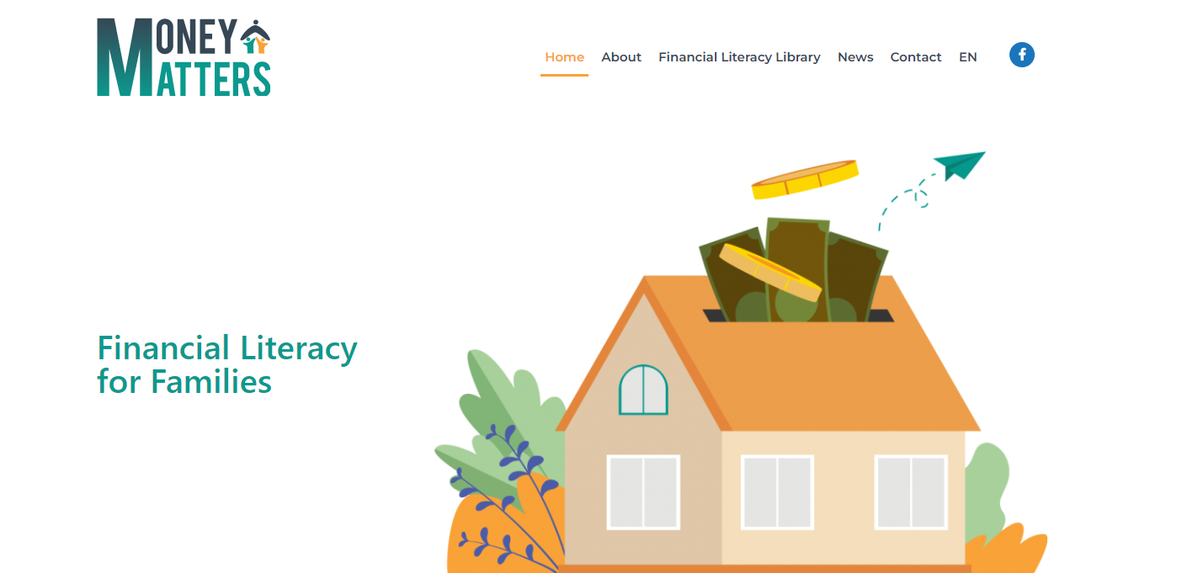
Digital Toolkit Money Matters
Exploring The Money Matters Library
The Money Matters Library offers a toolkit of three different age-appropriate resources:
Comic Books
Online Escape Rooms
Mobile App
Training programmes

Slide 7
Digital Toolkit Money Matters
The Money Matters Library
Comic Strips (aged 6-12)
Online Escape Rooms (aged 13-18)
Mobile App for Financial Planning (aged 19-25)
Training Programme (parents and guardians)

Slide 8
Digital Toolkit Money Matters
For Parents
and Guardians
A training programme aiming to tackle financial literacy using a workshop-based approach
Support for parents and guardians to use the family learning model
For Youth
19 to 25 years old
A mobile app encouraging learners to develop financial plans to respond to financial situations
A personal or family budget planner
Links to local support agencies
For Teenagers
13 to 18 years old
Six Online Educational Escape Room challenge -based learning resources
Their scenarios will be related to effective financial management
For Children
6 to 12 years old
12 monthly editions of themed comics
Covering some basic good financial principles
Notes:
Delete

Slide 9

Digital Toolkit Money Matters
The Money Matters Comic Strips
Targeting young family members between the ages of 6 and 12 years, this new comic strip addresses financial literacy in an amusing and interactive way.
The 12 monthly themed comic strips feature a financial literacy "Superhero" who deals with issues related to financial literacy with his friends.
Visual elements and characters are attractive, colourful and age appropriate.

Slide 10

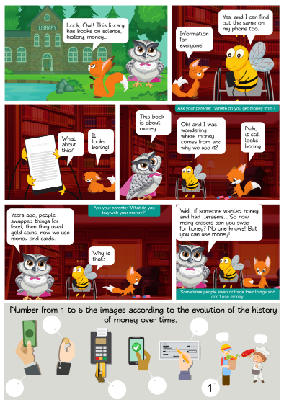
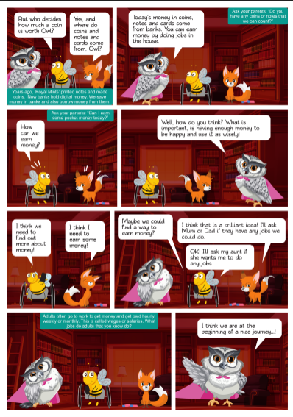
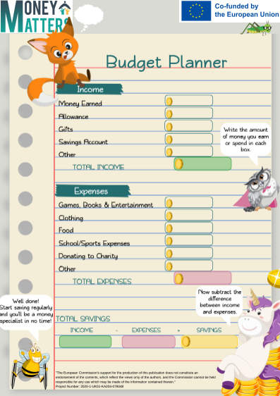
Digital Toolkit Money Matters
The Money Matters Comic Strips: an example

Slide 11

Digital Toolkit Money Matters
Topics in the Money Matters Comic Strips:
What money is, why we use it, and the history of money.
Needs and wants and the effects of advertising
Budgeting
Savings
Digital money in the bank
Different kinds of advertising techniques
Charity
Entrepreneurship & loans
Online purchases and safety
Currency
Taxes
Circular economy and sustainability

Slide 12

Digital Toolkit Money Matters
Activity M8.2
The topics in the Money Matters Comic Strips
In pairs:
Look at a comic strip that you have not seen before in the training.
Explain how you could use the comic to explore financial literacy.
List 4 ideas for sharing the learning experience with a child.

Slide 13

Digital Toolkit Money Matters
Tips for using the Money Matters Comic Strips at home:
Use the strips to teach children about the topics in the comic.
Make time to sit down and use the resources with your children. Maybe once a month teach them a new concept related to the comic theme.
Encourage discussion and talk to your child about finances in a way that they will understand. Let them ask questions.
Spark curiosity by listening to your child and helping them to feel more confident and competent to make wise financial decisions as they grow up.

Slide 14

Digital Toolkit Money Matters
Money Matters ‘Digital Escape Rooms’
The online digital escape room challenges in this learning resource address key themes related to financial literacy for teenagers between 13 and 18 years.
The resources are at introductory and intermediate levels and introduce best practice in financial planning, debt management, dealing with scammers etc.
An introductory escape room has 3 challenges that get gradually more difficult. An intermediate one has
5 challenges that get gradually more difficult.

Slide 15

Digital Toolkit Money Matters
Topics of the Money Matters Digital Escape Rooms
The Digital Escape Rooms address a wide range of financial topics at both introductory and intermediate level.
Banking Peer Pressure Money Scams Budgeting Financial Crises
Financial concepts Currencies

Slide 16
Digital Toolkit Money Matters
Activity M8.3
Try out an Escape Room
Follow a link to an escape room and try out the challenges in pairs:
Debt Management, introductory level: https://forms.gle/5p7qCmixSsfpecQ99
Debt Management, intermediate level: https://forms.gle/gxarZoqbYHutH45c8

Slide 17
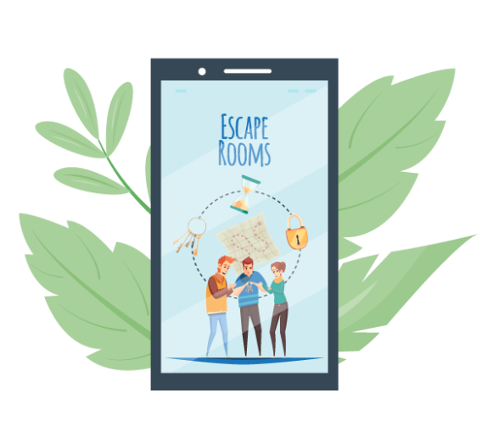
Digital Toolkit Money Matters
Tips for using the Money Matters Digital Escape Rooms
You can use the escape rooms to teach teenagers about the topics related to financial literacy using gamification. Adolescents often enjoy learning through problem-solving activities.
Complete the escape rooms as a family solving the puzzles together as a group activity.
Encourage personal reflections on the challenges and ask about a similar real-life situation.

Slide 18

Digital Toolkit Money Matters
Coffee and Tea Break

Slide 19
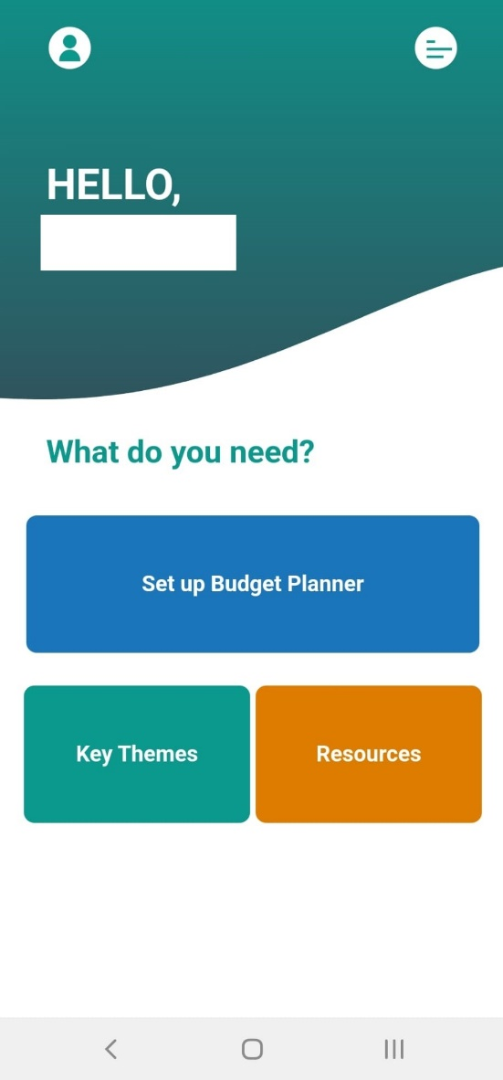
Digital Toolkit Money Matters
The Money Matters Application
With the MONEY MATTERS application:
you can play a vocabulary game
you can learn about money management
you can make a savings plan
How might this App be useful for family learning in an intergenerational way?

Slide 20


Digital Toolkit Money Matters
Activity M8.4
Immerse yourself! Download the App

Slide 21


Digital Toolkit Money Matters
Downloading the Money Matters App:
The Money Matters App is available on:
App Store – Apple
Play Store – Android

Slide 22
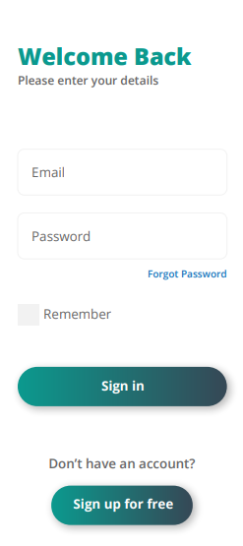

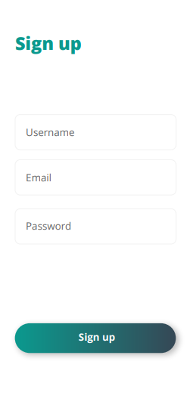
Digital Toolkit Money Matters
Registering and getting started on the Money Matters App

Slide 23
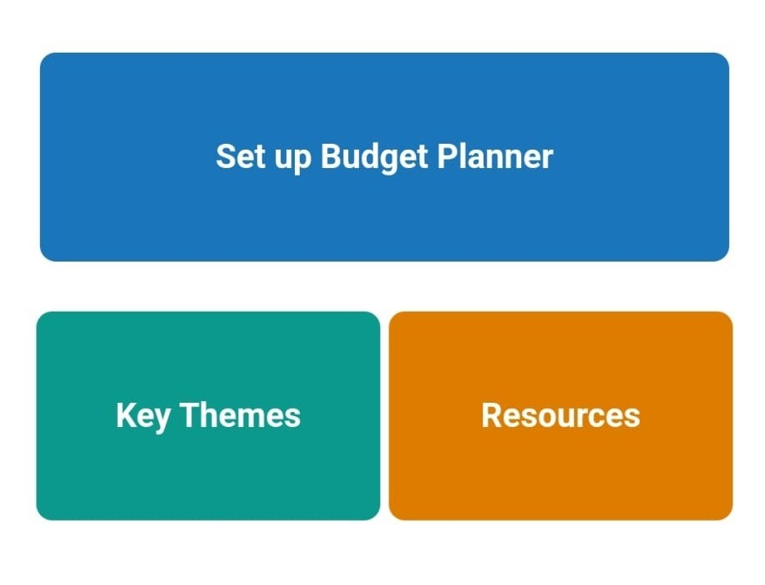
Digital Toolkit Money Matters
What is featured on the app?
The Money Matters app offers you the opportunity to gain access to:
A Budget Planner including an overview of spending and savings goals.
Key Themes associated with the topic of financial literacy.
Nationally-specific Resources that can help you to learn more about financial information in your country.

Slide 24

Digital Toolkit Money Matters
Activity M8.5
Group Discussion: Financial Literacy at home and how to use the Money Matters App

Slide 25
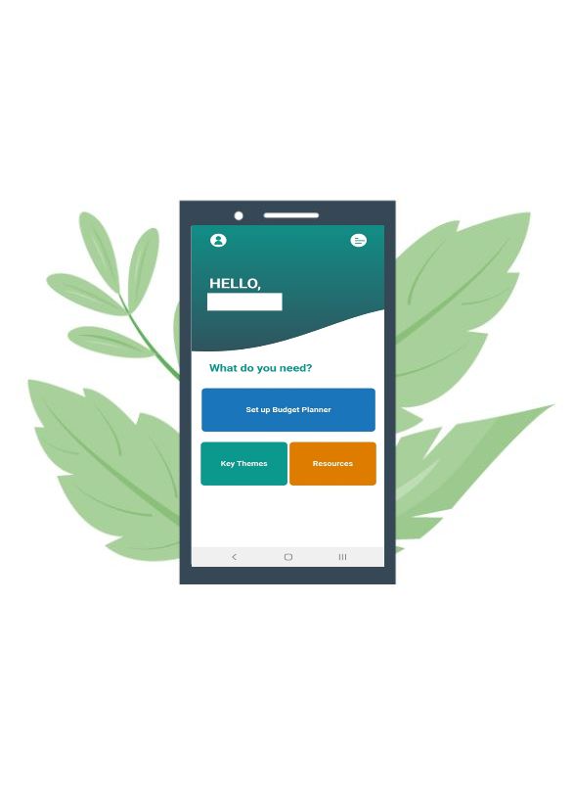
Digital Toolkit Money Matters
Tips for using the Money Matters App at home
Explore the app as a family and ask the young people in your home to download the app on their mobile devices.
Complete the budget planner together. This can help to navigate how to create a personal budget and savings plan.
Learn more through the key themes and resources.
Listen to questions and support discussion about the topics allowing time for questions related to financial literacy for clarification.

Slide 26
Thank you for attending. For more resources, visit the Money Matters website: https://moneymattersproject.eu/

